Slide 1

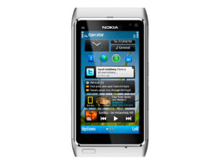
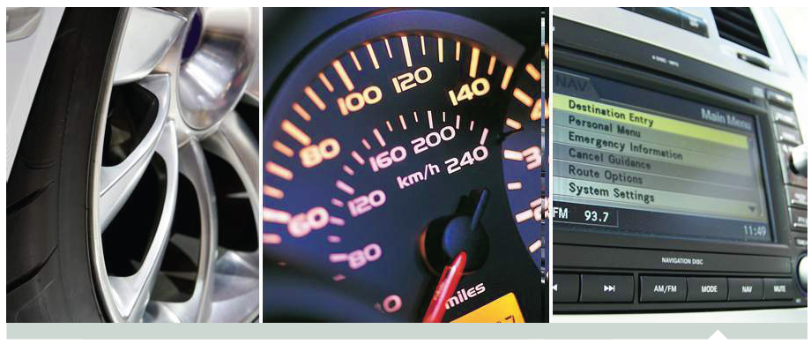
Development and Practice in Intelligent Transport Systems
Haifeng Wang
Y2014 Sino-Germany Workshop, Mar. 4th

Slide 2
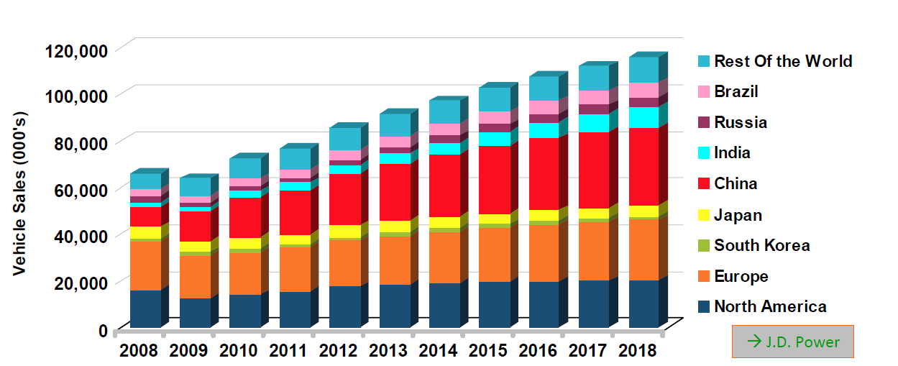
Global Vehicle Market Forecast
Source: Strategy Analytics
GAGR between 2010 to 2018
Global: 6.1% (~72 million….116 million)
China: 8.6%
Europe: 4.5%
North America: 4.6%
Japan: -1%
Notes:
CAGR = Compound annual growth rate

Slide 3
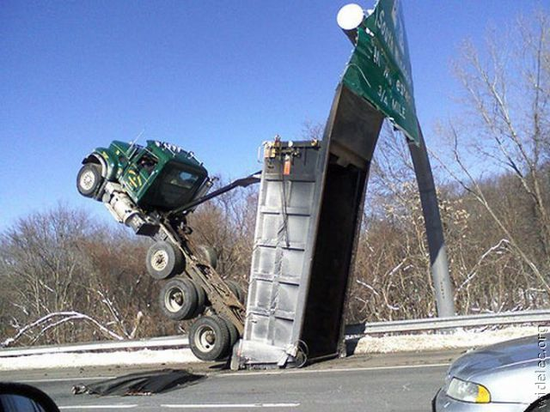
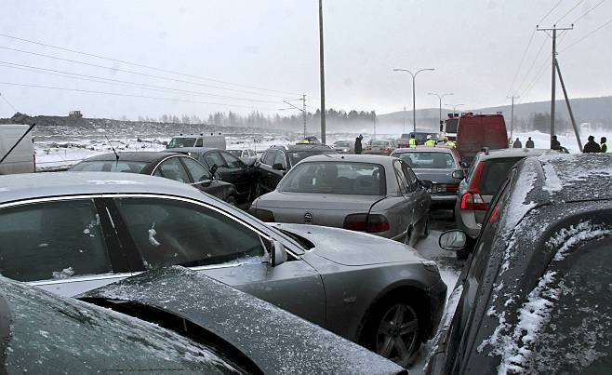
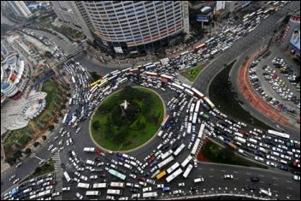
The Problem – Traffic Jams/Crashes
USA –numbers/year:
  Safety: 6 million crashes, >30 000 deaths
  Mobility: 4,2 Billion hours travel delay (urban), causing $80 Billion extra cost
  Energy: >13 million m^3 wasted fuel!
  Huge ecocidal pollution accordingly!

Slide 4
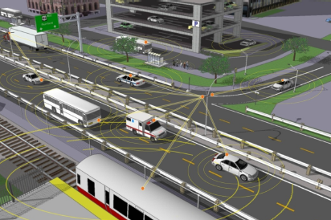
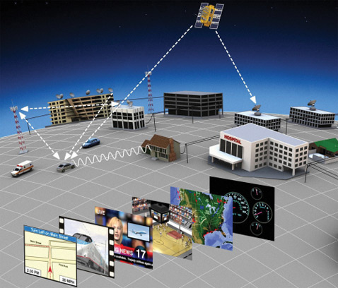
Wireless Vehicle Connectivity: Main Tracks
Distributed
Centralized
ITS – Intelligent Transport Systems
DSRC - Dedicated Short Range Communications
  Wave – Wireless Access in Vehicular Environments
  5.9 GHz band with bandwidth of 75 MHz and approximate range of 1000m
  IEEE 802.11p – WLAN variant
Nodes: Vehicles and roadside stations
  Need for a new infrastructure
Services like safety warnings and traffic information
  Commands like “brake”
  Broadcasting like “accident”
Cellular based internet connectivity
  GSM, HSPA, LTE
  Complemented by e.g. GPS (location) and in-car connectivity solutions (like WLAN and Bluetooth)
Telecom compatibility + cloud based services: classical telecom, internet/cloud, telematics
Mature technology
  Little need for extra infra updates
  Fast progress possible!
Main challenges:
  Radio signal attenuation due to car cabin (poor indoor signal without special arrangements)
  Multi-operator / multi-passanger support
  Car-specific requirements

Slide 5
Wireless Vehicle Connectivity: Main Tracks
Distributed
Centralized
ITS – Intelligent Transport Systems
DSRC - Dedicated Short Range Communications
  Wave – Wireless Access in Vehicular Environments
  5.9 GHz band with bandwidth of 75 MHz and approximate range of 1000m
  IEEE 802.11p – WLAN variant
Nodes: Vehicles and roadside stations
  Need for a new infrastructure
Services like safety warnings and traffic information
  Commands like “brake”
  Broadcasting like “accident”
Cellular based internet connectivity
  GSM, HSPA, LTE
  Complemented by e.g. GPS (location) and in-car connectivity solutions (like WLAN and Bluetooth)
Telecom compatibility + cloud based services: classical telecom, internet/cloud, telematics
Mature technology
  Little need for extra infra updates
  Fast progress possible!
Main challenges:
  Radio signal attenuation due to car cabin (poor indoor signal without special arrangements)
  Multi-operator / multi-passanger support
  Car-specific requirements
We believe that “internet connectivity for every car” is the first step towards connected cars

Slide 6
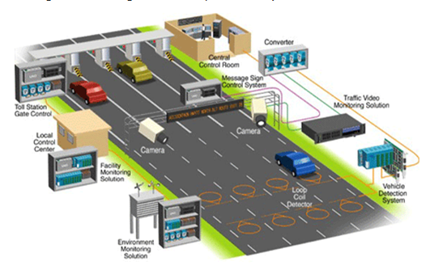
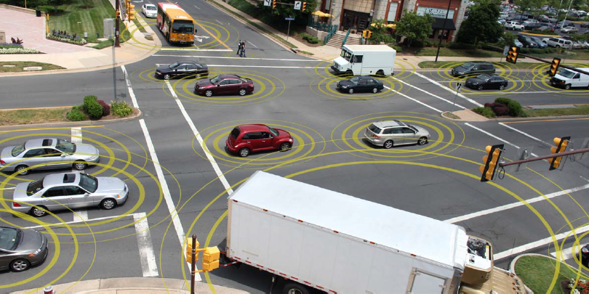
ITS - Intelligent Transportation Systems
Basic use cases
  Advanced Traveler Information Systems
  Advanced Transportation Management Systems
  ITS-Enabled Transportation Pricing Systems
  Advanced Public Transportation Systems
  Fully integrated intelligent transportation systems (V2I, V2V)
Technology
  Wireless communications
  Computational technologies
  Floating car data/floating cellular data
  Sensing
  Radio base: 802.11p – WLAN variant
Needed especially for V2V use cases, like transferring low-latency (real time) & short range commands (safety)
Notes:
Advanced Traveler Information Systems
Real time information about transit routes and schedules
Information about delays due to congestion, accidents, weather conditions, or road repair work
Advanced Transportation Management Systems include traffic control devices
Traffic signals, ramp meters, variable message signs, traffic operations centers, etc
ITS-Enabled Transportation Pricing Systems include systems such as electronic toll collection, congestion pricing, fee-based express lanes, and vehicle miles traveled usage-based fee systems
Advanced Public Transportation Systems, for example, allow trains and buses to report their position so passengers can be informed of their real-time status (arrival and departure information).
Fully integrated intelligent transportation systems, such as vehicle-to-infrastructure and vehicle-to-vehicle integration, enable communication among assets in the transportation system, for example, from vehicles to roadside sensors, traffic lights, and other vehicles.

Slide 7
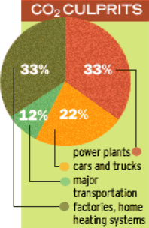
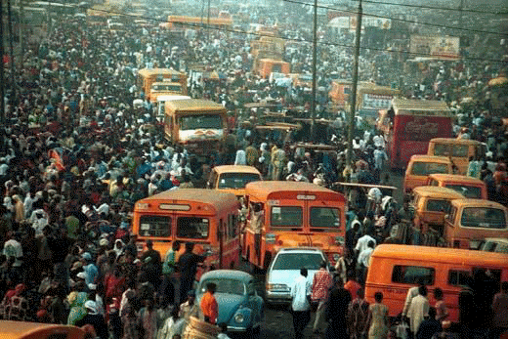
Vehicle Internet Connectivity – Why First?
Maturity:
  Utilize existing world wide markets
  Mature & available technology
  Existing infra deployment
Cost: no need to invest for extra infra structure
Timing: opportunity for fast progress
Solves junk of main transportation –related communication problems
  Increasing demand for internet traffic
  Increasing demand for telematics services
  Demand for telecomm service continuity (e.g. voice)
More & more time spent for commuting
Compatibility with normal mobile terminals, CE gadgets and related services
Opportunity for after-sale markets
Rapidly developing technology field
Solution
Wireless module(s) for every car

Slide 8
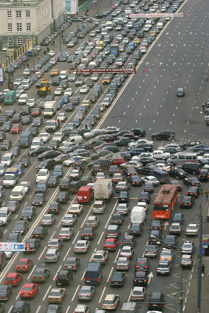
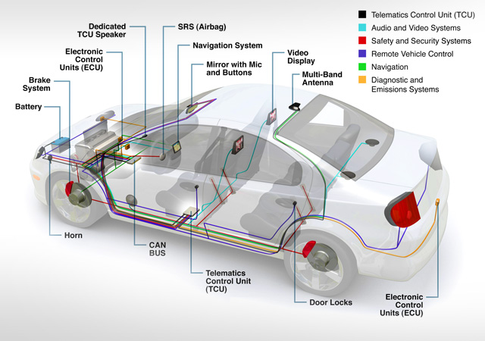
Vehicle Internet Connectivity - Services
Telecom compatible services
  Voice services (incl. emergency), sms, e-mails,…
  Hand-held connectivity to module e.g. via WLAN or Bluetooth
Cloud based /generic services
  Internet services (entertainment /infotainment) like maps/location, traffic assistance, videos, music, …
Telematics
  General car-specific applications (like fleet management, location, toll-systems, car theft prevention,…including cloud computing)
  Telemetry & navigation + related uploads
  Car diagnosis & maintenance
  Software updates
  Electric Vehicle applications (e.g. charging)

Slide 9
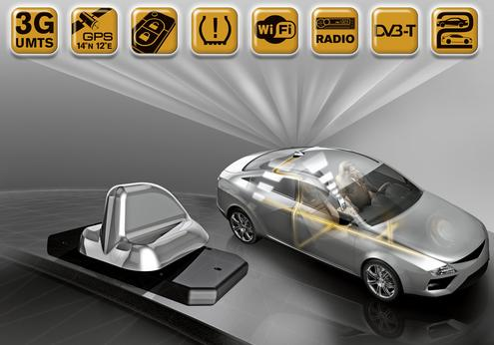
Vehicle Internet Connectivity - Challenges
Additional signal attenuation caused by cabin or trunk (car body in general) is of order 5-20 dB
  Growing annoyance since of e.g. enhanced covers in car windows
  Causing “out of coverage inside a car” situations - even with on bar signal levels just outside a car
  The major radio-related gaining factor compared to in-car hand-held gadgets, like mobile stations!
  Solution: antennas outside the cabin
  Problem: # of antennas + cables
Car-specific requirements, e.g.
  Wide range temperature (from car industry: -40…+70 °C)
  Automotive quality req’s (e.g. shock & vibration tolerance)
  Life expectation value & warranty; Automotive cycles: (long) availability
  Target: maximize utilization of existing
  offer (CE grade module) + modularity (USB)
Module/multi-radio system concept & architecture
  What radios/variants/frequencies?
  Relation to driver’s/passenger’s UE
Authentication/security
  How to treat SIM?
  Multi-operator support?

Slide 10

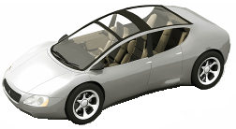
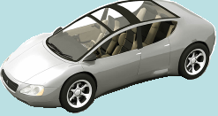
Wireless Technology in Automotive Environment
Safety Driving Assistance
Telematics (External Communications)
Emergency Call Center
Cellular Network
(Operator)
Police/Insurance Company
ETC
Wanted vehicle tracking
Stolen Car Tracking
DSRC
5.8GHz ETC
(1Mbps)
Accident info
Emergency Vehicle
Dispatch
5.8GHz DSRC
(4Mbps)
Outlet/Car Dealers
Remote Vehicle failure monitoring
GPS map data update
WAVE/802.11p
5.9GHz,700MHz
Vehicle to Vehicle comm.
(10Mbps)
Contents Provider
Vehicle to Vehicle
Collision Prevention
Contents distribution for automotive applications
Local area info distribution
Smart community
In-vehicle Wireless communication
Cloud Service Provider
Cloud computing services
(Infotainment etc)
Automotive wireless network can be split into 3 categories
Current telematics services are limited with using data cards or using mobile handsets as a modem
Wireless broadband evolution and lower tariffs will enhance services and applications running over telematics network
Telematcis services to evolve similar to or more than mobile handsets, with constant connection to the net

Slide 11
Killer Applications
Medical Condition Awareness
  Automatic notification
  Autonomous operation in medical emergency
  Integrated medical sensing
  Diagnostic Steering Wheel
Energy Management
  Traffic Conditions
  Weather / Temperature
  Oxygen sensoring
  Traffic Signals / State
  Hybrid Energy Usage
  Improved Navigation
  Intelligent / Safe routing
  Parking lot
Fun
  Performance
  Driver assistance
Safety
  Accident avoidance
  Occupant protection
  Reliability
  Out of Area notification
  Alertness: lane departure, speed limit
Sustainable
  Low impact on the environment
  Production, use and recycle

Slide 12
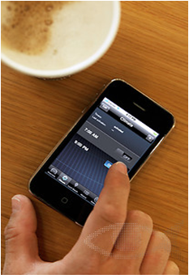
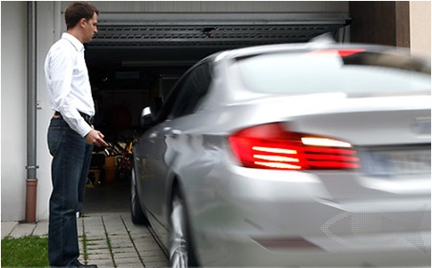
Remote Control
ESCK in cellular mobile terminal allows the driver to remote control the vehicle from outside the car, even he is very far from the vehicle.
  Locking and unlocking doors
  Pre-starting, adjusting the temperature
  Activate/deactivate functions based on acquired information
  Remote Parking

Slide 13
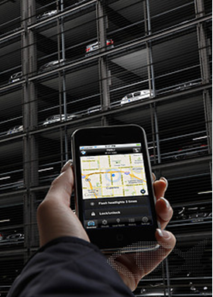
Location Tracking and Discovery
The driver can request the vehicle to send the location information via cellular network, and display the location information on the mobile terminal to enable it to be found easily.
  Car was stolen
  Illegal parking towed by police
  Car parked by somebody else
  Find the rental car by remotely leasing
  Forgot the parking place
  …

Slide 14
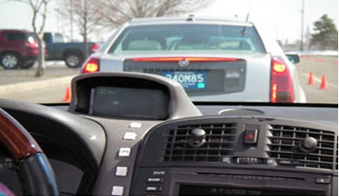
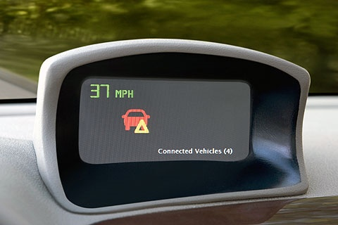
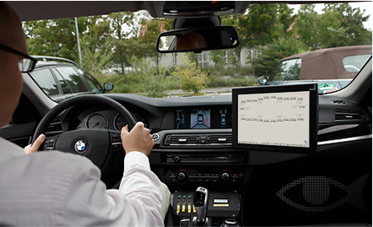
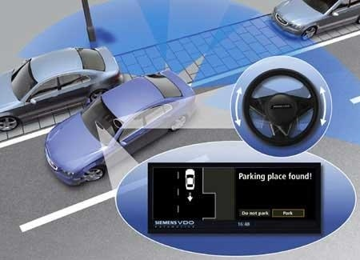
Wireless Vehicle communications
V2V, V2R, V2C communications
  Monitor the distance between vehicles, warn the driver the short distance and initiates emergency braking.
  Exchange the information of dangerous spots of the road, warn the driver to avoid the potential accidents.
  Interactive with service center for the real-time traffic, identify a shortest or fastest route.
  Intelligent parking: detect the parking position, monitor the distance, display information to help parking.

Slide 15
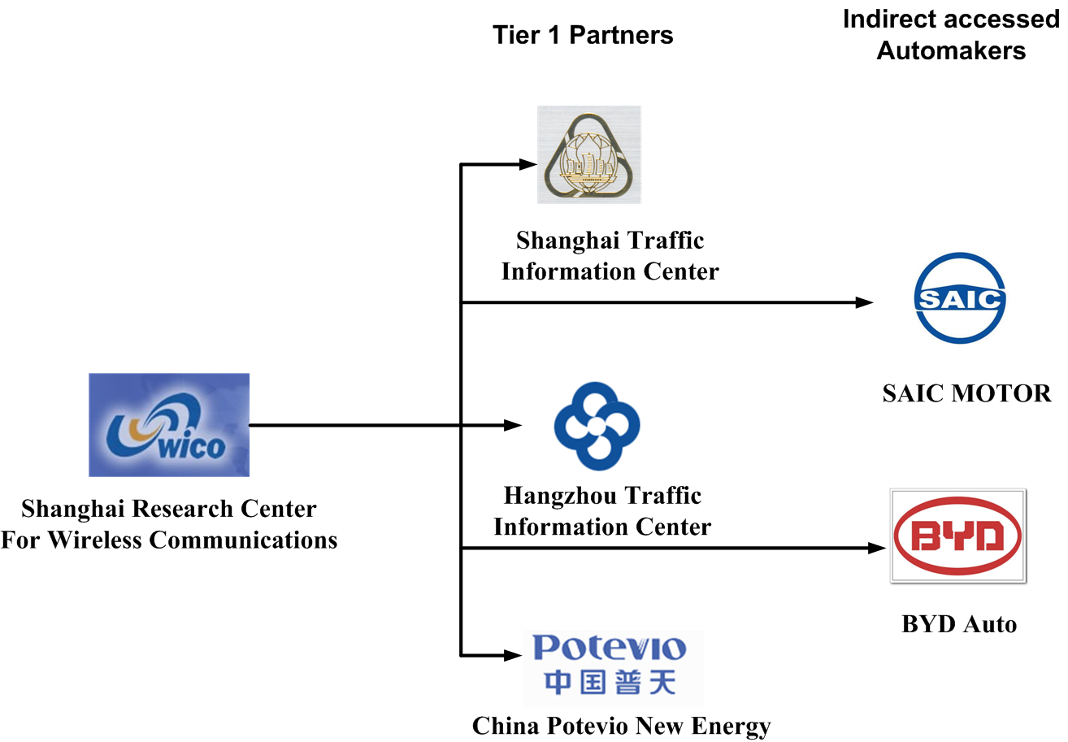
Collaboration Partner

Slide 16
Demo System Diagram
802.11p demo system(OBU & RSU)
802.11p unit
Notes:
1. Flexibility study to embed REL ZigBee USB stick in RMSH demonstrator
1) According to present solution for demo, we can consider using Renesas’s zigbee module in Mobile gateway.
2) TI's zigbee module replacement for Renesas's module will involve much work, including
hardware learning and protocol/software development learning, which needs about six to seven months.
3) The compatibility testing between TI's zigbee and Renesas' zigbee can be performed after June, but
it will depend on the present tasks' progress.
2. Questions

Slide 17
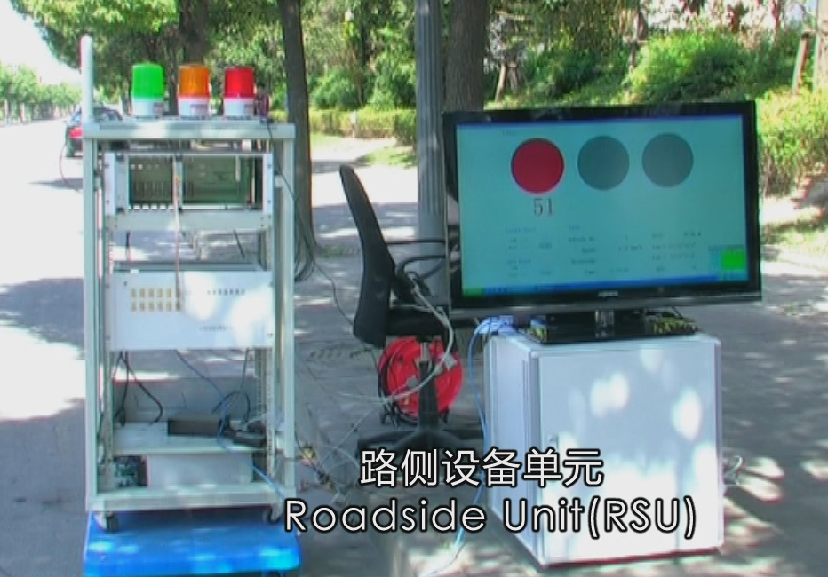
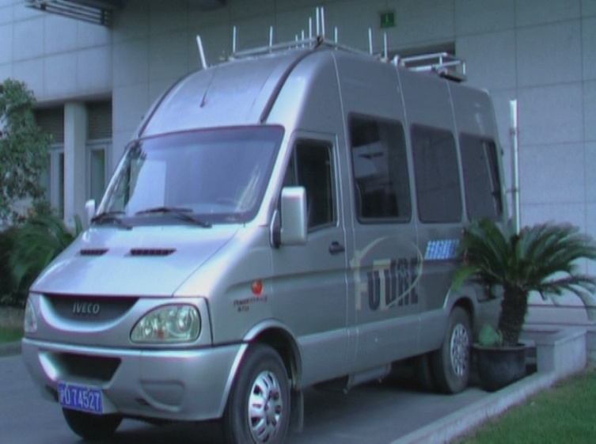
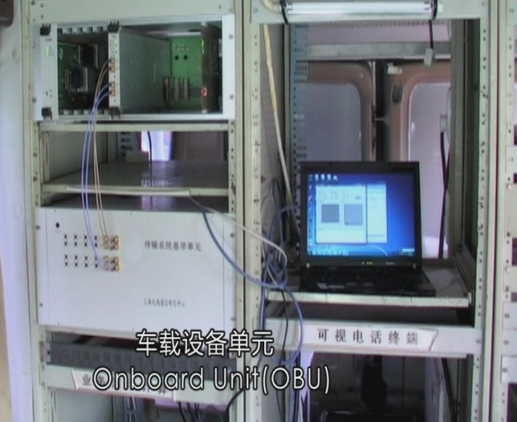
Demo System Integration & Road test
Notes:
1. Flexibility study to embed REL ZigBee USB stick in RMSH demonstrator
1) According to present solution for demo, we can consider using Renesas’s zigbee module in Mobile gateway.
2) TI's zigbee module replacement for Renesas's module will involve much work, including
hardware learning and protocol/software development learning, which needs about six to seven months.
3) The compatibility testing between TI's zigbee and Renesas' zigbee can be performed after June, but
it will depend on the present tasks' progress.
2. Questions

Slide 18
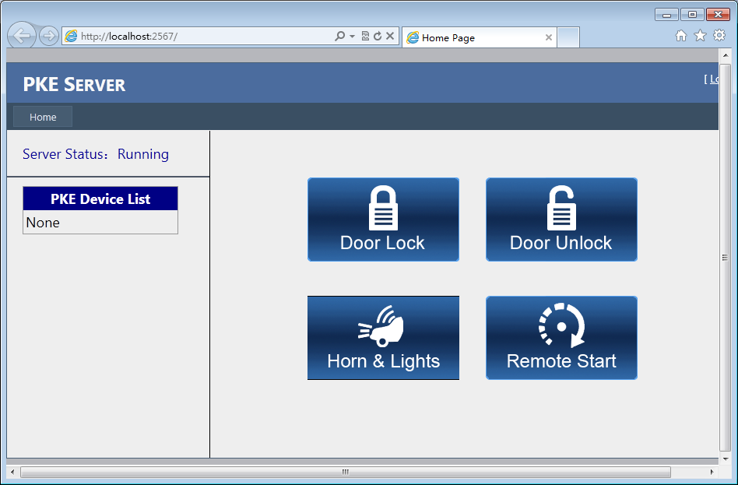


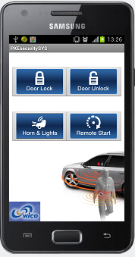
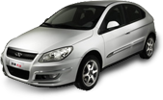
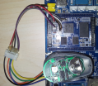
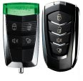
ESCK Demo Scenarios
Control vehicle from cell phone
Control vehicle from internet
Server
Lock/Unlock the door
Remote Controller
Battery status
Maintenance Promotion
Tire pressure detection
GPS Service
GPRS/3G
GPRS/3G
Cell Phone
RF
In Vehicle
Module

Slide 19
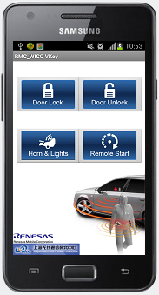
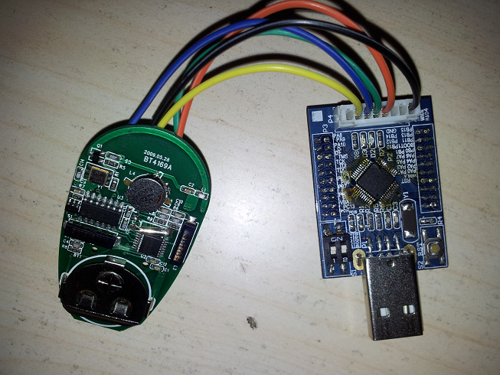
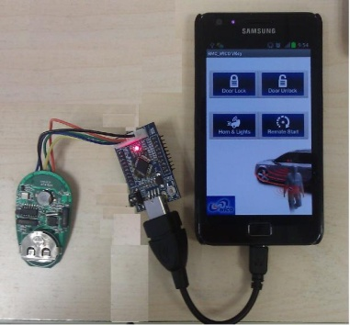
ESCK System on Cell phone
Cell phone connects to car
RFID
Cell phone
Controller
RFID+MCU

Slide 20



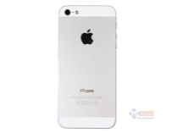
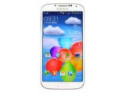




IoT Protocal/Service/App.
Environment Protection
ITS
Smart Grid
Public Safety
Location Service
Cloud
Memory Server
App. Server
Data Centric Network
Wide Coverage
LTE WCDMA TD-SCDMA GRPS
Channel
短距离通讯 (11p)
WiFi (11g/ac)
ZigBee
蓝牙
Local Coverage
Device
App. Development in teminal device (Android/iOS/Linux/COS)
Internet of Car OBD/PKE
汽车信息平台
Info-entertainment
Sensor Nodes
Water/air quality/pollution
partner

Slide 21
Thank You!

