Slide 1


Lattice Partition Based
Physical-layer Network Coding
Qifu (Tyler) Sun
University of Science and Technology Beijing
6, Mar, 2014 @ Sino-German Workshop
Notes:
Thanks Yonghui. Good afternoon everyone. It’s my greatest pleasure to have a visit at the University of Sydney. It’s also my first time to come to the Southern Hemisphere. So I’m so pleasant to have a chance to experience a sunny shiny X’mas.
Now more precisely, besides INC, I’m also affiliated with the INC Shenzhen branch. INC branch was just established at the beginning of this year. Its goal is to establish a tighter connection and collaboration with research institutes and industries in mainland China. In particular, via this newly established branch, we are able to apply for various types of research grants supported by different tiers’ government in mainland China.
OK. Today’s talk …
Perhaps LNC, you may not hear about this term.
However, for another concept that is closely related to it, called Physical layer network coding, it may not be so unfamiliar to you any more.

Slide 2
References
  B. Nazer and M. Gastpar, “Reliable physical layer network coding,” Proceedings of the IEEE, vol. 99, no. 3, Mar., 2011.
  C. Feng, D. Silva, and F. R. Kschischang, “An algebraic approach to physical-layer network coding,” IEEE Transactions on Information Theory, vol. 59, pp. 7576-7596, no. 11, Nov. 2013.
  Q. T. Sun, J. Yuan, T. Huang and W. K. Shum, “Lattice network codes based on Eisenstein integers,” IEEE Transactions on Communications, vol. 61, no. 7, Jul., 2013.

Slide 3
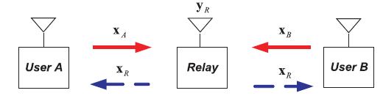
Physical-layer Network Coding (PNC)
y_{R}= x_{A}+x_{B}
F
  Relay computes the modulo-two sum w_{A}⊕w_{B} from linearly superimposed receiving signals y_{R}= x_{A}+x_{B}
  Enhances the throughput of a binary-input TWRC.
  [Nam-Chung-Lee’10]roach the capacity upper bound of a Gaus
Zhang-Liew-Lam, Hot topic: physical layer network coding, MobiCom, 2006.
Popviski-Yomo, The anti-packets can increase the achievable throughput of a wireless multi-hop network, ICC, 2006.
Nazer-Gastpar, ,Computing over multiple-access channels with connections to wireless network coding, ISIT, 2006..
C

Slide 4
Physical-layer Network Coding (PNC)
y_{R}= h_{A}x_{A}+ h_{B}x_{B}
a_{A}w_{A}+a_{B}w_{B}
  Relay computes the F-linear combination of a_{A}w_{A}+a_{B}w_{B} from linearly superimposed receiving signals y_{R}= h_{A}x_{A}+ h_{B}x_{B}
  [Nam-Chung-Lee’10]roach the capacity upper bound of a Gaus
We need an appropriate modulation scheme to map linearity from over complex number field to over finite fields.

Slide 5
Physical-layer Network Coding (PNC)
y_{R}= h_{A}x_{A}+h_{B}x_{B}+z
a_{A}w_{A}+a_{B}w_{B}
  Relay computes the F-linear combination of a_{A}w_{A}+a_{B}w_{B} from linearly superimposed receiving signals y_{R}= h_{A}x_{A}+ h_{B}x_{B} + z
  [Nam-Chung-Lee’10]roach the capacity upper bound of a Gaus
We need an appropriate modulation scheme to map linearity from over complex number field to over finite fields.
We need an appropriate coding technique for reliable PNC over F.
  Good candidate: Lattice partition structure embedded in C

Slide 6
Lattice Partitions in C
  Why is lattice partition a good candidate to model PNC?
  Based on lattice partition structure,
  the arithmetic of finite field can be appropriately represented over complex plane.
  several capacity-achieving lattice codes have been designed for (complex) Gaussian channels.
  C = log₂(1 + |h|² SNR) (bits / channel use)

Slide 7
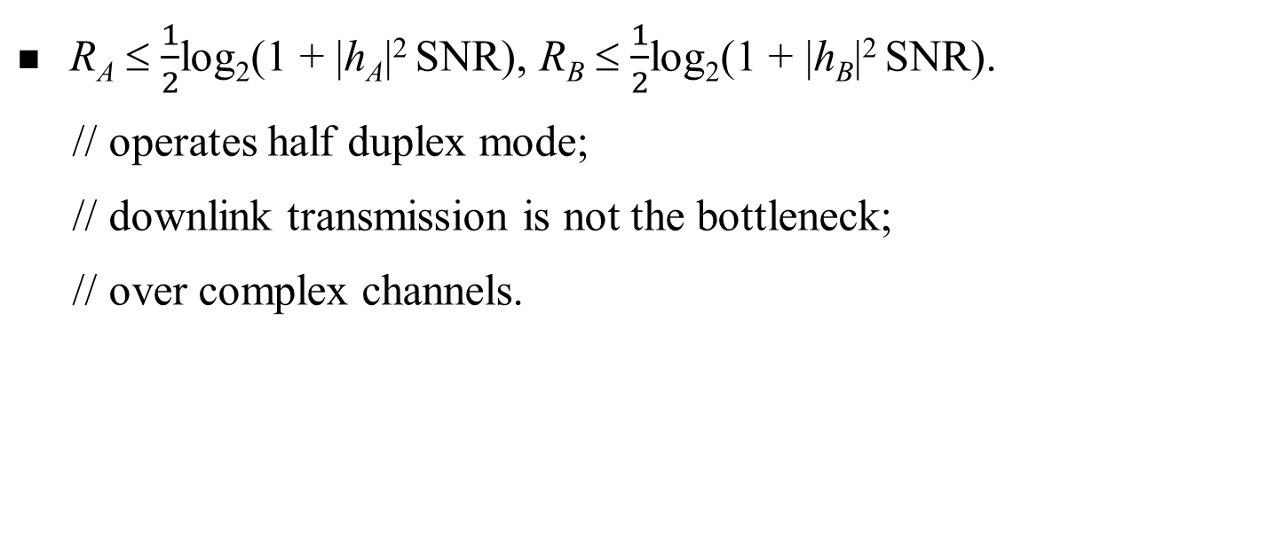
Almost capacity-achieving PNC in TWRC
y_{R}= h_{A}x_{A}+ h_{B}x_{B}
  R_{A} ≤ $\frac{1}{2}$log₂(1 + |h_{A}|² SNR), R_{B} ≤ $\frac{1}{2}$log₂(1 + |h_{B}|² SNR).
  // operates half duplex mode;
  // downlink transmission is not the bottleneck;
  // over complex channels.

Slide 8
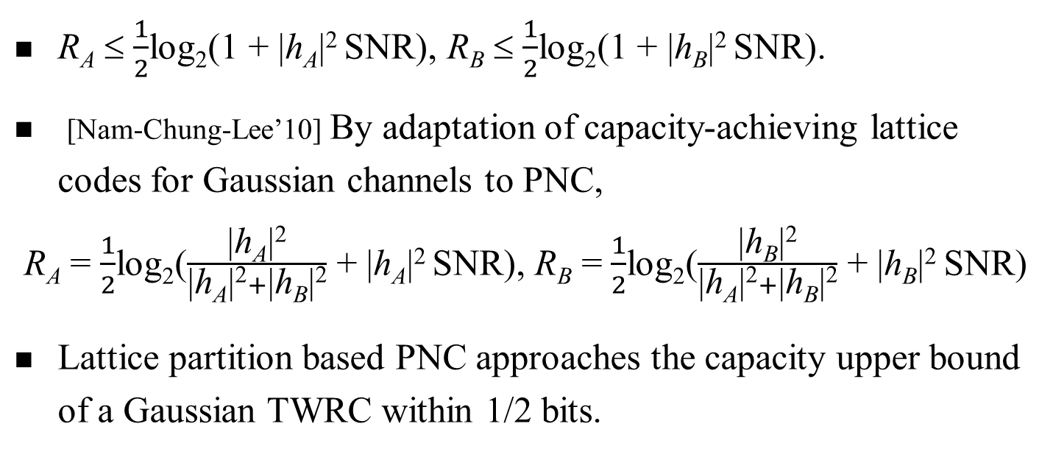
Almost capacity-achieving PNC in TWRC
y_{R}= h_{A}x_{A}+ h_{B}x_{B}
  R_{A} ≤ $\frac{1}{2}$log₂(1 + |h_{A}|² SNR), R_{B} ≤ $\frac{1}{2}$log₂(1 + |h_{B}|² SNR).
  [Nam-Chung-Lee’10] By adaptation of capacity-achieving lattice codes for Gaussian channels to PNC,
  R_{A} = $\frac{1}{2}$log₂($\frac{\text{|}\text{h}\text{A}\text{|}\text{2}}{\text{|}\text{h}\text{A}\text{|}\text{2}+\text{|}\text{h}\text{B}\text{|}\text{2}}$ + |h_{A}|² SNR), R_{B} = $\frac{1}{2}$log₂($\frac{\text{|}\text{h}\text{B}\text{|}\text{2}}{\text{|}\text{h}\text{A}\text{|}\text{2}+\text{|}\text{h}\text{B}\text{|}\text{2}}$ + |h_{B}|² SNR)
  Lattice partition based PNC approaches the capacity upper bound of a Gaussian TWRC within 1/2 bits.
  // h_{A}, h_{B} known at A and B

Slide 9
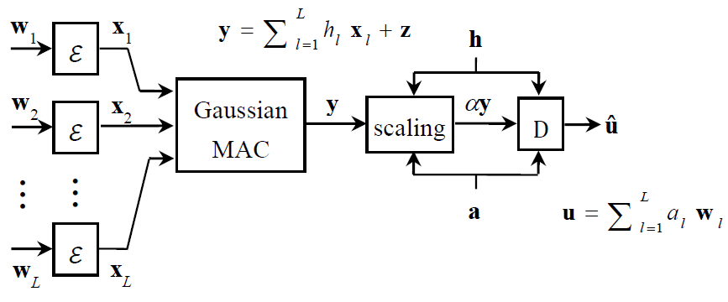
CF: Lattice partition based PNC in MARC
Nazer-Gastpar, Compute-and-Forward: Harnessing Interference through Structured Codes, IEEE Trans. Inform. Theory, 2011.
Gaussian Multiple Access Relay Channel
Multi-user
q-ary input
Fading h_{l}∈C
Notes:
a complex circularly-symmetric additive white Gaussian noise

Slide 10
CF: Lattice partition based PNC in MARC
Nazer-Gastpar, Compute-and-Forward: Harnessing Interference through Structured Codes, IEEE Trans. Inform. Theory, 2011.
Gaussian Multiple Access Relay Channel
Key idea:
Based on αy, relay decodes a linear function of w_{i} w.r.t. a coefficient vector a, instead of decoding each w_{i} individually.
Multi-user
q-ary input
Fading h_{l}∈C

Slide 11
CF: Lattice partition based PNC in MARC
The CF scheme is proposed based on an infinite sequence of good lattice partitions over C^{n}, which can asymptotically achieve the computation rate
  // h not known at transmitters
// Computation rate = Reliable transmission rate of u
Notes:
… such that under this rate the relay can decode the desired linear combination u with arbitrarily small error.
Here the information of fading is supposed to be known at the relay but not the transmitters.

Slide 12
CF: Lattice partition based PNC in MARC
The CF scheme is proposed based on an infinite sequence of good lattice partitions over C^{n}, which can asymptotically achieve the computation rate
// This scheme is not practical to implement.
// An information theoretical guideline

Slide 13
Lattice Network Coding (LNC)
⎯ An algebraic framework for practical design
Feng-Silva-Kschischang, An algebraic approach to physical-layer network coding, IEEE Trans. Inform. Theory, 2013.
  Considers finite dimensional lattice partitions for PNC.
  Makes direct connection between the LNC design and module theory over principal ideal domains in commutative algebra.
Notes:
In order to design and implement practical CF schemes, most recently, an algebraic framework, called lattice network coding, was proposed by Feng-Silva-Kschischang.
The system model for LNC is same as the one for Compute-and-Forward

Slide 14
Message space of LNC
  Let R ⊂ C be a principal ideal domain (e.g., Z, Z[i] := Z+iZ)
  An n-dim R-lattice Λ is a subset of C^{n} that is closed under ‘+’ and ‘× by scalars in R’. // an R-module
  Given a sublattice Λ′ of Λ,
  the quotient group Λ/Λ′ naturally forms a lattice partition of Λ. // an R-module
  Λ = Z
  Λ′ = 3Z
  Λ/Λ′ = Z/3Z ≅ F₃
3Z
–3
0
3
1+3Z
2+3Z
Λ: fine lattice; Λ′: coarse lattice

Slide 15
Message space of LNC
  Let R ⊂ C be a principal ideal domain (e.g., Z, Z[i] := Z+iZ)
  An n-dim R-lattice Λ is a subset of C^{n} that is closed under ‘+’ and ‘× by scalars in R’. // an R-module
  Given a sublattice Λ′ of Λ,
  the quotient group Λ/Λ′ naturally forms a lattice partition of Λ. // an R-module
  The message space of an LNC W = Λ/Λ′
w_{l} is a coset
in Λ/Λ′

Slide 16
Message space of LNC
  Let R ⊂ C be a principal ideal domain (e.g., Z, Z[i] := Z+iZ)
  An n-dim R-lattice Λ is a subset of C^{n} that is closed under ‘+’ and ‘× by scalars in R’. // an R-module
  Given a sublattice Λ′ of Λ,
  the quotient group Λ/Λ′ naturally forms a lattice partition of Λ. // an R-module
  The message space of an LNC W = Λ/Λ′
Code Rate
=
log₂|Λ/Λ′|

Slide 17
Message space of LNC over Z[i]
  The set of Gaussian integers Z[i] ⊂ C forms a PID.
    Z[i] = {a ⋅ 1+b ⋅ i : a, b ∈ Z}
    Λ = Z[i], Λ′ = (1+i)Z[i], Λ/Λ′ = F₂ = {■ ■}
    F₂ = Z[i]/(1+i)Z[i] = Z/2Z
i
1

Slide 18
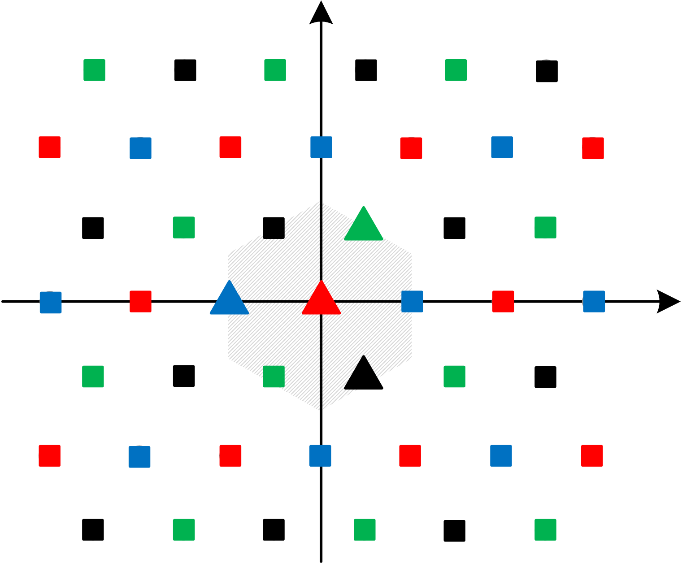
Message space of LNC over Z[ω]
  E.g., the set of Eisenstein integers Z[ω] ⊂ C forms a PID.
    Z[ω] = {a ⋅ 1+b ⋅ ω : a, b ∈ Z}, ω =
    Λ = Z[ω], Λ′ = 2Z[ω], Λ/Λ′ = F₄ = {■ ■ ■ ■}
W = (Z[ω]/2Z[ω])^{n} :
Baseline (uncoded) LNC
ω
1

Slide 19
Encoding of LNC
  The encoding function E maps each coset w_{l} ∈ W = Λ/Λ′ to a coset leader x_{l} ∈ w_{l}, which is in the fundamental Voronoi region V(Λ′) of Λ′.
Z[ω]/2Z[ω], Λ/Λ′ = F₄

Slide 20
Decoding of LNC at the relay
  Received signal vector , h_{l} ∈ C
  Relay’s goal: based on αy, decode , a_{l} ∈ R
  The real message decoded is û = ϕ(D_{Λ}(αy))
Notes:
Now let’s move from the encoding side to the decoding side. After the L source signals transmitted through the Gaussian MAC, the received signal vector is a linear combination of x w.r.t. the fading gains, plus a vector z representing the complex circularly-symmetric Additive White Gaussian Noise.
The goal of the relay is to decode an R-linear combination of source messages

Slide 21
Decoding function
  û = ϕ(D_{Λ}(αy))
natural projection from Λ onto Λ/Λ′
quantizer: map to a closest lattice point in Λ
αy
    Λ = Z[ω], Λ′ = 2Z[ω], Λ/Λ′ = F₄ = {■ ■ ■ ■}
Notes:
The physical meaning of the decoding function is as follows.
First the quantizer D will map the scaled version of received signal y to a closest fine lattice point, and then project this fine lattice point to the coset in the lattice partition it belongs to. Recall that every message in the message space corresponds to a coset in the lattice partition.

Slide 22
Decoding error
  Received signal vector
  Relay’s goal: based on αy, decode , a_{l} ∈ R
  The real message decoded is û = ϕ(D_{Λ}(αy))
  A decoding error occurs when u ≠ û.
Non-trivial analysis
effective noise n

Slide 23
Decoding error probability of LNC
  [Feng-Silva-Kschischang] Consider an LNC Λ/Λ′ with Λ′ hypercube shaped, i.e., equivalent to Z[i]^{n}.
Notes:
Here, the shape of the sublattice Lambda’ is assumed to be isomorphic to a hypercube after possible rotation, reflection and multiplication by a scaling factor.

Slide 24
Decoding error probability of LNC
  NOT applicable for Z[ω]-based LNCs
  [Feng-Silva-Kschischang] Consider an LNC Λ/Λ′ with Λ′ hypercube shaped, i.e., equivalent to Z[i]^{n}. The union bound Estimation (UBE) of the decoding error probability for Λ/Λ′ is
  d(Λ/Λ′) = minimum inter-coset (Euclidean) distance
  = length of shortest vectors in Λ\Λ′
  K(Λ/Λ′) = The number of shortest vectors in Λ\Λ′
  N_{o}Q(α, a) = variance of effective noise n
Notes:
In this expression, the parameters K and d are related to the lattice partitions.

Slide 25
Decoding error probability of LNC
  [Sun-Yuan-Huang-Shum] Consider an LNC Λ/Λ′ with Λ′ equivalent to Z[ω]^{n}. The UBE of the decoding error probability for Λ/Λ′ is
  d(Λ/Λ′) = length of shortest vectors in Λ\Λ′
  K(Λ/Λ′) = The number of shortest vectors in Λ\Λ′
  N₀Q(α, a) = variance of effective noise n
Notes:
Now let’s move from the quantization to the decoding side of LNCs over Eisenstein integers.
Here, the shape of the sublattic Lambda’ is assumed to be isomorphic to a hypercube after possible rotation, reflection and multiplication by a scaling factor.

Slide 26
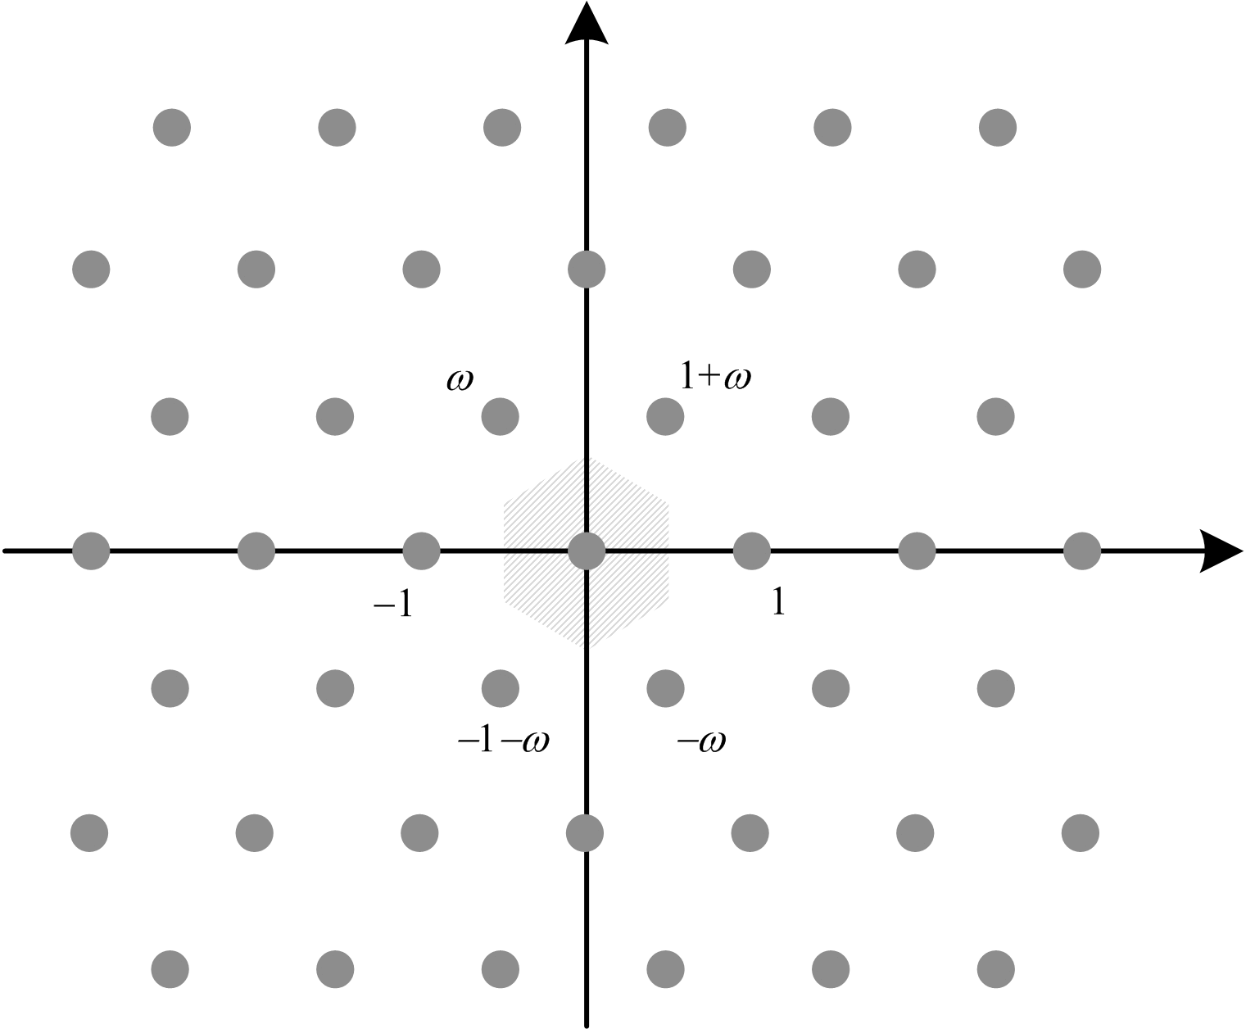
LNC over Z[ω] vs over Z[i]
  Z[ω] provides well-known additional shaping gain of conventional lattice codes over Z[i].
Optimal lattice packing in 2-D plane
Z[ω]
  Under the same code rate and SNR, baseline LNC over Z[ω] performs slightly better than baseline LNC over Z[i].

Slide 27
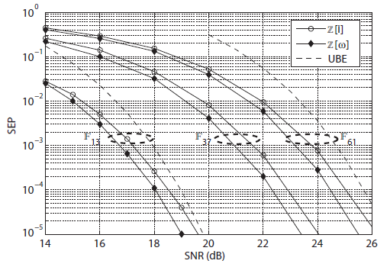
LNC over Z[ω] vs over Z[i]
  Two transmitters;
  A fixed channel gain
  Optimal α, a are chosen.
  Baseline LNCs over Z[ω] are 0.5-0.6 dB better than baseline LNCs over Z[i].
Notes:
SEP = Symbol error probability

Slide 28
LNC over Z[ω] vs over Z[i]
  Z[ω] enriches candidates of finite fields for LNC designs.
    F_{q} can be represented by a lattice partition Z[ω]/βZ[ω] if
    q = 3; or q ≡ 1 mod 6; or
      q is a square of a rational prime ≡ 2 mod 3
    F_{q} can be represented by a lattice partition Z[i]/βZ[i] if
    q = 2; or q ≡ 1 mod 4; or
      q is a square of a rational prime ≡ 3 mod 4
  The only GF(2^{m}) that can be represented over Z, Z[i] and Z[ω] are F₂ = Z[i]/(1+i)Z[i] = Z/2Z and F₄ = Z[ω]/2Z[ω] .
Sun-Huang-Yuan, On lattice partition based physical-layer network coding over GF(4), IEEE Comm Letters, 2013..

Slide 29
Code design of LNC
  Theorem. Consider an LNC Λ/Λ′ over R = Z[i] or Z[ω]. The UBE of the decoding error probability is
  K(Λ/Λ′) and d(Λ/Λ′) are parameters for Λ/Λ′.
  Construct fine lattice Λ from linear codes over GF(q) = R/πR by complex Construction A, B, D;
  Set coarse lattice Λ′ = (R /π^{r} R)^{n}

Slide 30

Optimal choice of α, a
  Theorem. Consider an LNC Λ/Λ′ over R = Z[i] or Z[ω]. The UBE of the decoding error probability is
  K(Λ/Λ′) and d(Λ/Λ′) are parameters for Λ/Λ′.
  N₀(|α|² + SNR||αh – a||²) = variance of effective noise.
  Minimum variance criterion for choosing optimal α and a.

Slide 31

Optimal choice of a
  Theorem. Consider an LNC Λ/Λ′ over R = Z[i] or Z[ω]. The UBE of the decoding error probability is
  where M =
  Since M is Hermitian and positive-definite, M = LL*
lattice reduction
Notes:
Where M is Hermitian and postivie-definite.
As a result, M can be further decomposed into a product of a lower triangular matrix L and its Hermitian conjugate. (This is the Cholesky decomposition).

Slide 32
Lattice reduction
  In general, given an R-lattice Λ generated by a basis {v₁, …, v_{L}}, a lattice reduction algorithm aims to find another basis
  {u₁, …, u_{L}} s.t.
    u₁ is the shortest nonzero vector in Λ
    u₂ is the shortest vector in Λ\⟨u₁⟩ …
  L = 2: efficiently solved (over Z-lattice) by Guassian reduction algorithm, which is generalized to over Z[i]- and Z[ω]-lattices.

Slide 33
Lattice reduction
  In general, given an R-lattice Λ generated by a basis {v₁, …, v_{L}}, a lattice reduction algorithm aims to find another basis
  {u₁, …, u_{L}} s.t.
    u₁ is the shortest nonzero vector in Λ
    u₂ is the shortest vector in Λ\⟨u₁⟩ …
  L > 2: No known efficient algorithm for exact optimal solutions;
  LLL algorithm is the most popular approximate one.

Slide 34
Summary
  Via lattice partition structure embedded in C,
  finite field arithmetic can be represented over C, and thus modulation and coding can be reconciled for design of reliable PNC over a finite fields.
  information theoretical perspective,
    in TWRC, the capacity approached within 1/2 bits.
    in MARC, a lower bound on the achievable computation rate.
  practical design perspective, algebraic frameworks over both Z[i] or Z[ω] are developed
    UBE of decoding error probability.
    Design criteria for Λ/Λ′, α_{opt}, a_{opt}.

Slide 35
Thank you.

