Slide 1


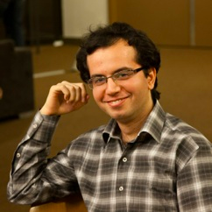


Reliable Deniable Communication: Hiding Messages in Noise
ME
Pak Hou (Howard) Che
Mayank Bakshi
Mahdi Jafari Siavoshani
Sidharth Jaggi
The Chinese University
of Hong Kong
The Institute of
Network Coding

Slide 2

Reliable Deniable Communication: Hiding Messages in Noise
ME
Pak Hou (Howard) Che
Mayank Bakshi
Mahdi Jafari Siavoshani
Sidharth Jaggi
The Chinese University
of Hong Kong
The Institute of
Network Coding

Slide 3

Alice
Bob
Reliability

Slide 4
Alice
Bob
Reliability
Deniability
Willie
(the Warden)

Slide 5
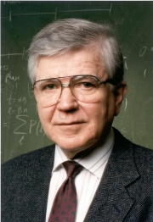
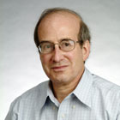
Alice
Bob
Reliability
Deniability
Willie-sky

Slide 6
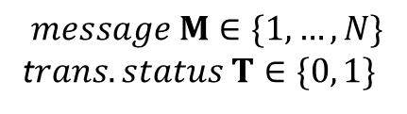


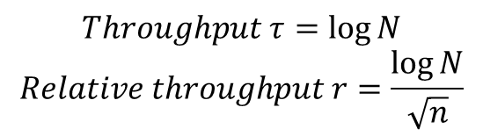
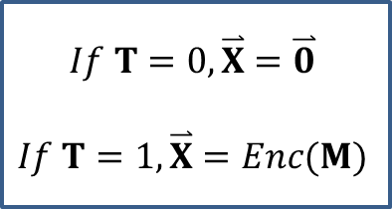
Alice’s Encoder
M
$$If T=0, \overset{⃑}{X}=\overset{⃑}{0}$$
$$If T=1,\overset{⃑}{X}=Enc(M)$$
$$\overset{⃑}{X}$$
T
$$message M∈\{1, …, N\}$$
t$rans. status T∈\{0, 1\}$
$$N=2^{θ(\sqrt{n})}$$
$$Throughput τ=\log{N}$$
$$Relative throughput r=\frac{\log{N}}{\sqrt{n}}$$

Slide 7
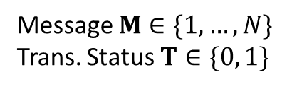


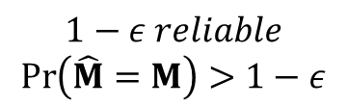

Alice’s Encoder
M
$$If T=0, \overset{⃑}{X}=\overset{⃑}{0}$$
$$If T=1,\overset{⃑}{X}=Enc(M)$$
Bob’s Decoder
$$\overset{⃑}{X}$$
$${\overset{⃑}{Y}}_{b}$$
$$\hat{M}$$
BSC(p_{b})
$$\hat{M}=Dec({\overset{⃑}{Y}}_{b})$$
T
$$1−ε reliable$$
$$\operatorname{Pr}\left(\hat{M}=M\right)>1−ε$$
Message $M∈\{1, …, N\}$
Trans. Status $T∈\{0, 1\}$
$$N=2^{θ(\sqrt{n})}$$

Slide 8
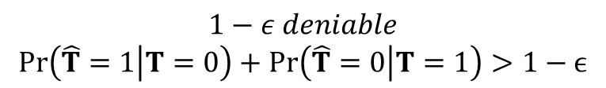



Alice’s Encoder
M
$$If T=0, \overset{⃑}{X}=\overset{⃑}{0}$$
$$If T=1,\overset{⃑}{X}=Enc(M)$$
Bob’s Decoder
$$\overset{⃑}{X}$$
$${\overset{⃑}{Y}}_{b}$$
$$\hat{M}$$
BSC(p_{b})
$$\hat{M}=Dec({\overset{⃑}{Y}}_{b})$$
T
$$1−ε reliable$$
$$\operatorname{Pr}\left(\hat{M}=M\right)>1−ε$$
Message $M∈\{1, …, N\}$
Trans. Status $T∈\{0, 1\}$
$$N=2^{θ(\sqrt{n})}$$
BSC(p_{w})
$${\overset{⃑}{Y}}_{w}$$
$$\hat{T}=Dec({\overset{⃑}{Y}}_{w})$$
Willie’s (Best) Estimator
$$\hat{T}$$

Slide 9
Bash, Goeckel & Towsley [1]
Shared secret
AWGN channels
But capacity only
[1] B. A. Bash, D. Goeckel and D. Towsley, “Square root law for communication with low probability of detection on AWGN channels,” in Proceedings of the IEEE International Symposium on Information Theory (ISIT), 2012, pp. 448–452.

Slide 10
This work
No shared secret
BSC(p_{b})
p_{b} < p_{w}
BSC(p_{w})

Slide 11
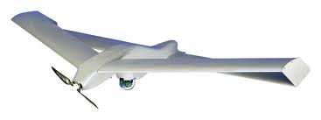
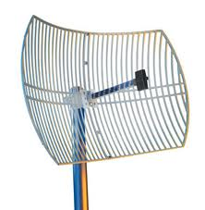

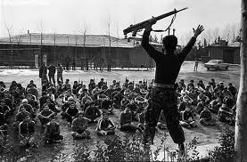
Aerial Alice
Directional antenna
Wicked Willie(s)
Base-station Bob

Slide 12
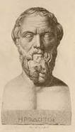
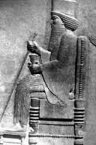
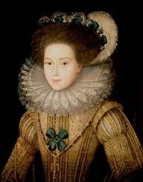

Steganography: Other work

Slide 13
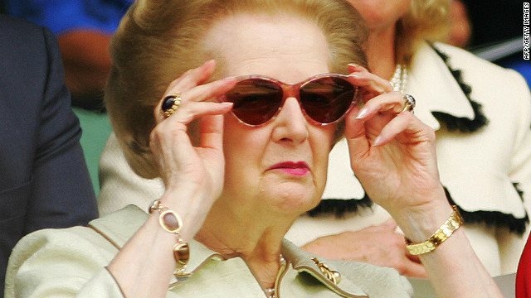

Steganography: Other work

Slide 14
Other work: “Common” model
Shared secret key
O(n.log(n)) bits (not optimized)
Message,
Covertext
Stegotext(covertext,message,key)
No noise
d(stegotext,covertext) “small”
Capacity O(n) message bits
Information-theoretically tight characterization
(Gel’fand-Pinsker/Dirty paper coding)
[2] Y. Wang and P. Moulin, "Perfectly Secure Steganography: Capacity, Error Exponents, and Code Constructions,"
IEEE Trans. on Information Theory, special issue on Information Theoretic Security, June 2008

Slide 15
Other work: Square-root “law”
(“empirical”)
“Steganographic capacity is a loosely-defined concept, indicating the size of payload which
may securely be embedded in a cover object using a particular embedding method. What
constitutes “secure” embedding is a matter for debate, but we will argue that capacity should
grow only as the square root of the cover size under a wide range of definitions of security.” [3]
“Thanks to the Central Limit Theorem, the more covertext we give the warden, the better
he will be able to estimate its statistics, and so the smaller the rate at which
[the steganographer] will be able to tweak bits safely.” [4]
“[T]he reference to the Central Limit Theorem... suggests that a square root relationship
should be considered. “ [3]
[3] A. Ker, T. Pevny`, J. Kodovsky`, and J. Fridrich, “The square root law of steganographic capacity,” in Proceedings of the 10th ACM
workshop on Multimedia and security. ACM, 2008, pp. 107–116.
[4] R. Anderson, “Stretching the limits of steganography,” in Information Hiding, 1996, pp. 39–48.

Slide 16
Alice’s Encoder
M
$$If T=0, \overset{⃑}{X}=\overset{⃑}{0}$$
$$If T=1,\overset{⃑}{X}=Enc(M)$$
Bob’s Decoder
$$\overset{⃑}{X}$$
$${\overset{⃑}{Y}}_{b}$$
$$\hat{M}$$
BSC(p_{b})
$$\hat{M}=Dec({\overset{⃑}{Y}}_{b})$$
T
$$1−ε reliable$$
$$\operatorname{Pr}\left(\hat{M}=M\right)>1−ε$$
Message $M∈\{1, …, N\}$
Trans. Status $T∈\{0, 1\}$
$$N=2^{θ(\sqrt{n})}$$
BSC(p_{w})
$${\overset{⃑}{Y}}_{w}$$
$$\hat{T}=Dec({\overset{⃑}{Y}}_{w})$$
Willie’s (Best) Estimator
$$\hat{T}$$

Slide 17
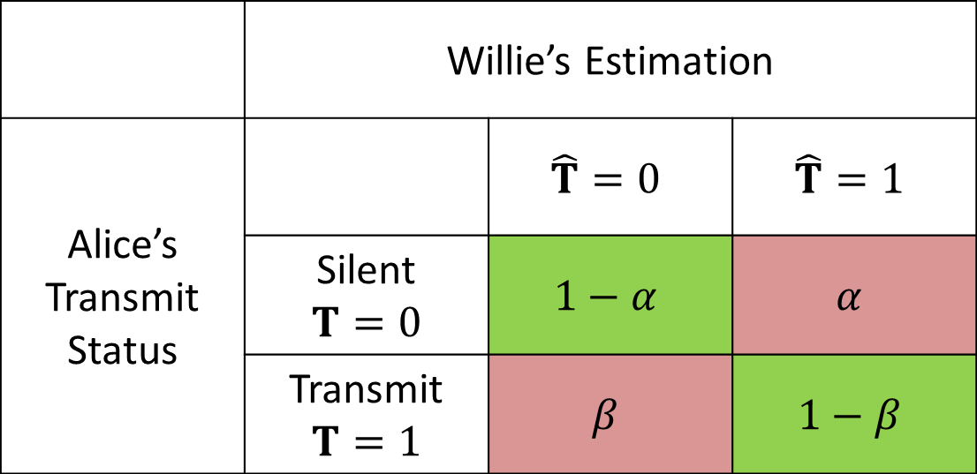
Hypothesis Testing
 | Willie’s Estimate
Alice’s Transmission Status
$α=Pr\left(\hat{T}=1 | T=0\right), β=Pr\left(\hat{T}=0 | T=1\right)$

Slide 18
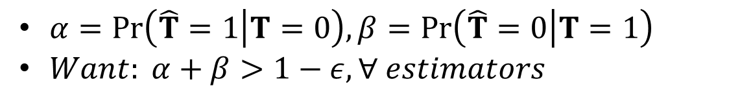
Hypothesis Testing
 | Willie’s Estimate
Alice’s Transmission Status

Slide 19
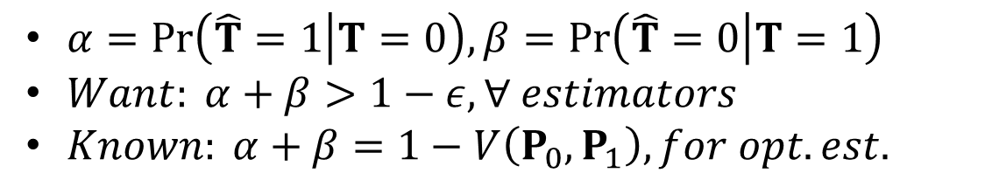
Hypothesis Testing
 | Willie’s Estimate
Alice’s Transmission Status

Slide 20
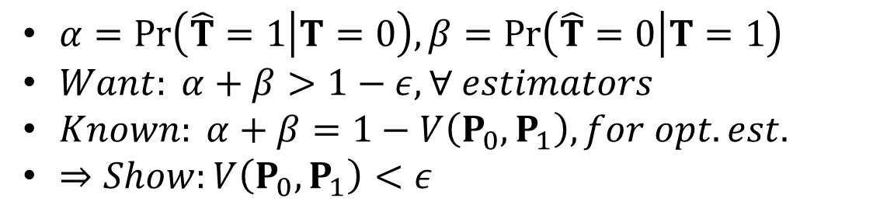
Hypothesis Testing
 | Willie’s Estimate
Alice’s Transmission Status

Slide 21
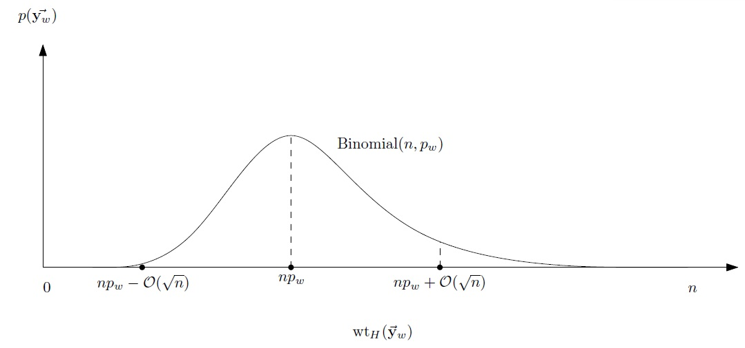

Intuition
$T=0, {\overset{⃑}{y}}_{w}={\overset{⃑}{z}}_{w}\sim Binomial(n,p_{w})$

Slide 22
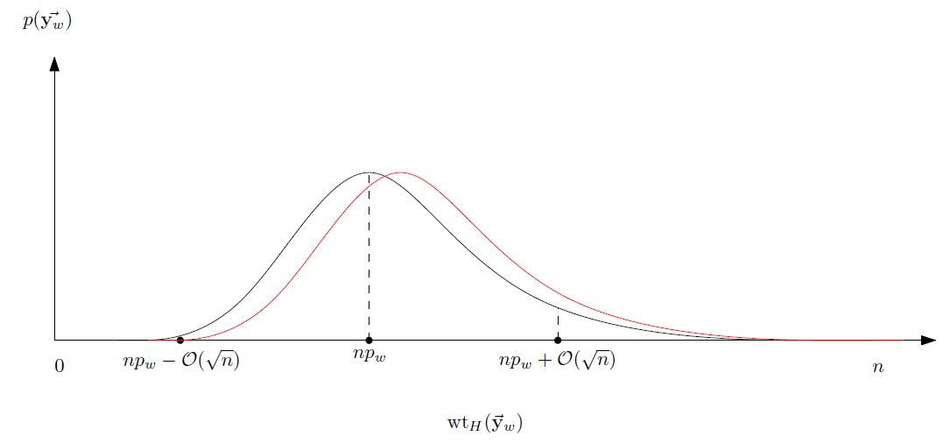

Intuition
$T=0, {\overset{⃑}{y}}_{w}={\overset{⃑}{z}}_{w}\sim Binomial\left(n,p_{w}\right)$
$When T=1,$

Slide 23
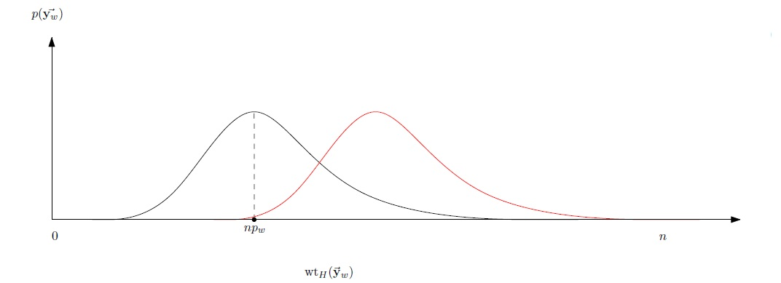
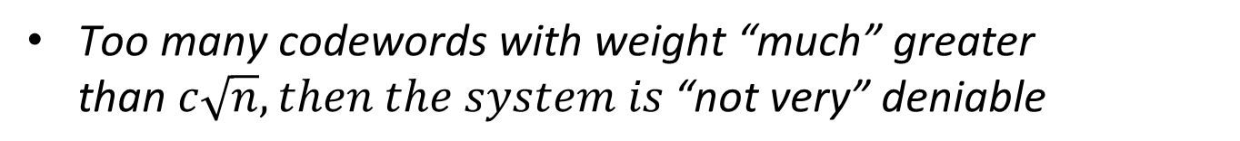
Theorem 1 (Wt(c.w.))
(high deniability => low weight codewords)
$\text{Too} \text{many} \text{codewords} \text{with} \text{weight}\text{ “}\text{much}\text{” }\text{greater} \text{than} c\sqrt{n}, then the system is \text{“}\text{not} \text{very}\text{”} \text{deniable}$

Slide 24
Theorems 2 & 3
(Converse & achievability for reliable & deniable comm.)

Slide 25


Theorems 2 & 3
$$p_{w}$$
1/2
p_{b}>p_{w}
0
1/2
$$p_{b}$$

Slide 26

Theorems 2 & 3
$$p_{w}$$
1/2
$$N=0$$
(Symmetrizability)
0
1/2
$$p_{b}$$

Slide 27
Theorems 2 & 3
$$p_{w}$$
p_{w}=1/2
1/2
0
1/2
$$p_{b}$$

Slide 28
Theorems 2 & 3
$$p_{w}$$
1/2
(BSC(p_{b}))
0
1/2
$$p_{b}$$

Slide 29
Theorems 2 & 3
$$p_{w}$$
1/2
p_{b}=0
0
1/2
$$p_{b}$$

Slide 30
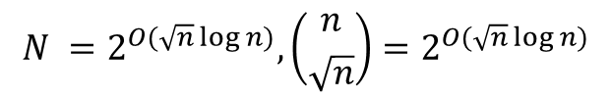
Theorems 2 & 3
$$p_{w}$$
$$N =2^{O(\sqrt{n}\log{n})}, \left({n \atop \sqrt{n}}\right)=2^{O(\sqrt{n}\log{n})}$$
1/2
0
1/2
$$p_{b}$$

Slide 31
Theorems 2 & 3
$$p_{w}$$
1/2
p_{w}>p_{b}
0
1/2
$$p_{b}$$

Slide 32

Theorems 2 & 3
$$p_{w}$$
$$N =2^{O(\sqrt{n})}$$
1/2
“Standard” IT inequalities
+
Wt(“most codewords”)<√n
(Thm 1)
0
1/2
$$p_{b}$$

Slide 33
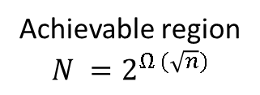
Theorems 2 & 3
$$p_{w}$$
1/2
Main thm:
0
1/2
$$p_{b}$$

Slide 34

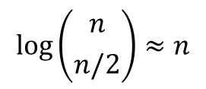
$$\log\left({n \atop n/2}\right)≈n$$
logarithm of
# codewords
0
n
$$wt_{H}({\overset{⃑}{y}}_{w})$$

Slide 35




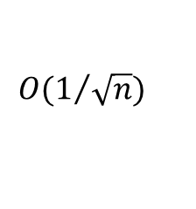



log(# codewords)
$$nH(p_{w})$$
$$\overset{⃑}{x}=\vec{0}$$
$$\underset{{\overset{⃑}{Z}}_{w}}{Pr}⁡(wt_{H}\left({\overset{⃑}{y}}_{w}\right))$$
$$O(1/{\sqrt{n}})$$
0
$$p_{w}n$$
$$p_{w}n+O(\sqrt{n})$$
n
$$wt_{H}({\overset{⃑}{y}}_{w})$$
$$p_{w}n−O(\sqrt{n})$$

Slide 36






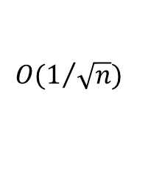
log(# codewords)
$$nH(p_{w}∗ρ)$$
$$\underset{M,{\overset{⃑}{Z}}_{w}}{Pr}⁡(wt_{H}\left({\overset{⃑}{y}}_{w}\right))$$
$$c\sqrt{n}$$
$$O(1/{\sqrt{n}})$$
0
n
$$wt_{H}({\overset{⃑}{y}}_{w})$$
$${(p}_{w}∗ρ)n−O(\sqrt{n})$$
$${(p}_{w}∗ρ)n$$
$${(p}_{w}∗ρ)n+O(\sqrt{n})$$

Slide 37
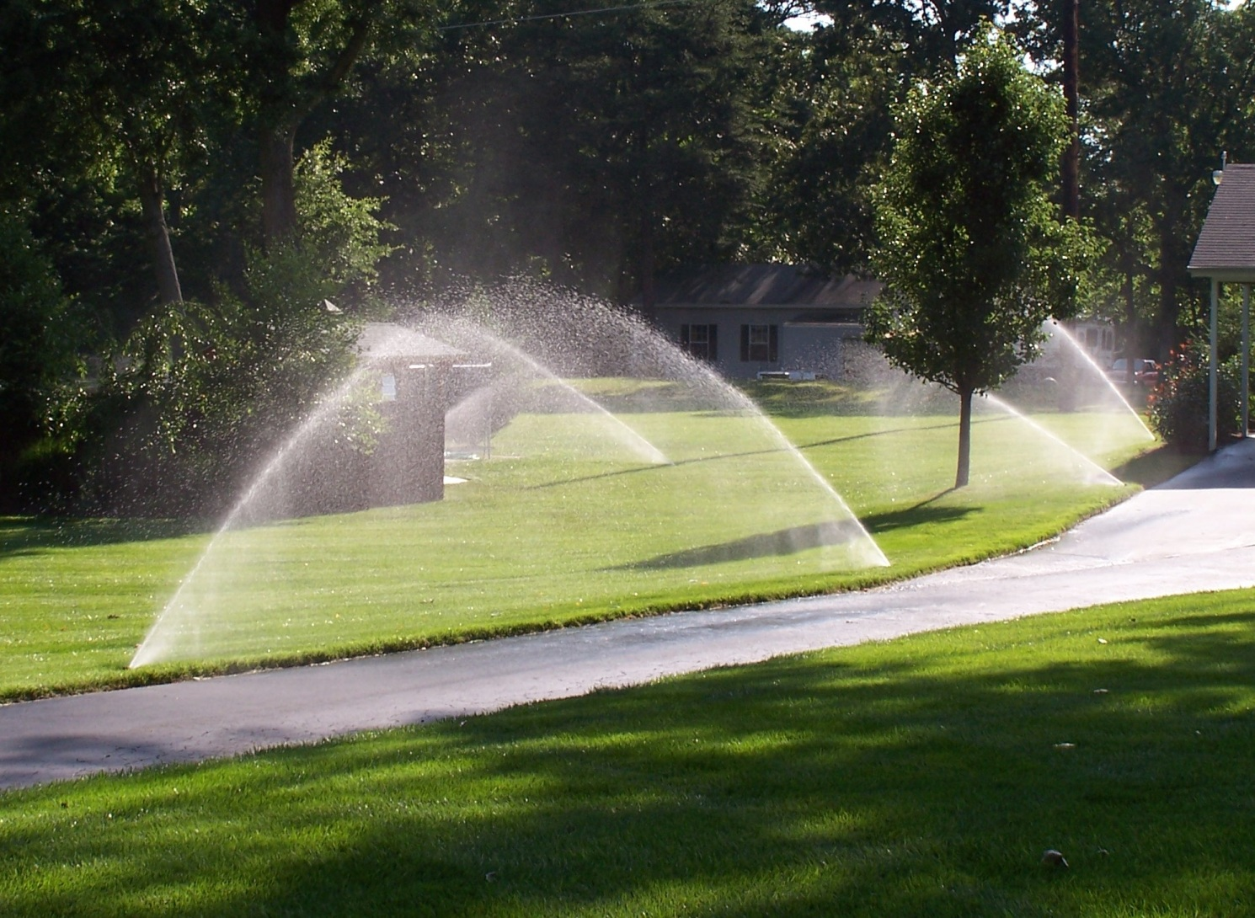

Slide 38
Theorem 3 – Reliability proof sketch
0
n
Noise magnitude >> Codeword weight!!!

Slide 39
Theorem 3 – Reliability proof sketch
Random code
Weight O(√n)
1000001000000000100100000010000000100
0001000000100000010000000010000000001
0010000100000001010010000000100010011
.
.
.
2^{O(√n)} codewords
0000100000010000000000010000000010000

Slide 40
Theorem 3 – Reliability proof sketch
Weight O(√n)
E(Intersection of 2 codewords) = O(1)
1000001000010000100100000010000000100
Pr(d_{min}(x) < c√n) < 2^{-O(√n)}
0001000000100000010000000010000000001
“Most” codewords “well-isolated”
0010000100000001010010000000100010011
.
.
.
0000100000010000000000010000000010000

Slide 41

Theorem 3 – d_{min} decoding
x
+
O(√n)
x’
Pr(x decoded to x’) < 2^{-O(√n)}

Slide 42

Theorem 3 – Deniability proof sketch
Recall: want to show $V\left(P_{0},P_{1}\right)<ε$

Slide 43
Theorem 4 – unexpected detour
logarithm of
# codewords
0
n
$$wt_{H}({\overset{⃑}{y}}_{w})$$

Slide 44
Theorem 4 – unexpected detour
Too few codewords
=> Not deniable
logarithm of
# codewords
0
n
$$wt_{H}({\overset{⃑}{y}}_{w})$$

Slide 45
log(# codewords)
$$nH(p_{w}∗ρ)$$
$$\underset{M,{\overset{⃑}{Z}}_{w}}{Pr}⁡(wt_{H}\left({\overset{⃑}{y}}_{w}\right))$$
$$c\sqrt{n}$$
$$O(1/{\sqrt{n}})$$
0
n
$$wt_{H}({\overset{⃑}{y}}_{w})$$
$${(p}_{w}∗ρ)n−O(\sqrt{n})$$
$${(p}_{w}∗ρ)n$$
$${(p}_{w}∗ρ)n+O(\sqrt{n})$$

Slide 46
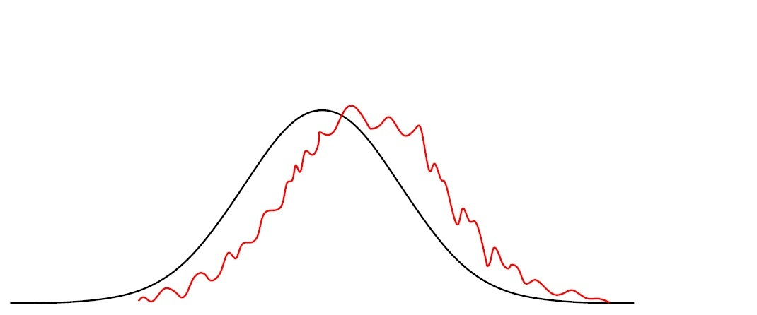



Theorem 3 – Deniability proof sketch
Recall: want to show $V\left(P_{0},P_{1}\right)<ε$
$$P_{0}$$
$$P_{1}$$

Slide 47
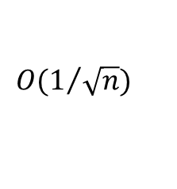






Theorem 3 – Deniability proof sketch
log(# codewords)
$$nH(p_{w})$$
0
n
$$\underset{C,{\overset{⃑}{Z}}_{w} }{Pr}⁡(wt_{H}\left({\overset{⃑}{y}}_{w}\right))$$
$$O(1/{\sqrt{n}})$$
$$wt_{H}({\overset{⃑}{y}}_{w})$$
$${(p}_{w}∗ρ)n−O(\sqrt{n})$$
$${(p}_{w}∗ρ)n$$
$${(p}_{w}∗ρ)n+O(\sqrt{n})$$

Slide 48
Theorem 3 – Deniability proof sketch
logarithm of
# codewords
0
n
$$wt_{H}({\overset{⃑}{y}}_{w})$$

Slide 49
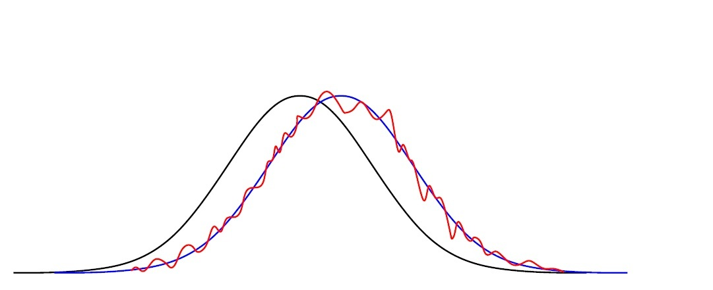
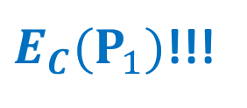
Theorem 3 – Deniability proof sketch
${E_{C}(P}_{1})$!!!
$$P_{0}$$
$$P_{1}$$

Slide 50

Theorem 3 – Deniability proof sketch
$V\left(P_{0},P_{1}\right)≤V\left(P_{0},{E_{C}(P}_{1})\right)+V\left({E_{C}(P}_{1}),P_{1}\right)$
${E_{C}(P}_{1})$!!!
$$P_{0}$$
$$P_{1}$$

Slide 51
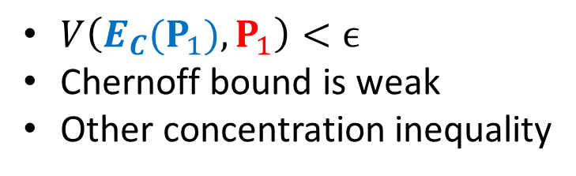
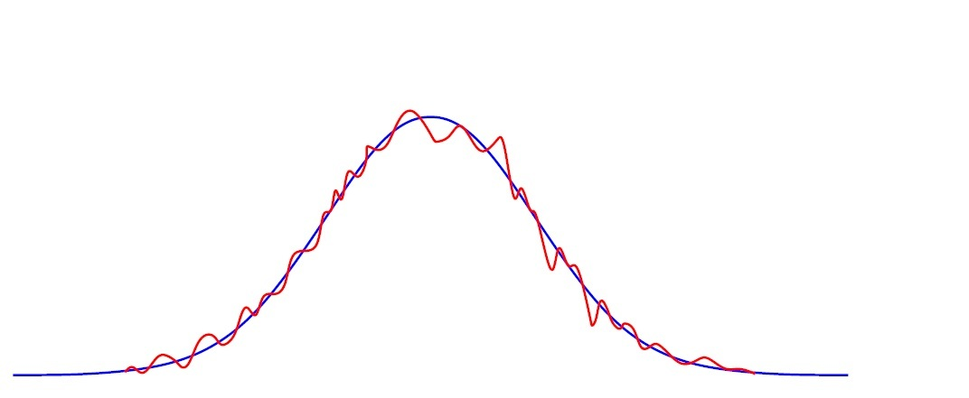

Theorem 3 – Deniability proof sketch
$${E_{C}(P}_{1})$$
$$P_{1}$$

Slide 52



Theorem 3 – Deniability proof sketch
logarithm of
# codewords
0
$$p_{w}n$$
$$p_{w}n+O(\sqrt{n})$$
n
$$wt_{H}({\overset{⃑}{y}}_{w})$$
$$p_{w}n−O(\sqrt{n})$$

Slide 53



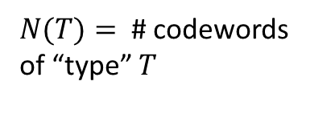
Theorem 3 – Deniability proof sketch
$$T_{1}$$
$$T_{3}$$
$$T_{2}$$
$N(T)=$ # codewords of “type” $T$

Slide 54

Theorem 3 – Deniability proof sketch
$p\left(\overset{⃑}{y}\right)=\sum_{\overset{⃑}{x}∈C}{p\left(\overset{⃑}{y} | \overset{⃑}{x}\right)p(\overset{⃑}{x})}$

Slide 55

Theorem 3 – Deniability proof sketch
$p\left(\overset{⃑}{y}\right)=\sum_{\overset{⃑}{x}∈C}{p\left(\overset{⃑}{y} | \overset{⃑}{x}\right)p(\overset{⃑}{x})}$
$E_{C}(N(T)) =ω(n)$

Slide 57
Theorem 3 – Deniability proof sketch
$p\left(\overset{⃑}{y}\right)=\sum_{\overset{⃑}{x}∈C}{p\left(\overset{⃑}{y} | \overset{⃑}{x}\right)p(\overset{⃑}{x})}$
$E_{C}(N(T)) =ω(n)$

Slide 58
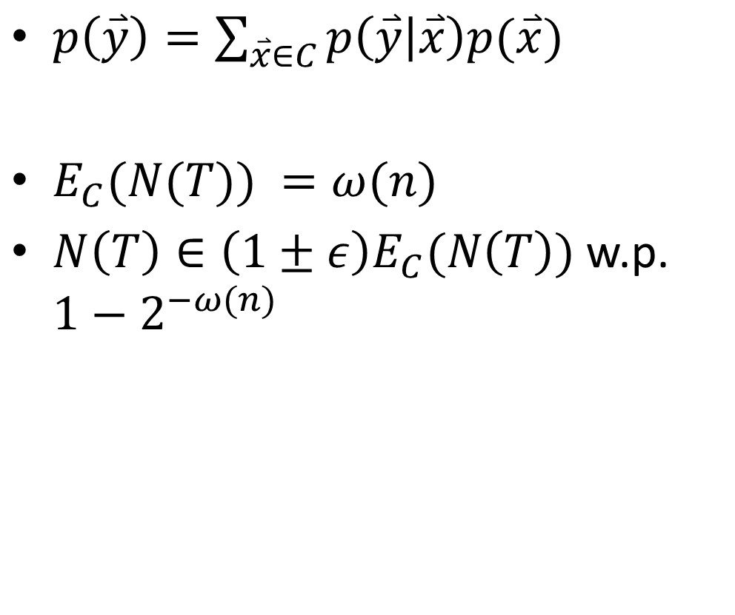
Theorem 3 – Deniability proof sketch
$p\left(\overset{⃑}{y}\right)=\sum_{\overset{⃑}{x}∈C}{p\left(\overset{⃑}{y} | \overset{⃑}{x}\right)p(\overset{⃑}{x})}$
$E_{C}(N(T)) =ω(n)$
$N\left(T\right)∈\left(1±ε\right)E_{C}(N\left(T\right))$ w.p. $1−2^{−ω(n)}$

Slide 59
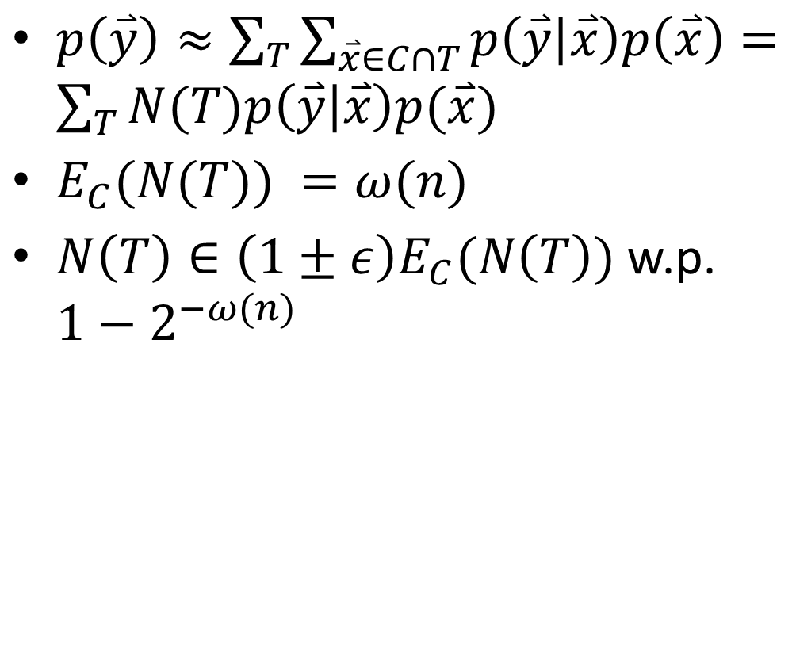
Theorem 3 – Deniability proof sketch
$p\left(\overset{⃑}{y}\right)≈\sum_{T}{\sum_{\overset{⃑}{x}∈C∩T}{p\left(\overset{⃑}{y} | \overset{⃑}{x}\right)p\left(\overset{⃑}{x}\right)}}=\sum_{T}{N(T)p\left(\overset{⃑}{y} | \overset{⃑}{x}\right)p(\overset{⃑}{x}) }$
$E_{C}(N(T)) =ω(n)$
$N\left(T\right)∈\left(1±ε\right)E_{C}(N\left(T\right))$ w.p. $1−2^{−ω(n)}$

Slide 60
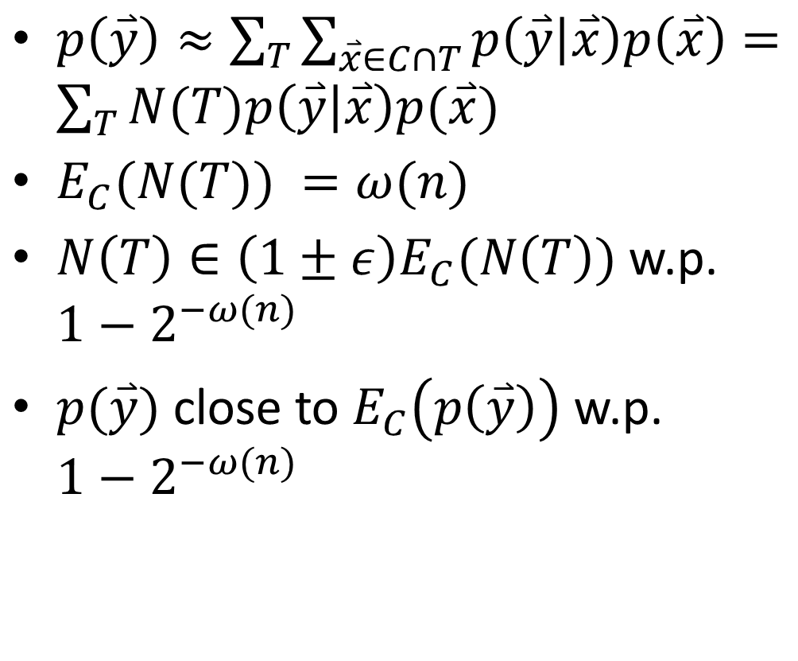
Theorem 3 – Deniability proof sketch
$p\left(\overset{⃑}{y}\right)≈\sum_{T}{\sum_{\overset{⃑}{x}∈C∩T}{p\left(\overset{⃑}{y} | \overset{⃑}{x}\right)p\left(\overset{⃑}{x}\right)}}=\sum_{T}{N(T)p\left(\overset{⃑}{y} | \overset{⃑}{x}\right)p(\overset{⃑}{x}) }$
$E_{C}(N(T)) =ω(n)$
$N\left(T\right)∈\left(1±ε\right)E_{C}(N\left(T\right))$ w.p. $1−2^{−ω(n)}$
$p(\overset{⃑}{y})$ close to $E_{C}\left(p\left(\overset{⃑}{y}\right)\right)$ w.p. $1−2^{−ω(n)}$

Slide 61
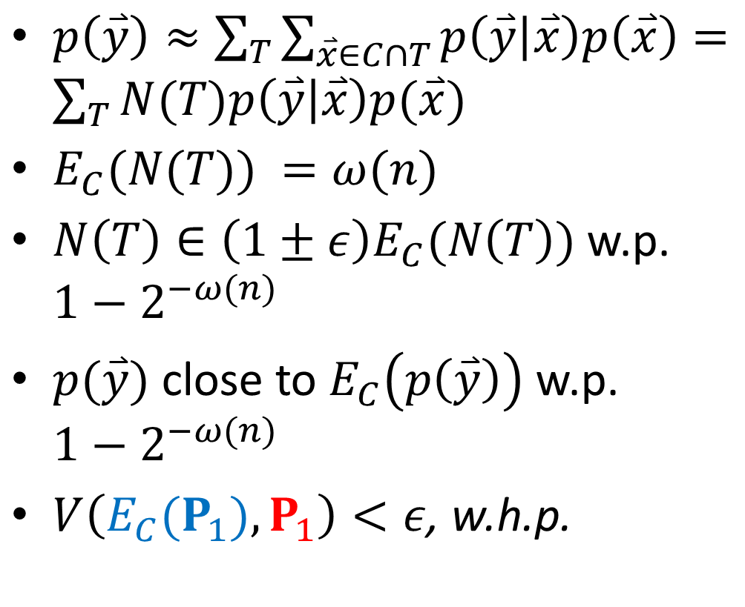
Theorem 3 – Deniability proof sketch
$p\left(\overset{⃑}{y}\right)≈\sum_{T}{\sum_{\overset{⃑}{x}∈C∩T}{p\left(\overset{⃑}{y} | \overset{⃑}{x}\right)p\left(\overset{⃑}{x}\right)}}=\sum_{T}{N(T)p\left(\overset{⃑}{y} | \overset{⃑}{x}\right)p(\overset{⃑}{x}) }$
$E_{C}(N(T)) =ω(n)$
$N\left(T\right)∈\left(1±ε\right)E_{C}(N\left(T\right))$ w.p. $1−2^{−ω(n)}$
$p(\overset{⃑}{y})$ close to $E_{C}\left(p\left(\overset{⃑}{y}\right)\right)$ w.p. $1−2^{−ω(n)}$
$V\left({E_{C}(P}_{1}),P_{1}\right)<ε$, w.h.p.

Slide 62

Summary

Slide 63

Summary
$$p_{w}$$
1/2
0
1/2
$$p_{b}$$

