Slide 1


Game-theoretic Resource Allocation Methods for D2D Communication
Lingyang Song* and Zhu Han⁺
* School of Electronics Engineering and Computer Science,
Peking University, Beijing, China
⁺ Department of Electrical and Computer Engineering
University of Houston, Houston, TX, USA
Tutorial Presentation at Globecom’13, Atlanta, US
Slides available at :
http://wireless.egr.uh.edu/research.htm

Slide 2
Table of Content
Overview
Resource Allocation and Game Theoretical Study
Conclusions

Slide 3
Table of Content
Overview
  Background
  Device-to-device Direct Communication
  Device-to-device Local Area Networks
Resource Allocation and Game Theoretical Study
Conclusions

Slide 4
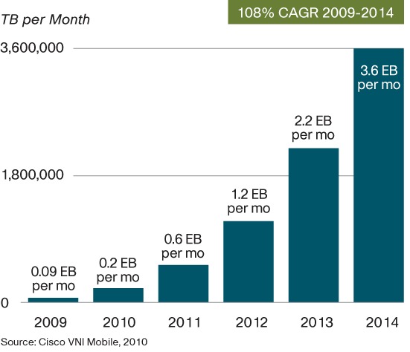
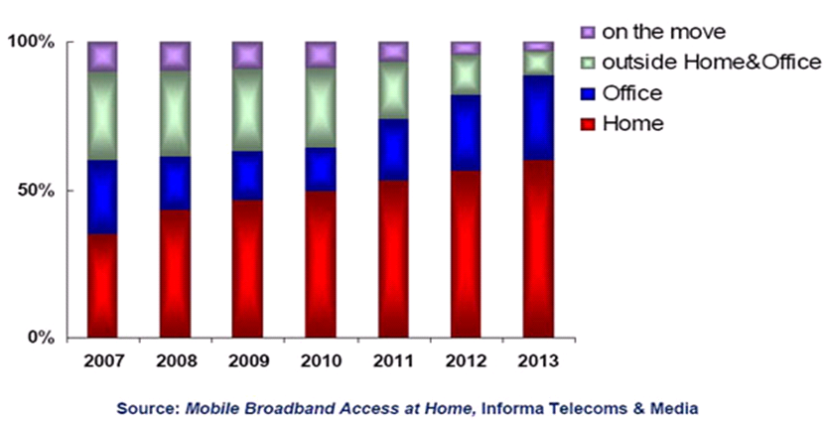
Future Wireless Challenges
Mobile Internet and Smart Phones
  Bandwidth and data traffic boost (Cisco)
    Data traffic increases 2 times/per year, 1000 times by 2020
    Wireless network cannot support that!
  Information aggregate to hotspot and local area
    70% in office and hotspot, over 90% in future
    Hotspot QoS cannot be guaranteed!
  Bandwidth demand over 1200MHz，ITU assignment less than 600MHz

Slide 5
Possible Solutions
Add fixed AP
Combine Cellular and Ad-hoc
Cell Capacity
Ad-hoc opti-mal rate
By “Shannon Theory”，network capacity relies on bandwidth and APs
Current：Add fixed APs
Sum rates
Number of UE
P. Gupta and P. Kumar, “The capacity of wireless networks,” IEEE Transactions on Information Theory, vol. 46, no. 2, pp. 388-404, Mar. 2000.

Slide 6






Definition and Benefits
Definition of Device-to-Device (D2D) Communications
  D2D communications commonly refer to the technologies that enable devices to communicate directly without an infrastructure of access points or base stations.
Increase network capacity
Extend coverage
Offload data
Improve energy efficiency
Create new applications
eNB
eNB

Slide 7
Table of Content
Overview
  Background
  Device-to-device direct Communication
  Device-to-device Local Area Networks
Resource Allocation and Game Theoretical Study
Conclusions

Slide 8

Device-to-Device Communications
Peer-to-peer Communications
Cooperative Communications
  Cooperative Mobile as Relay
  Cooperative Diversity
Wireless Network Coding
eNB
NB
NB
A
B
C

Slide 9


Deployment Roadmap
Cellular unaware D2D
Cellular network is not aware of D2D
2 RATs, e.g. 3G + Wifi
No cooperation between cellular and D2D
Cellular aware D2D
Cellular network is aware of D2D
2 RATs, e.g. LTE + Wifi
Kind of cooperation between cellular and D2D
Cellular controlled D2D
Cellular network fully controls D2D
A single RAT, e.g. LTE-A
D2D is a part of cellular communication
RAT1
RAT1
RATs converging
RAT1
flow1
flow1
flow1
flow2
RAT2
UE2
RAT2
flow2
UE2
flow2
UE2
UE1
UE1
UE1
Scenario A
Scenario B
Scenario C
D2D Benefits Scenario A Scenario B Scenario C
Traffic offload
Unified & Simplified comm.
User experience improvement
Cellular capacity enhancement

Slide 10
Table of Content
Overview
  Background
  Device-to-device Direct Communication
  Device-to-device Local Area Networks
Game Theoretical Study
Conclusions

Slide 11
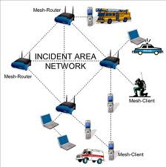
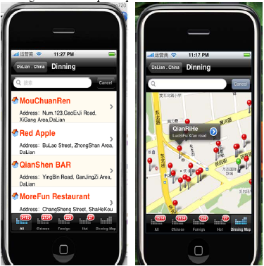
Introduction
RAT | Solution | Benefits | Frequency | Disadvantages
Wireless Mesh | WLAN + Ad Hoc | Flexible | Un-authorized | QoS in-guaranteed
D2D LAN | Cellular +Ad Hoc | Flexible | Authorized | QoS guaranteed
Smart-phones and data-service based mobile internet
eNB
eNB
D2D LAN
UEs can be connected in an Ad-hoc way and use cellular frequency with guaranteed QoS
Create new services for operators and vendors
Expand to many other areas
Wireless Mesh
Mobile social networks:
Mobile + social
Connected via mobiles
Information push, sharing, etc
New business model

Slide 12
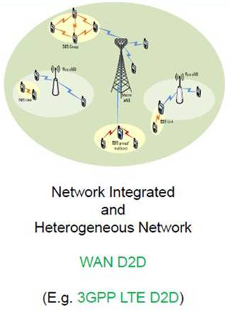
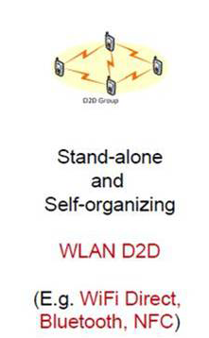
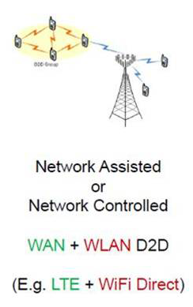
D2D LAN Roadmap
Source：Intel

Slide 13
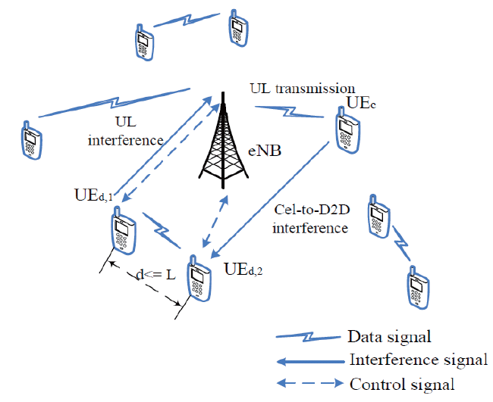
Two Basic System Models
MME
S-GW
CN
Cellular
D2D LAN

Slide 14
Table of Content
Overview
  Background
  Device-to-device Direct Communication
  Device-to-device Local Area Networks
Resource Allocation and Game Theoretical Study
  Introduction
Conclusions

Slide 15
Spectrum Sharing
Spectrum sharing as an overlay:
  The D2D users occupies the vacant cellular spectrum for communication.
  This approach that completely eliminates cross-layer interference is to divide the licensed spectrum into two parts (orthogonal channel assignment).
  This way, a fraction of the subchannels would be used by the cellular users while another fraction would be used by the D2D networks.
  Although optimal from a cross-layer interference standpoint, this approach is inefficient in terms of spectrum reuse.
Spectrum sharing as an underlay:
  This scheme allows multiple D2D users to work as an underlay with cellular users, and thus to improve the spectrum efficiency.
  Therefore, co-channel assignment of the cellular and D2D users seems more efficient and profitable for operators, although far more intricate from the technical point of view.

Slide 16
Radio Resource Management
With regards to the underlay approach, to mitigate cross- and co-layer interference, there would be a central entity in charge of intelligently telling each cell which subchannels to use.
This entity would need to collect information from the D2D users, and use it to find an optimal or a good solution within a short period of time.
The presence of large number of D2D users, and the allowance of multiple D2D users coexistence with cellular user makes the optimization problem too complex.
Latency issues arise when trying to facilitate the D2D communication with the central subchannels broker throughout the backhaul.

Slide 17
Table of Content
Overview
  Background
  Device-to-device Direct Communication
  Device-to-device Local Area Networks
Resource Allocation and Game Theoretical Study
  Game-theoretic methods for D2D-Direct
  Game-theoretic methods for D2D-LAN
Conclusions

Slide 18
Game-theoretic Methods for RRM in D2D-Direct
Given resource allocation methods, corresponding games can be applied.
Global Optimization: Optimize both cellular and D2D users
  Auction game: combinatorial auction
Local Optimization: Given the current cellular networks, optimize D2D users only
  Non-cooperative game
  Stackelberg-type game

Slide 19
Stackelberg-type Game Preliminaries
Leader-follower game
  A hierarchical game with one leader and one/multiple followers.
  The leader acts first.
  The follower observes the leader’s behavior, and decides its own strategy
Solving Stackelberg game
  The leader knows ex ante that the follower observes his action.
  The follower has no means of committing to a future non-Stackelberg follower action and the leader knows this.
  The game can be solved by backward induction.

Slide 20
Stackelberg-type Game Preliminaries
Applications in D2D Resource Allocation
  Appropriate for classes of system problems consisting of multiple criteria, multiple decision makers, decentralized information, and natural hierarchy of decision making levels.
  To study the interactions between source-destination pairs and cooperative relays.
D2D User as Buyer:
  The buyer-level game
  Aim to achieve the best security performance with the relays/jammers’ help with the least reimbursements to them.
Cellular User as Sellers:
  The seller-level game
  Aim to gains as many profits as possible.

Slide 21
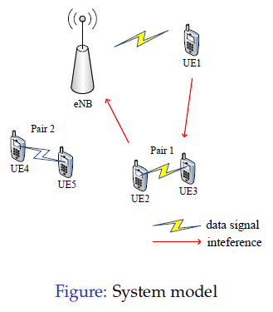
Joint Scheduling and Resource Allocation for Device-to-Device Underlay Communication
A single cell environment, uplink period
K cellular UEs occupying orthogonal channels
D D2D pairs (D > K)
Interference: Cellular to D2D, D2D to eNB
During each TTI, K D2D pairs are selected to reuse the channels, other D2Ds wait
Feiran Wang, Lingyang Song, Zhu Han, Qun Zhao, Xiaoli Wang, “Joint Scheduling and Resource Allocation for Device-to-
Device Underlay Communication,” 2013 IEEE Wireless Communications and Networking Conference (WCNC), Shanghai
China, Apr. 2013.
Notes:
D2D communication can cause serious interference to the cellular networks
Cellular and D2D communication needs elaborate coordination.
We study joint scheduling, power control and channel allocation for D2D communications

Slide 22
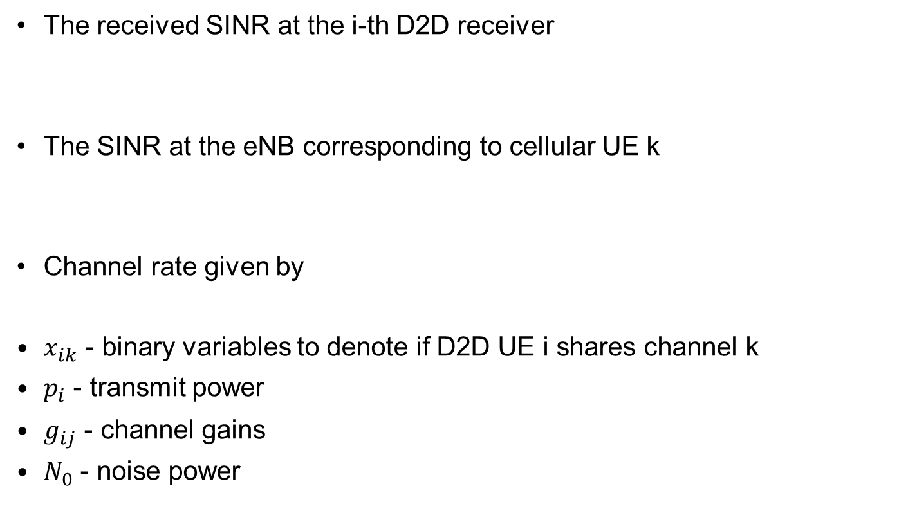
System Model
The received SINR at the i-thD2D receiver
The SINR at the eNB corresponding to cellular UE k
Channel rate given by
$x_{ik}$ - binary variables to denote if D2D UE i shares channel k
$p_{i}$ - transmit power
$g_{ij}$ - channel gains
$N_{0}$ - noise power
Notes:
Transmit power and channels of the cellular UEs assumed fixed
Focused on scheduling and resource allocation for D2D UEs
Three goals are considered
Limiting the interference from D2D to the cellular
Improving D2D throughput performance
Guaranteeing fairness among D2D UEs

Slide 23
Stackelberg-type Game - Introduction
We employ the Stackelberg game to coordinate the system.
A hierarchical game with a leader and a follower
The leader acts first
The follower observes the leader’s behavior, and determines its own strategy
The leader knows ex ante that the follower will react to the leader’s strategy
Cellular UEs – leaders
D2D UEs – followers
The leader can charge the D2D UE some fees for using the channels, and has the right to decide the price.
The leader has an incentive to share the channel with the D2D UE if it is profitable.
The follower can choose the optimal power to maximize its payoff.

Slide 24
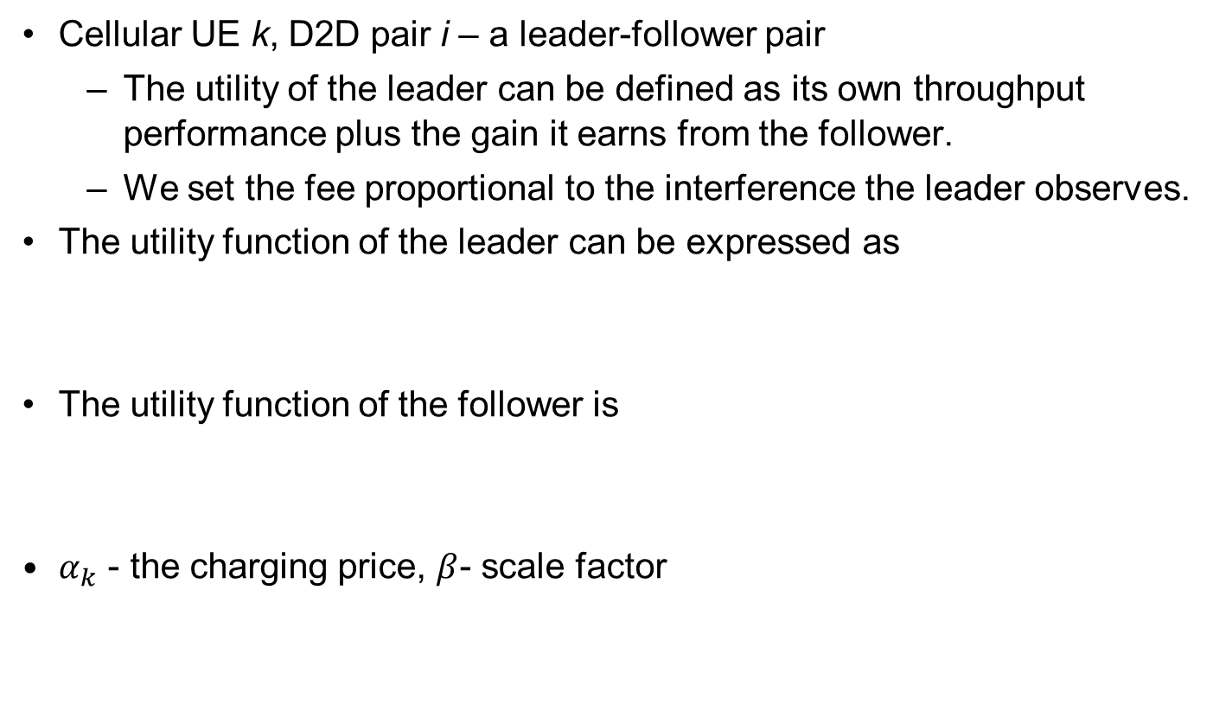
Stackelberg Game – Utility Function
Cellular UE k, D2D pair i – a leader-follower pair
  The utility of the leader can be defined as its own throughput performance plus the gain it earns from the follower.
  We set the fee proportional to the interference the leader observes.
The utility function of the leader can be expressed as
The utility function of the follower is
$α_{k}$ - the charging price, $β$- scale factor

Slide 25
Stackelberg Game – Utility Function
The optimization problem for the leader is to set a charging price that maximizes its utility, i.e.,
The optimization problem for the follower is to set proper transmit power to maximize its utility, i.e.,

Slide 26
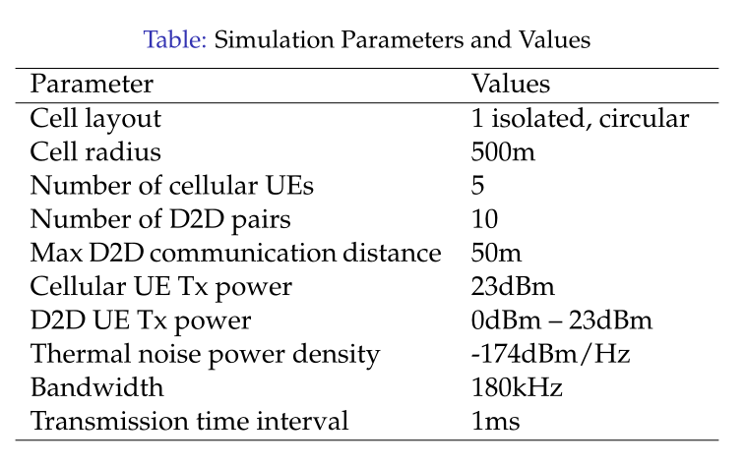
Simulation Results

Slide 27
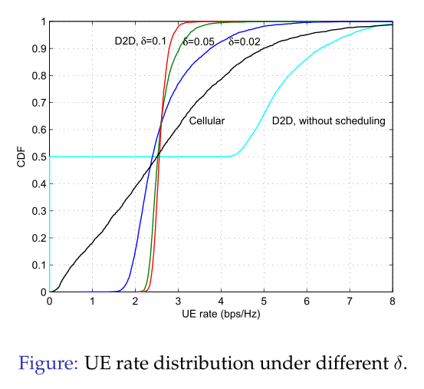
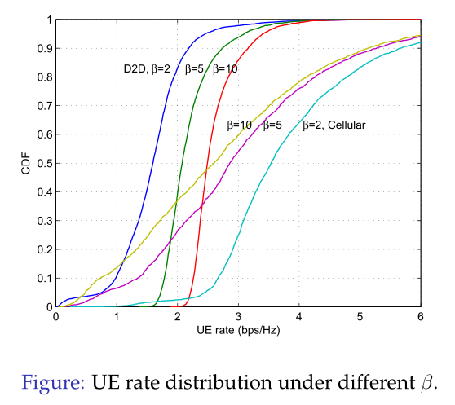
Simulation Results

Slide 28
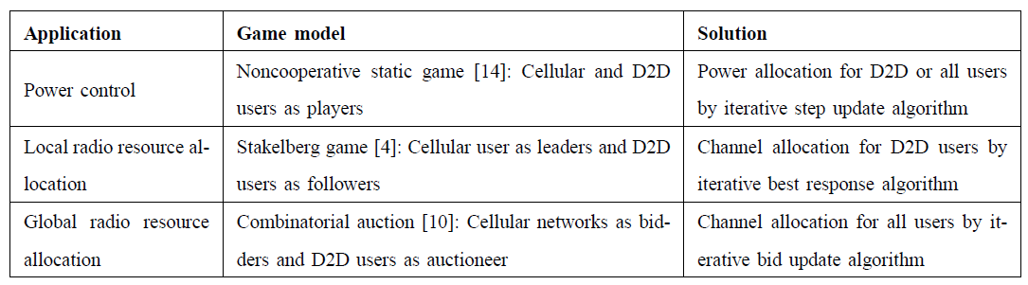
Summary for Game-theoretic RRM in D2D-Direct

Slide 29
Table of Content
Overview
  Background
  Device-to-device Direct Communication
  Device-to-device Local Area Networks
Resource Allocation and Game Theoretical Study
  Game-theoretic methods for D2D-Direct
  Game-theoretic methods for D2D-LAN
Conclusions

Slide 30
Game-theoretic Methods for RRM in D2D-LAN
For resource allocation of group communication and multi-hop relay communication in D2D LANs, cooperative game models will be more suitable.
In the non-cooperative approach, each mobile makes individual decisions, which may lead to severe interference.
With a cooperative approach, the mobiles cooperate with each other to maximize its utility function for a better network

Slide 31

Coalitional Games Preliminaries
Coalitional game (N,v)
  A set of players N, a coalition S is a group of cooperating players
  Value (utility) of a coalition v
  User payoff x_{i} : the portion received by a player i in a coalition S
Transferable utility (TU)
  The worth v(S) of a coalition S can be distributed arbitrarily among the players in a coalition hence,
  v(S) is a function over the real line
Non-transferable utility (NTU)
  The payoff that a user receives in a coalition is pre-determined, and hence the value of a coalition cannot be described by a function
  v(S) is a set of payoff vectors that the players in S can achieve

Slide 32
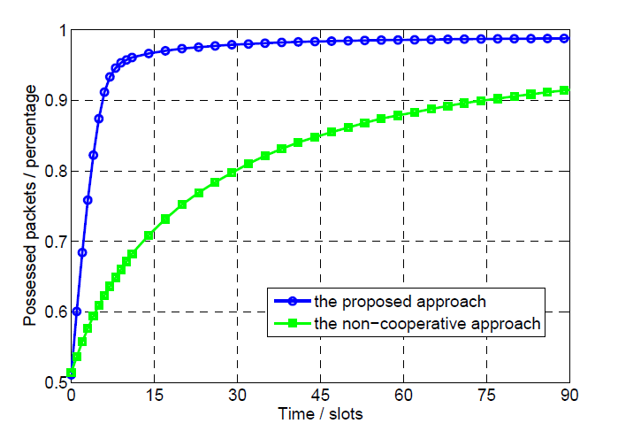
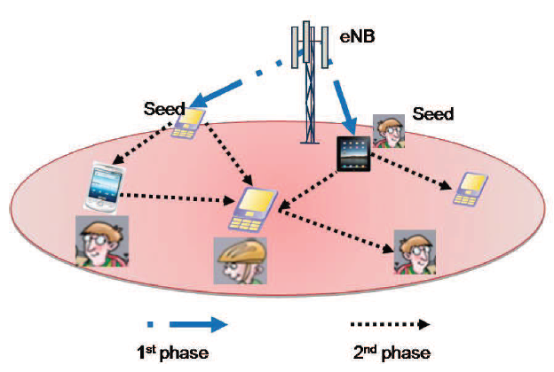
Popular content downloading in hotspot areas, such as concert and stadium networks
N users want the same file from the Internet, while only K ‘seeds’ have already downloaded it.
The rest N -K ‘normal’ UEs can ask the seeds to send the file using D2D communication.

Slide 33
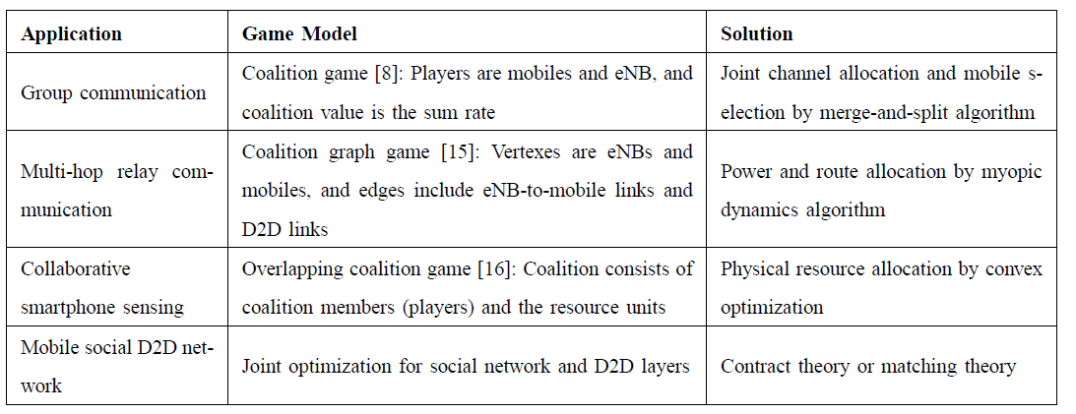
Summary for Game-theoretic RRM in D2D-LAN

Slide 34
Conclusions
D2D-Direct and D2D-LAN Communications:
  Can perform BS-controlled short-range direct data transmission for local area services;
  Can share the resources with traditional cellular communications;
  Improved network spectral efficiency;
  Enhanced local user throughput;
Game theory can be readily used:
  Non-cooperative game
  Cooperative game

Slide 35
References
Books
Chen Xu, Lingyang Song, and Zhu Han, “Resource Management for Device-to-Device Underlay Communication”, Springer Briefs in Computer Science, 2014.
Tutorial
Lingyang Song and Zhu Han, “Resource Allocation for Device-to-Device Communications,” IEEE International Conference on Communications in China (ICCC 2013), Xi’ An, Aug. 2013
Lingyang Song and Zhu Han, “Device-to-Device Communications and Networks,” IEEE Globe Communication Conference (Globecom), Atlanta, USA, Dec. 2013.
Papers
Tianyu Wang, Lingyang Song, and Zhu Han, “Coalitional Graph Games for Popular Content Distribution in Cognitive Radio VANETs,” to appear, IEEE Transactions on Vehicular Technologies, special issue “on Graph Theory and Its Application in Vehicular Networking”
Chen Xu, Lingyang Song, Zhu Han, Qun Zhao, Xiaoli Wang, and Bingli Jiao, “Efficient Resource Allocation for Device-to-Device Underlaying Networks using Combinatorial Auction”, to appear, IEEE Journal on Selected Areas in Communications, special issue “on Peer-to-Peer Networks”
Tianyu Wang, Lingyang Song, Zhu Han, and Bingli Jiao “Popular Content Distribution in CR-VANETs with Joint Spectrum Sensing and Channel Access” to appear, IEEE Journal on Selected Areas in Communications, special issue “on Emerging Technologies”

Slide 36
References
Feiran Wang, Chen Xu, Lingyang Song, Qun Zhao, Xiaoli Wang, and Zhu Han, “Energy-Aware Resource Allocation for Device-to-Device Underlay Communication," IEEE International Conference on Communications, Budapest, Hungary, June 2013.
Rongqing Zhang, Lingyang Song, Zhu Han, Xiang Cheng, and Bingli Jiao, “Distributed Resource Allocation for Device-to-Device Communications Underlaying Cellular Networks," IEEE International Conference on Communications, Budapest, Hungary, June 2013.
Feiran Wang, Lingyang Song, Zhu Han, Qun Zhao, Xiaoli Wang, “Joint Scheduling and Resource Allocation for Device-to-Device Underlay Communication,” 2013 IEEE Wireless Communications and Networking Conference (WCNC), Shanghai China, Apr. 2013.
Feiran Wang, Chen Xu, Lingyang Song, Zhu Han, and Baoxian Zhang, “Energy-Efficient Radio Resource and Power Allocation for Device-to-Device Communication Underlaying Cellular Networks,” The IEEE International Conference on Wireless Communications and Signal Processing (WCSP), Anwei,China, Otc. 25 - 27, 2012.
Chen Xu, Lingyang Song, Zhu Han, Dou Li, and Bingli Jiao, “Resource Allocation Using A Reverse Iterative Combinatorial Auction for Device-to-Device Underlay Cellular Networks,” IEEE Globe Communication Conference (Globecom), Los Angels, USA, Dec. 2012.
Chen Xu, Lingyang Song, Zhu Han, Qun Zhao, Xiaoli Wang, and Bingli Jiao, “Interference-Aware Resource Allocation for Device-to-Device Communications as an Underlay Using Sequential Second Price Auction," IEEE International Conference on Communications (ICC), Ottawa, Canada, Jun. 2012.
Yanru Zhang, Lingyang Song, Walid Saad, Zaher Dawy, and Zhu Han, “Exploring Social Ties for Enhanced Device-to-Device Communications in Wireless Networks,” IEEE Globe Communication Conference (Globecom), Atlanta, USA, Dec. 2013.

Slide 37
Thanks for your attention!

