Slide 1
frameless ALOHA: analysis of the physical layer effects
Petar Popovski
Cedomir Stefanovic, Miyu Momoda
Aalborg University
Denmark

Slide 2
outline
intro: massive M2M communication
frameless ALOHA
  random access based on rateless codes
  noise and capture
summary

Slide 3
the shape of wireless to come
R1: today’s systems
R2: high-speed versions of today’s systems
R3: massive access for sensors and machines
R4: ultra-reliable connectivity
R5: physically impossible
data rate
Gbps
≥99%
R2
R5
Mbps
≥99%
≥95%
R1
kbps
≥99.999%
R4
≥90-99%
R3
bps
1
10
100
1000
10000
# devices

Slide 4
massive M2M
it will be billions, but how many?
  Ericsson figure is pointing to 50 billions
  others are less ambitious
massive variation in the requirements
  traffic burstiness/regularity
    smart meter vs. event-driven surveillance camera
  data chunk size
    single sensor reading vs. image
  dependability requirements
    emergency data vs. regular update

Slide 5
defining massive M2M the total number of managed connections to individual devices is much larger than the average number of active connections within a short service period

Slide 6
access protocols for massive M2M
massive M2M setup emulates
the original analytical setup for ALOHA
  infinite population,
  maximal uncertainty about the set of active devices
difference occurs if the arrivals are correlated
short service period
event
…
time
…
…

Slide 7
how to make protocols for massive access
predict the activation:
  account for the relations among the devices,
  group support, traffic correlation
control the activation
  load control mechanisms
our focus:
improve the access capability of the protocols
  departure from “collision is a waste”
  put more burden on the BS

Slide 8
observations on random access
useful when
  the devices have not interacted before
  the required flexibility is above a threshold
use with caution
  in a static setup , the devices “know each other”,
  and a better strategy (learning, adaptation) can be used
signaling, waste (error, collisions)
may take a large fraction of the resources
  especially important for small data chunks

Slide 9
frameless aLOHA or rateless coded random access

Slide 10
slotted ALOHA
essentially part of all cellular standards
all collisions destructive
  only single slots contribute to throughput
memoryless randomized selection
of the retransmission instant

Slide 11
expanding ALOHA with SIC
(successive interference cancellation)
users send replicas in
several randomly chosen slots
  same number of replicas per user
  throughput 0.55 with two repetitions per user
time
slots
frame of M slots
. . .
E. Casini, R. De Gaudenzi, and O. Herrero, “Contention Resolution Diversity Slotted ALOHA (CRDSA): An Enhanced Random Access Scheme for Satellite Access Packet Networks,” Wireless Communica- tions, IEEE Transactions on, vol. 6, pp. 1408 –1419, april 2007.
N users
. . .

Slide 12
how SIC is done
each successfully decoded replica
enables canceling of other replicas
user 1
user 2
user 3
slot 1
slot 2
slot 3
slot 4
time

Slide 13
SIC and codes on graphs
new insight
  analogy with the
  codes-on-graphs
  each user selects its no. of repeated transmissions according to a predefined distribution
important differences
  left degree can be controlled to exact values,
  right degree only statistically
  right degree 0 possible (idle slot)
check nodes
. . .
. . .
variable nodes
G. Liva, “Graph-Based Analysis and Optimization of Contention Resolution Diversity Slotted ALOHA,” IEEE Trans. Commun., Feb. 2011.

Slide 14

frameless ALOHA
N users
idea: apply paradigm of rateless codes to slotted ALOHA:
  no predefined frame length
  slots are successively added until a criterion related to key performance parameters of the scheme is satisfied
M slots
. . .
. . .

Slide 15
frameless ALOHA overview
. . .
time
slots
. . .
. . .
single feedback used after M-th slot
  M not defined in advance (rateless!)
feedback when sufficient slots collected
  - for example, N_{R} < N resolved users lead
  to throughput of

Slide 16
frameless ALOHA stopping criterion
a typical run of frameless ALOHA in terms of
(1) fraction of resolved users
(2) instantaneous throughput
heuristic stopping criterion:
fraction of resolved users
genie-aided stopping criterion:
stop when T is maximal

Slide 17
analogy with the rateless codes
structural
  selection of transmission probabilities
operational
  stopping criterion based on target performance
controlling of the degree distribution
  in the simplest case all the users have the same
  transmission probability

Slide 18
errorless case
all users transmit with the same probability distribution
  no channel-induced errors
slot access probability
β is the average slot degree
objective:
maximize throughput by selecting β and
designing the termination criterion

Slide 19
asymptotic analysis
probability of user resolution P_{R}
when the number of users N goes to infinity
M is the number of elapsed slots
asymptotic throughput

Slide 20
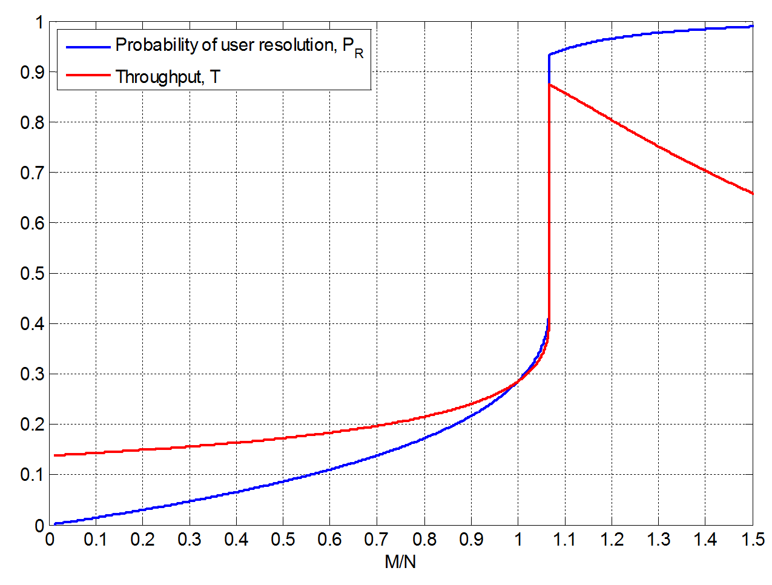
result of the AND-OR analysis

Slide 21
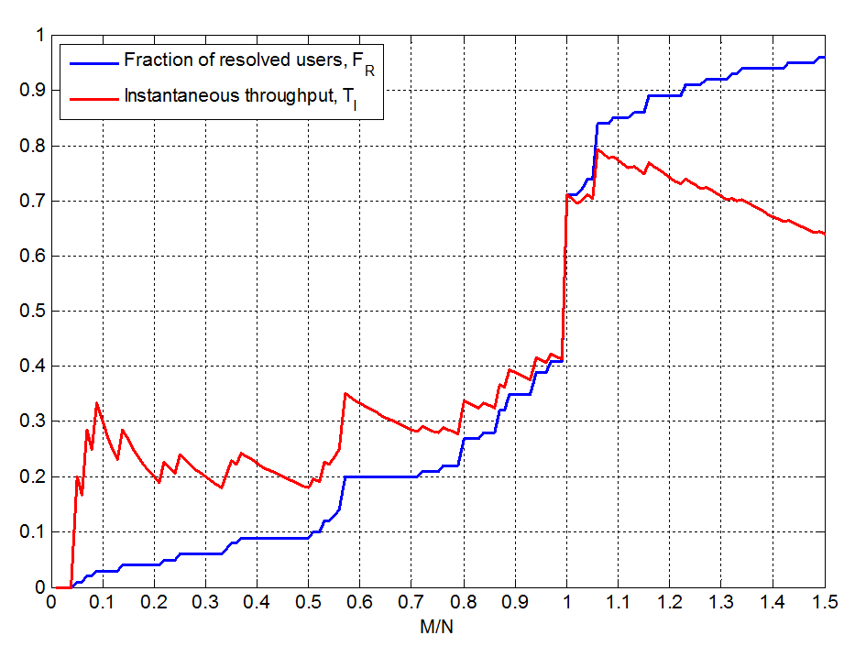
non-asymptotic behavior

Slide 22
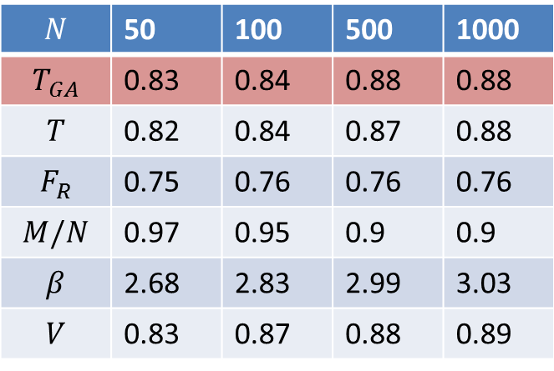
termination and throughput
simple termination:
stop the contention
if either is true
F_{R}≥V or T=1
genie-aided (GA)
termination
 | 50 | 100 | 500 | 1000
 | 0.83 | 0.84 | 0.88 | 0.88
 | 0.82 | 0.84 | 0.87 | 0.88
 | 0.75 | 0.76 | 0.76 | 0.76
 | 0.97 | 0.95 | 0.9 | 0.9
 | 2.68 | 2.83 | 2.99 | 3.03
 | 0.83 | 0.87 | 0.88 | 0.89
the highest reported throughput
for a practical (low to moderate) no. of users

Slide 23
average delay
the rateless structure provides an elegant framework
to compute the average delay of the resolved users
average delay as a function of
the total number of contention slots M
  the probability that a user is resolved after m slots is p(m)

Slide 24
average delay example
slot access probability
  optimized for throughput maximization
asymptotic analysis
observations
  average delay shifted towards the end of the contention period
  most of the users get resolved close to the end
  typical for the iterative belief-propagation
  NB: we have not optimized the protocol for
  delay minimization
p(M) | T | M/N | D(M)/N
0.928193 | 0.874474 | 1.06145 | 0.928031

Slide 25
noise –induced errors
plug in the noise
the link of each individual user has a different SNR
received signal in a slot
example
  if user 2 is resolved elsewhere and cancelled by SIC,
  the probability that slot j is useful is high
  situation opposite when user 1 removed by SIC,
  slot j less likely useful

Slide 26
capture effect (1)
gives rise to intra-slot SIC in addition to inter-slot SIC
typical model for the decoding process
received power of user i
capture threshold
noise power
Received power of interfering users

Slide 27
capture effect (2)
the capture effect boost the SIC
capture can occur anew after
every removal of a colliding transmission from the slot
  asymptotic analysis significantly complicated
unresolved user
resolved user
no capture effect
with capture effect

Slide 28
capture effect: example
narrowband system, valid for M2M:
Rayleigh fading
pdf of SNR for user i at the receiver
  long-term power control and
  the same expected SNR for every user

Slide 29
asymptotic analysis (1)

Slide 30
asymptotic analysis (2)
high SNR => low b/SNR
  throughput is well over 1!
  throughput decreases as the capture threshold b increases
low SNR => high b/SNR
  the achievable throughputs drop
  noise impact significant
target slot degrees are higher
compared the case without capture effect
  the capture effect favors more collisions

Slide 31
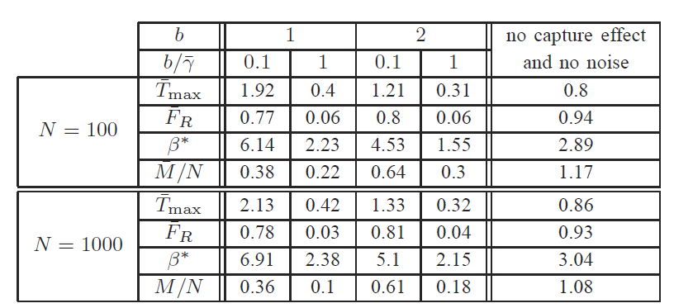
non-asymptotic results
confirm the conclusions of the asymptotic analysis

Slide 32
summary
high interest for massive access in the upcoming wireless
  M2M communication
coded random access
  addresses the fundamental obstacle of collisions in ALOHA
frameless ALOHA
  inspired by rateless codes, inter-slot SIC
  nontrivial interaction with capture and intra-slot SIC
main future steps
  finite blocklength
  reengineer and existing ALOHA protocol into coded random access

