Slide 1
Software Defined Radio - PHY and MAC Aspects
Friedrich Jondral
Shenzhen, March 6, 2014

Slide 2
Overview
Software Defined Radio (SDR)
SDR Technologies
SDR Types
Architectures for Reconfigurability, Portability and Interoperability
Cognitive Radio (CR)
CR Vision
CR Reality
Dynamic Spectrum Access

Slide 3
Tx Structure
t ∈[0, T]
cos 2πf_{c}t
1
2
3
M
I
Series/
Parallel-
Conversion
Symbol
Mapping
Impulse
Former g(t)
Information
bits b ∈{−1, 1}
s(t)
A(nT) δ(nT)
u(t)
. . .
Q
−sin 2πf_{c}t

Slide 4
Rx Structure: Super Het
(a)
(b)
(c)
RF
ZF1
ZF2
A
D
RF+ZF1
f_{s}
ZF1+ZF2+ΔF
local
oszillator
90°
system
bandwidth
channel
bandwidth
RF
ΔF
f_{s}/4
control
FIR
lowpass
FIR
lowpass
I
Q

Slide 5
Rx Structure: Direct Mixing
A
inphase component
D
RF
RF
sampling rate adaptation
π
I/Q balance
2
A
quadrature component
D
control

Slide 6
Radio Spectrum
wave length l
100 km
10 km
1 km
100 m
10 m
1 m
10 cm
1 cm
1 mm
 | Kilometer Waves | Hectometer Waves | Decameter Waves | Meter Waves | Decimeter Waves | Centimeter Waves | Millimeter Waves
Very Low Frequency VLF | Low Frequency LF | Medium Frequency MF | High Frequency HF | Very High Frequency VHF | Ultra High Frequency UHF | Super High Frequency SHF | Extremely High Frequency EHF
Ground Wave, Highest Distances | Ground Wave > 1000 km | Ground Wave > 100 km | Ground Wave ineffectual |  | Optical Propagation
Ionospheric Wave | ionospheric wave, attenuated on daytime, longer range than ionospheric wave at night | ionospheric wave usable mainly during night time | ionospheric wave for long distances; multiple reflections at ionosphere and earth surface | no ionospheric reflections, short range, frequency reuse possible | OTH- connections by diffraction („scattering") high attenuation | molecule resonances at specific frequencies high attenuation) | attenuation by rain, fog etc., still under investigation
Myriametric Wave (Under water reception possible, e.g. by submarines) | Long Wave | Medium Wave | Short Wave | Ultra Short Wave | Micro Wave Links Satellite Radio RADAR
30 kHz
300 kHz
3 MHz
30 MHz
300 MHz
3 GHz
30 GHz
300 GHz
10 kHz
100 kHz
1 MHz
10 MHz
100 MHz
1 GHz
10 GHz
100 GHz
frequency f
L-Band: 1 - 2GHz ; S-Band: 2 - 4 GHz ; C-Band: 4 – 8 GHz ; X-Band: 8 – 12,4 GHz ; Ku-Band: 12,4 – 18 GHz ; K-Band: 18 – 26,5 GHz ; Ka-Band: 26,5 – 40 GHz
Univ.-Prof. Dr.rer.nat. Friedrich Jondral

Slide 7
Multi Band Radio
3 MHz – 30 MHz
HF Tx/Rx
30 MHz – 300 MHz
VHF Tx/Rx
band selector
300 MHz – 3 GHz
to IF
UHF Tx/Rx
3 GHz – 30 GHz
SHF Tx/Rx
30 GHz – 300 GHz
EHF Tx/Rx
control

Slide 8
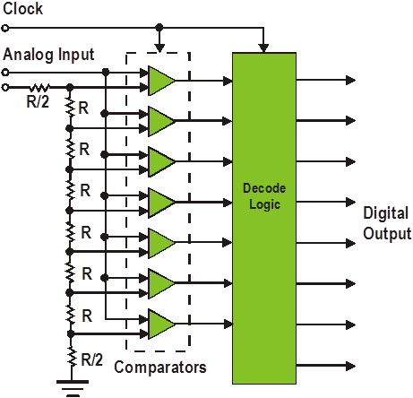
ADC Principles
multi stage
flash
Σ-Δ

Slide 9
ADC System
The signal-to-quantization noise ratio of an ADC is mainly determined by its resolution b:
Additional features that have to be considered:
Aperture jitter
Linearity
ADC has to be seen as a system with an analog input and a digital output (I/Q).

Slide 10
Walden Survey
22
20
18
slope: −1 bit/Oktave
16
14
12
nominal resolution [bit]
10
8
6
4
2
0
10⁴
10⁵
10⁶
10⁷
10⁸
10⁹
10¹⁰
10¹¹
sampling rate [Hz]
monolithically integrated ADCs, state of the art

Slide 11
Parameter Controlled SDR
receive
to user
radio
frequency
RF
ADC/DAC
baseband
processing
data
processing
transmit
from user
control

Slide 12
Parameter Controlled SDR
Every communication standard is looked at as a member of a family.
The signal processing chain is generic, i.e. identical for all standards.
A standard is characterized by a parameter set.
Special tasks are executed by hardware accelerators.
Application:
Multi standard systems, vertical handover
Advantages:
The definition of the hardware becomes easy.
Switching between standards may be very fast.
Disadvantages:
Standards must be represented in a “harmonized” manner.
Signal processing is inherently not flexible. This leads to unnecessary power consumption.
RF processing and A/D conversion may be involved.

Slide 13
Modular SDR
source
sink
formatting
deformatting
source coding
source decoding
ciphering
deciphering
channel coding
channel decoding
from other
sources
to other
sinks
multiplexing
demultiplexing
synchronization
symbol creation
detection
modulation
demodulation
spreading
despreading
oszillator
channel access
channel access
Tx frontend
Rx frontend
channel
Univ.-Prof. Dr.rer.nat. Friedrich Jondral

Slide 14
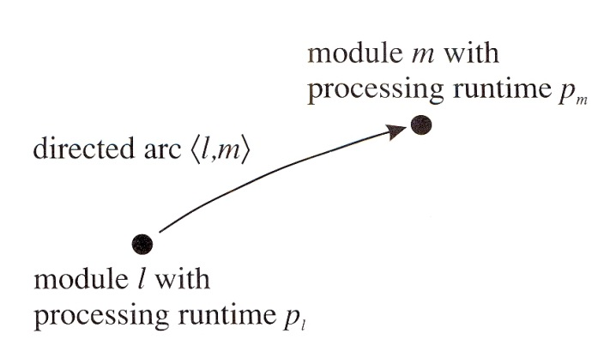
Modular SDR
The signal processing chain is represented as a directed acyclic graph that connects modules by arcs.
Interfaces between modules have to be defined completely and uniquely.
Application:
Modular SDRs may support virtually
any waveform.
Advantages:
Highest flexibility, recent developments can
be included
Largely hardware independent
Disadvantages:
Many interfaces have to be standardized.
Scheduling for processing resources becomes involved.

Slide 15
Velcro SDR
receive/transmit antenna
input/output Interface
GSM
LTE
Bluetooth
ZigBEE

Slide 16
Velcro SDR
Each standard uses its specific chip set.
The actual standard is selected via a switch.
Application:
Modular SDRs may support virtually
any waveform.
Advantages:
Highest flexibility, recent developments can
be included
Largely hardware independent
Disadvantages:
Many interfaces have to be standardized.
Scheduling for processing resources becomes involved.

Slide 17
Mobile Cellular Terminals
Network providers are not overly interested in flexibility for terminals, e.g. in terminal originated vertical handovers.
Low energy consumption is most important. Therefore, the velcro approach is preferred (my phone supports GSM, UMTS, WLAN, and GPS).
Reconfigurability (of the terminal by implementing a new standard) is not an issue.
Portabilty (of software) over different hardware platforms provided by one vendor is guaranteed by employing (vendor specific) re-usable radio architectures.
Interoperability between terminals and base stations provided by different users is guaranteed by the standard.
Repositories for waveforms are not necessary because standards are publicly available.

Slide 18
Re-useable Radio Architecture
Customer Applications
Middleware Service Platform
Network
Access
Service
Data
Communication
Services
MMI and
Multimedia
Services
Application
Platform
Services
Operation
Services
Hardware Abstraction Layer (HAL)
Product specific Hardware
General radio architecture
All platforms use the same open and stable APIs
Hardware depends on product configuration (WCDMA, EDGE, GPRS, ... )

Slide 19
SCA: SDR Reconfigurability/Portability
The same platform
can host multiple standards
with the same platform services
The same standard
can be implemented
on multiple platforms with
the same standard software
standard 1
standard 2
standard
abstraction layer API
abstraction layer API
platform
platform 1
platform 2
reconfigurability
portability

Slide 20
CR: Vision
ORIENT
Establish Priority
Infer on Context
Hierarchie
Immediate Urgent Normal
Generate
Alternatives
Evaluate
Alternatives
Pre-Process
Parse
OBSERVE
LEARN
PLAN
New
States
Register to
Current Time
Receive a Message
Read Buttons
Prior
States
DECIDE
Outside
World
Save Global States
Allocate Resources
Send a Message
Initiate Process(es)
Set Display
ACT
Joseph Mitola III: Cognitive Radio – An Integrated Agent Architecture for Software Defined Radio. KTH Stockholm, 2000

Slide 21
CR: Definition
“Cognitive Radio is an intelligent wireless communication system that is aware of its surrounding environment (i.e. its outside world), and uses the methodology of understanding-by-building to learn from the environment and adapt its internal states to statistical variations in the incoming RF stimuli by making corresponding changes in certain operating parameters (e.g. transmit power, carrier-frequency and modulation strategy) in real-time, with two primary objectives in mind:
- highly reliable communications whenever and wherever needed;
- efficient utilization of the radio spectrum.”
Simon Haykin: Cognitive Radio: Brain-Empowered Wireless Communications.
IEEE J. Select. Areas in Comm., vol. 23, no. 2, 2005, pp. 201-220

Slide 22
Reality
CR is not a revolution in radio communications, it is merely the way ahead to more automation and adaptation
in finding the optimum frequency and
in using the optimum transmission power
With these properties
higher spectrum efficiency
lower costs and
more environmental acceptability
are achieved.
The CR paradigm makes sense only in networks.

Slide 23
Dynamic Spectrum Access (DSA)
Dynamic Spectrum Access
Dynamic
Exclusiv Use Model
Open Sharing Model
(Spectrum
Commons Model)
Hierarchical
Access Model
Spectrum
Property
Rights
Dynamic
Spectrum
Allocation
Spectrum
Underlay
(Ultra Wide
Band)
Spectrum
Overlay
(Opportunistic
Spectrum
Access)
from: Qing Zhao, Brian M. Sadler: A Survey of Dynamic Spectrum Access.
IEEE Signal Processing Magazine, May 2007, pp. 79 - 89
Univ.-Prof. Dr.rer.nat. Friedrich Jondral

Slide 24
DSA: Questions
What is the meaning of “Spectrum Access”?
To enhance the efficiency in the usage of spectrum (briefly: spectral efficiency) in a specific geographic region, CRs access spectrum holes left by the licensed users’ system (primary users) as secondary users.
I.e.: Spectrum Access happens in time, frequency, and space.
What is the meaning of “Dynamic”?
Nobody knows …
On which scale is DSA based upon? Milliseconds, seconds, minutes, …? Change in primary users’ behavior?

Slide 25
Dynamic / Detection Time
high
short
Burst
Dynamic
Detection
Time
TV White Space
low
long
Univ.-Prof. Dr.rer.nat. Friedrich Jondral

Slide 26
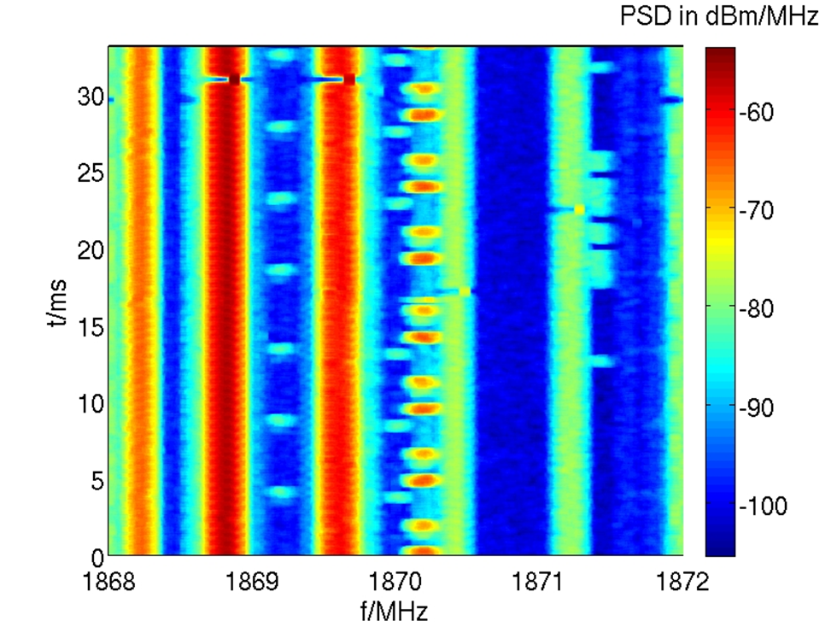
Time/Frequency Plane
GSM 1800
No. of Channels: 374
Bandwidth: ≈270 kHz
Distance: 200 kHz
Burst Duration: 0.577 ms

Slide 27
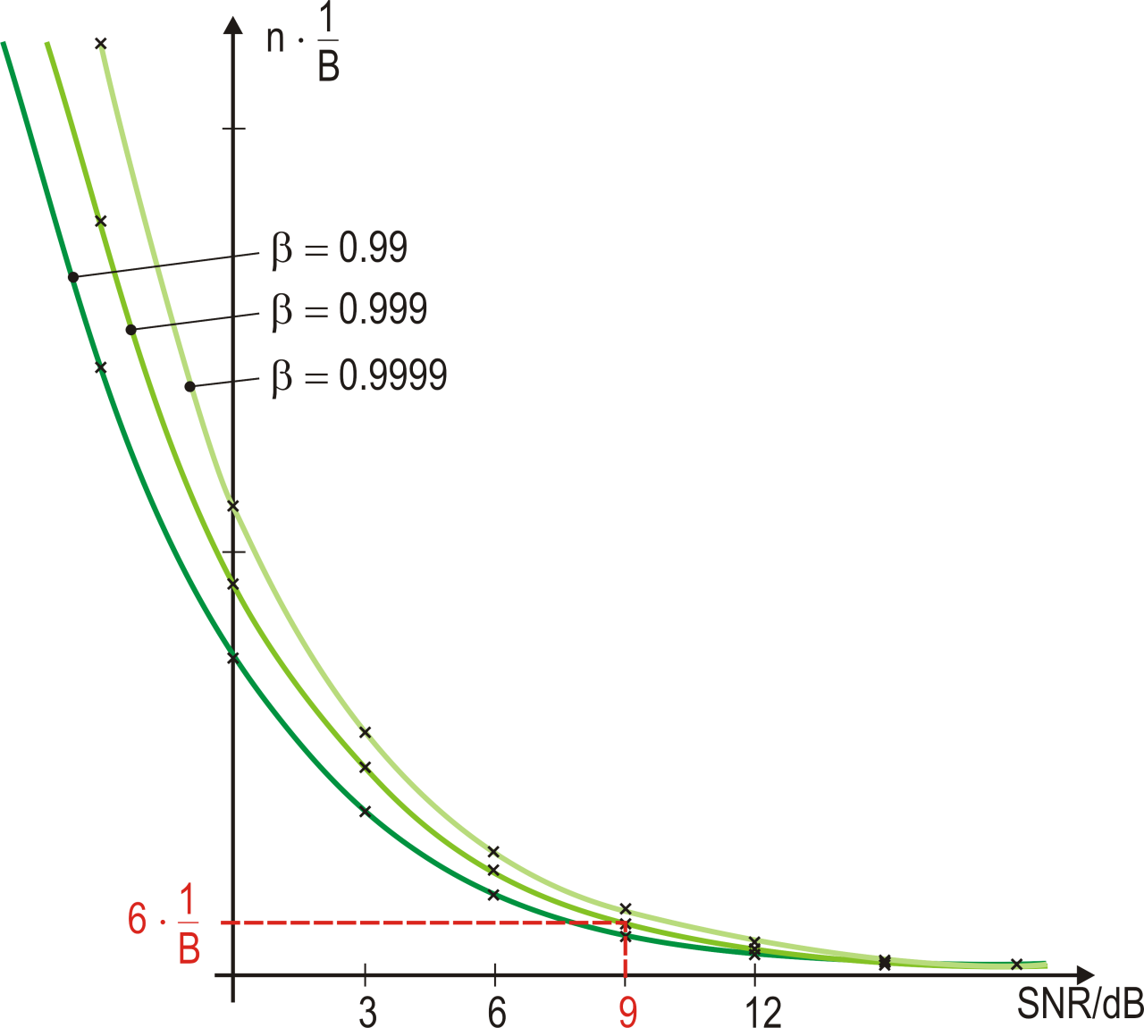
Energy Detector
β = 0.9999 | n β = 0.999 | β = 0.99 | σ² | SNR [dB]
111 | 93 | 74 | 2 | -3
56 | 47 | 37 | 1 | 0
28 | 24 | 19 | 1/2 | 3
14 | 12 | 10 | 1/4 | 6
7 | 6 | 5 | 1/8 | 9
4 | 3 | 3 | 1/16 | 12
2 | 2 | 2 | 1/32 | 15
2 | 2 | 2 | 1/32 | 15
 |  | 1 | 1/37 | 15.7
 | 1 |  | 1/47 | 16.7
1 |  |  | 1/56 | 17.5
Detection Time: AWGN
False Alarm Rate: 10⁻⁴
Detection Probability: β
(σ²: normalized noise variance)

Slide 28
Energy Detector
D = duration for one scan over the 374 channels of GSM 1800
false alarm rate: 10⁻⁴
detection probability: 0.999
SNR: 9 dB
Monitoring of the GSM band on burst basis by one scanning energy detector with false alarm rate 10⁻⁴ and detection probability 0.999 at an SNR of 9 dB is impossible!
And: What about the power needed in the mobile radio for permanent scanning and detection?
1
Bandwidth
1
270000
D = 6 x No. of Channels x = 6 x 374 x s = 8.31 ms
8.31
0.577
D = =14.4 bursts

Slide 29
Proposed Solution 1
Distributed Detection
For networks with access point:
Timo Weiß: OFDM-basiertes Spectrum Pooling. Dissertation, Forschungsberichte aus dem Institut für Nachrichtentechnik der Universität Karlsruhe (TH), Band 13, Karlsruhe 2004
For ad hoc networks:
Ulrich Berhold: Dynamic Spectrum Access Using OFDM-based Overlay Systems. Dissertation, Forschungsberichte aus dem Institut für Nachrichtentechnik der Universität Karlsruhe (TH), Band 21, Karlsruhe 2009
2 ms
MAC frame
MAC frame
MAC frame
P
detection
phase
boosting
phase
P
broadcast
phase

Slide 30
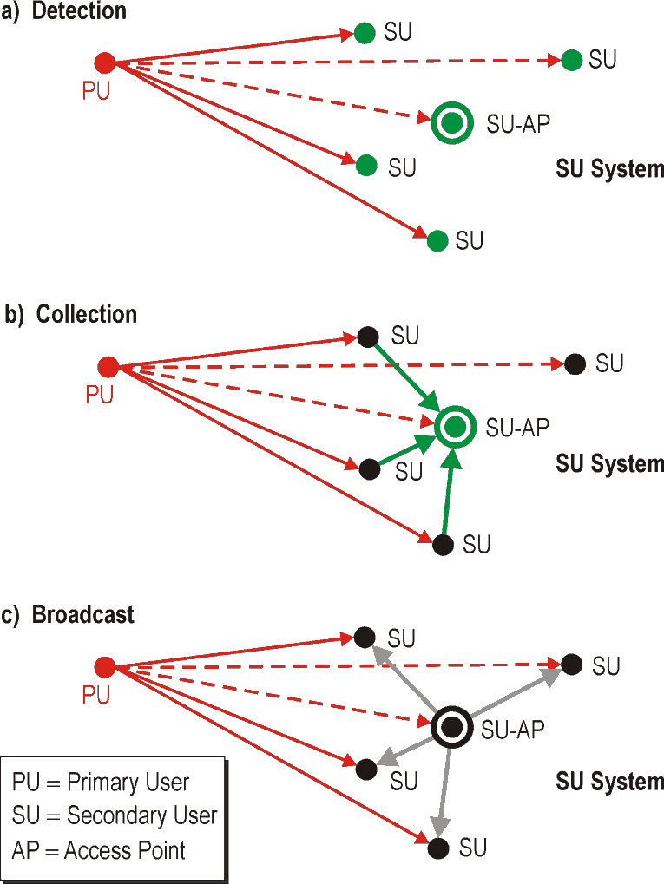
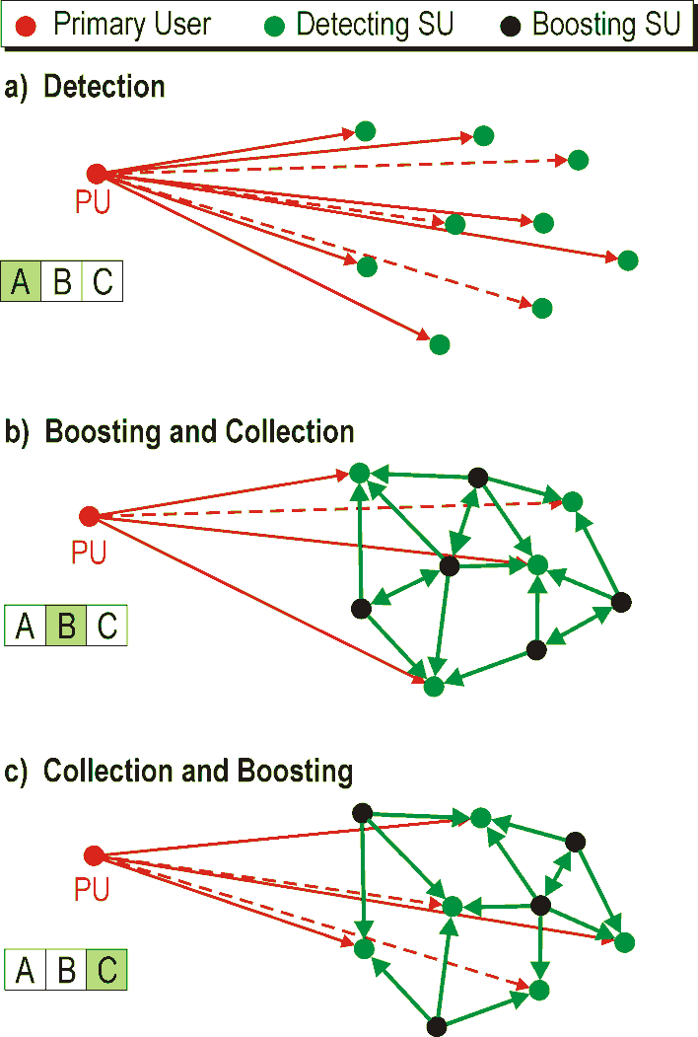
Distributed Detection and Boosting
With Access Point
Ad Hoc
b) Boosting and Collection

Slide 31
Proposed Solution 2
Off-line Sensing, Data Base Query, and Instantaneous Measurement
During idle times
The radio senses all potential transmission channels¹⁾
The sensing results for each channel, together with the time of the day when the sensing took place, are stored in a data base in order to establish channel utilization statistics depending on time and frequency
When a communications request occurs
The radio queries the data base for a channel that is idle with highest probability at the current time of the day and that has not been sensed yet
The radio instantaneously senses the chosen channel
If the channel is idle, the radio starts operation.
If not, it goes back to 1.
¹⁾ The power problem for this remains unsolved.

Slide 32
Data Base Query
Time
Channel Utilization Statistics
16:05
16:17
1
2
3
4
5
6
Channel No. | Priority
1 | 2
2 | 5
3 | 4
4 | 5
5 | 1
6 | 3
16:10
1
2
3
4
5
6
16:15
1
2
3
4
5
6
16:20
1
2
3
4
5
6
. . .
. . .
Univ.-Prof. Dr.rer.nat. Friedrich Jondral

Slide 33
Don‘t forget
Coordination
A channel idle at station A must not be idle at station B (agreement necessary).
Continuous Sensing
As long as a SU station is active, it must permanently sense it‘s channel (look through).
Automated Frequency Change
If a PU signal is detected on the currently used channel, communication partners must identify a new usable frequency and jointly switch to it.
Hidden Stations
Multicast / Broadcast

Slide 34
Book and Journal Publications
Friedrich Jondral, Ralf Machauer, Anne Wiesler: Software Radio – Adaptivität durch Parametrisierung. Weil der Stadt 2002: J. Schlembach Fachverlag, ISBN 3-935340-17-6
Anne Wiesler, Olivier Muller, Ralf Machauer, Friedrich Jondral: Parameter Representations for Baseband Processing of 2G and 3G Mobile Communications Systems. In: Software Radio (edited by E. Del Re), London 2001: Springer-Verlag, pp. 199 – 210, ISBN 1-85233-346-4
Friedrich Jondral: Parametrization – a Technique for SDR Implementation. In: Walter Tuttlebee (Ed.): Software Defined Radio – Enabling Technologies, London: John Wiley & Sons, 2002, pp. 232 – 256, ISBN 0470 84318 7
Clemens Kloeck, Volker Blaschke, Holger Jaekel, Friedrich K. Jondral, David Grandblaise, Jean Christophe Dunat, Sophie Gault: Cognitive Radio and Dynamic Spectrum Management. In: Yan Zhang, Jijun Luo, Honglin Hu (Ed.): Wireless Mesh Networking: Architectures, Protocols, and Standards Boca Ra-ton (FL), USA: Auerbach Publishers Inc., 2006, ISBN: 0-849-37399-9, pp. 467-508
Friedrich K. Jondral, Volker Blaschke: Evolution of Digital Radios – From Analog to Cognitive Features. In: F.H.P. Fitzek, M.D. Katz (Editors): Cognitive Wireless Networks. Dordrecht (The Netherlands), Springer, 2007, pp. 635-655
F.K. Jondral, U. Berthold, M. Schnell, S. Brandes: Coexistence of Systems. In: Hermann Rohling (Editor): OFDM – Concepts for Future Communication Systems. Springer-Verlag, Berlin Heidelberg 2011, S. 133-135
Friedrich Jondral: Automatic Classification of High Frequency Signals. EURASIP Journal on Signal Processing, vol. 9, 1985, pp. 177 – 190
Friedrich Jondral: Methoden zur Analyse von Kurzwellensignalen. Archiv für Elektronik und Übertragungstechnik (AEÜ), Band 41, 1987, S. 149-155
Friedrich Jondral: Software Defined Radio – Ansätze zur Entwicklung adaptiver Transceiver. Frequenz, Band 55, Heft 11-12, November/Dezember 2001, S. 287 – 295
Anne Wiesler, Friedrich Jondral: A Software Radio for Second and Third Generation Mobile Systems. IEEE Transactions on Vehicular Technology, Vol. 51, Issue 4, July 2002, pp. 738 – 748
Arnd-Ragnar Rhiemeier, Friedrich Jondral: Mathematical Modeling of the Software Radio Design Problem. IEICE Transactions on Communications (Japan), Vol. E86-B, No. 12 (special issue on Software Defined Radio Technolo-gy and its Applications), December 2003, pp. 3456 - 3467

Slide 35
Book and Journal Publications
Timo A. Weiss, Friedrich K. Jondral: Spectrum Pooling: An Innovative Strategy for the Enhancement of Spectrum Efficiency. IEEE Communications Magazine, March 2004, Radio Communications Supplement, pp. S8 - S14
Jörg Hillenbrand, Timo A. Weiss, Friedrich K. Jondral: Calculation of Detection and False Alarm Probabilities in Spectrum Pooling Systems. IEEE Communications Letters, April 2005, Vol. 9, No. 4, pp. 349 – 351
Friedrich K. Jondral: Software Defined-Radio – Basics and Evolution to Cognitive Radio. Invited paper, EURASIP Journal on Wireless Communications and Networking, 2005, No. 3, pp. 275 – 283
Friedrich K. Jondral: Signalverarbeitung in der Funktechnik – vom Digitalen Empfänger zum Cognitive Radio. Telekommunikation Aktuell, 59. Jahrgang, Heft 05-06, Mai-Juni 2005, S. 1-19
Volker Blaschke, Friedrich K. Jondral: An Approach for Providing QoS in Cognitive Radio Terminals. FREQUENZ, Band 60, Heft 9-10, September/Oktober 2006, S. 194-198
Mengüç Öner, Friedrich Jondral: Air interface identification for Software Radio Systems. AEÜ International Journal of Electronics and Communication, Vol. 61, Issue 2, February 2007, pp. 104-117
Mengüç Öner, Friedrich Jondral: On the Extraction of Channel Allocation Information in Spectrum Pooling Systems. IEEE Journal on Selected Areas in Communications, Vol. 25, No. 3, April 2007, pp. 558-565
Friedrich K. Jondral: Cognitive Radio: A Communications Engineering View. IEEE Wireless Communications, August 2007, pp. 28-33
Ulrich Berthold, Sinja Brandes, Michael Schnell and Friedrich K. Jondral: OFDM-Based Overlay Systems: A Promising Approach for Enhancing Spectral Efficiency. IEEE Communications Magazine, Vol. 45 No. 12, December 2007, pp. 52-58
Jens P. Elsner, Christian Körner, Friedrich K. Jondral: Centralized modeling of the communication space for spectral awareness in cognitive radio networks. ACM SIGMOBILE Mobile Computing and Communications Review Volume 13, Issue 2 (April 2009)
Volker Blaschke, Tobias Renk, Friedrich K. Jondral: A Cognitive Radio Receiver Supporting Wide-Band Sensing. Wireless Sensor Network, 2009, 3, pp. 123-131
Friedrich K. Jondral: Software Defined Radios - Ein Überblick. ntz, Heft 5/2010, S. 34 - 37
Stefan Nagel, Michael Schwall, Friedrich K. Jondral: Porting of Waveforms: Principles and Implementation. FREQUENZ, Band 64, Heft 11-12, November/Dezember 2010, S. 218-223

Slide 36
Book and Journal Publications
Ralph Tanbourgi, Jens P. Elsner, Holger Jakel, and Friedrich K. Jondral: Adaptive Frequency Hopping in Ad Hoc Networks with Rayleigh Fading and Imperfect Sensing. IEEE Wireless Communications Letters, Vol. 1, No. 3, June 2012, pp. 185-188
Georg Vallant, Michael Epp, Markus Allén, Mikko Valkama, Friedrich K. Jondral: System-Level Mitigation of Undersamp-
ling ADC Nonlinearity for High-IF Radio Receivers. FREQUENZ, Vol. 66(9-10), September/October 2012, pp. 311-319
Michael S. Mühlhaus, Mengüç Öner, Octavia Dobre, Friedrich K. Jondral: A Low Complexity Modulation Classification Algorithm for MIMO Systems. IEEE Communications Letters, October 2013 Vol. 17, No. 10, pp. 1881-1884

Slide 37
Ph.D. Theses
2001 Anne Wiesler: Parametergesteuertes Software Radio für Mobilfunksysteme
2004 Arnd-Ragnar Rhiemeier: Modulares Software Defined Radio
Mustafa Mengüç Öner: Air Interface Identification for Software Radio Systems
Timo Weiß: OFDM-basiertes Spectrum Pooling
2006 Piotr Rykaczewski: Quadraturempfänger für Software Defined Radios: Kompensation von Gleichlauffehlern
2008 Volker Blaschke: Multiband Cognitive Radio-Systeme
2009 Ulrich Berthold: Dynamic Spectrum Access Using OFDM-based Overlay Systems
Sinja Brandes: Suppression of Mutual Interference in OFDM Based Overlay Systems
2010 Christian Körner: Cognitive Radio – Kanalsegmentierung und Schätzung von Peridiozitäten
Tobias Renk: Cooperative Communications: Network Design and Incremental Relaying
2011 Stefan Nagel: Portable Waveform Development for Software Defined Radios
2013 Jens Elsner: Interference Mitigation in Frequency Hopping Ad Hoc Networks
Georg Vallant: Modellbasierte Entzerrung von Analog/Digital-Wandler-Systemen
2014 Michael Mühlhaus: Automatische Modulationsartenerkennung in MIMO-Systemen

