Slide 1
GPU-accelerated SDR Implementation of Multi-User Detector for Satellite Return Links
Chen Tang
Institute of Communication and Navigation
German Aerospace Center
Notes:
It becomes a hot topic to use GPU to perform general-purpose computation and to accelerate SDR implementation. Derived from network coding project (NEXT) ended last year, employ a GPU to accelerate MUD receiver for satellite return links.

Slide 2
Overview
Introduction and Motivation
MUD System Design
GPU CUDA Architecture
GPU-accelerated Implementation of MUD
Simulation Result
Summary
Notes:
In this presentation won’t go into much details of theoretical algorithms used in our system. Only brief introduction of MUD algorithms in our system, which are relevant to GPU implementation. Will mainly focus on very practical implementation work by using GPU. Will show you basic concept of GPU, how it works for SDR and its performance gain compared to CPU

Slide 3
Overview
Introduction and Motivation
MUD System Design
GPU CUDA Architecture
GPU-accelerated Implementation of MUD
Simulation Result
Summary
Notes:
Let’s start with a brief introduction of MUD for satellite return links.

Slide 4
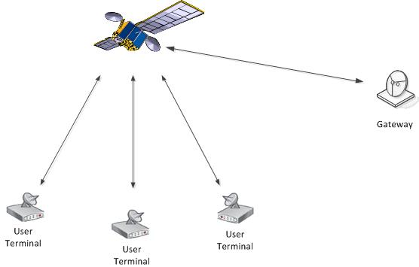
Introduction and Motivation
Bidirectional satellite communication
Multi-user access issue
  MF-TDMA (e.g. DVB-RCS)
Multiuser Detection (MUD)
  Increase spectrum efficiency
  Few practical MUD implementations for satellite systems
    High complexity
    Sensitive to synchronization and channel estimation errors
Notes:
In the past decade some new applications e.g internet over satellite, require a bidirectional satellite communication links, which use not only satellite forward link but also satellite return link.
If multi users to share satellite return link, considered as…
Issue solved by orthogonalization.
Digital Video Broadcasting - Return Channel via Satellite (DVB-RCS) uses Multi Frequency TDMA (MF-TDMA)
Although there is a big amount of literature in the field of MUD, there are actually only a few practical implementations for satellite systems. The first reason is due to high complexity. The second reason is MUD techniques are very sensitive to synchronization and channel estimation errors.

Slide 5
Introduction and Motivation
NEXT project - Network Coding Satellite Experiment
paved the way to the GEO research communication satellite H2Sat.
H2Sat: explore and test new broadband (high data rate) satellite communication
NEXT Exp 3: Multiuser detection (MUD) for satellite return links
Main objectives:
  Develop a MUD receiver in SDR
  Increase decoding throughput → real-time processing
Two users transmit at the same frequency and time
A transparent satellite return link
Notes:
Within NEXT project, developed a MUD receiver.
-Two users transmit at the same frequency and time
->Through a return link, on the receiver side signals from two users are overlapped.
-The objectives of our work are not only to design and implement a MUD receiver in SDR to decode properly such overlapped signals from multi users, but also to optimize it to increase the decoding throughput to be able to decode in real-time.

Slide 6
Overview
Introduction and Motivation
MUD System Design
GPU CUDA Architecture
GPU-accelerated Implementation of MUD
Simulation Result
Summary
Notes:
As mentioned before, high complexity restricts the adoption of MUD techs. In the next part of presentation, will focus on the system design from perspective of system complexity, which is relevant to our practical implementation.

Slide 7
MUD System Design
Multiuser detection (MUD) complexity
  Optimal MUD proposed by Verdú:
    exponential complexity on number of users
  Suboptimal MUD algorithms:
    e.g. PIC; SIC
  We use Successive Interference Cancellation (SIC)
    Linear complexity on number of users
    Straightforward extension to support more users
Notes:
The optimal MUD algorithm…
Suboptimal MUD (e.g. PIC/SIC)
(Synchronization is challenging due to multi-user interference)

Slide 8
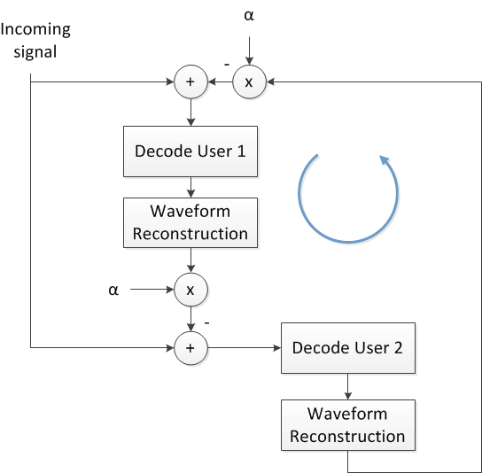
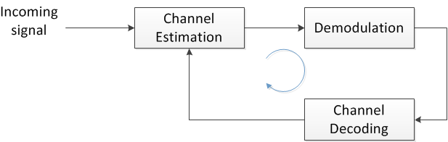
MUD System Design
  Successive Interference Cancellation (SIC)
  Sequentially decode users & cancel interference
  Multi-stage SIC → improve PER
  Error propagation
  Sensitive to channel estimation errors
  Phase noise
  Expectation Maximization Channel Estimation (EM-CE)
LDPC
Notes:
SIC is based on a simple idea: User 1 is decoded when treating the interference from the user 2 as Gaussian noise. After decoding user 1, its waveform is reconstructed and removed from the received signal. If this reconstruction is perfect, user 2 is now free of interference and can be decoded.
Multi-stage SIC: the basic SIC process is repeated for several times and each execution of SIC is denoted as a stage.
(If the user 2 signal cannot be recovered error free after the first stage, basic SIC process is repeated until the maximum number of stages is reached, or until both users are decoded correctly)
However, if have bad waveform reconstruction, error propagation. On the other hand, sensitive to channel estimation errors, meanwhile in our system have strong phase noise due to oscillator. So in order to improve SIC… an iterative channel estimation and decoding algorithm EM is used. The basic idea of this algorithm is to use not only pilot symbols but also data symbols to estimate the channel.
Channel coding: irregular binary LDPC. Give more details about our LDPC later
a standard deviation of 2.29 degree for the phase increments between consecutive symbols
(Partial IC (α ≤1))

Slide 9
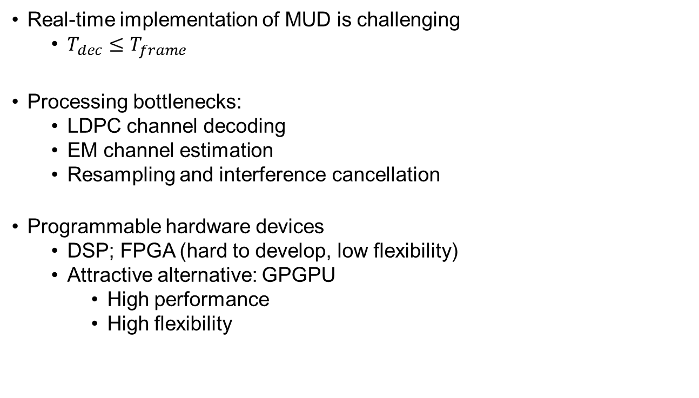
MUD System Design
Real-time implementation of MUD is challenging
  $T_{dec}≤T_{frame}$
Processing bottlenecks:
  LDPC channel decoding
  EM channel estimation
  Resampling and interference cancellation
Programmable hardware devices
  DSP; FPGA (hard to develop, low flexibility)
  Attractive alternative: GPGPU
    High performance
    High flexibility
Notes:
Although SIC has linear complexity on number of users, from the practical implementation point of view, it’s still quite complex. Especially combined with sophisticated channel estimation and channel coding introduced before, it is very challenging to achieve a real-time implementation of MUD. (i.e. the average decoding time of a data frame is lower than its frame duration.)
LDPC decoding: very computation-intensive
EM: the output of channel decoder is used again to estimate channel. Such process has to be repeated for several times, which increases the total decoding time significantly.
Downsamling and IC: cos of the oversampling factor 4, they have to work on much more data samples, which increases the processing time as well.
In order to overcome these bottlenecks, conventionally…are used to speed up these computation-intensive parts. Their drawbacks are considerable development effort and lack of flexibility. For instance, for FPGA-based LDPC decoder, every time change to different coding design, have to start a new design and development process on FPGA, time consuming.
In recent years general purpose computing on graphics processing unit (GPGPU) has become an attractive alternative to FPGA and DSP to achieve high-performance SDR systems. Compared to CPU-based SDR, provide much higher processing performance. Compared to FPGA, it is easier to develop and has higher flexibility.

Slide 10
Overview
Introduction and Motivation
MUD System Design
GPU CUDA Architecture
GPU-accelerated Implementation of MUD
Simulation Result
Summary
Notes:
In the following part of the presentation let’s have a look at the principle of GPU and how to use it to accelerate SDR system.

Slide 11
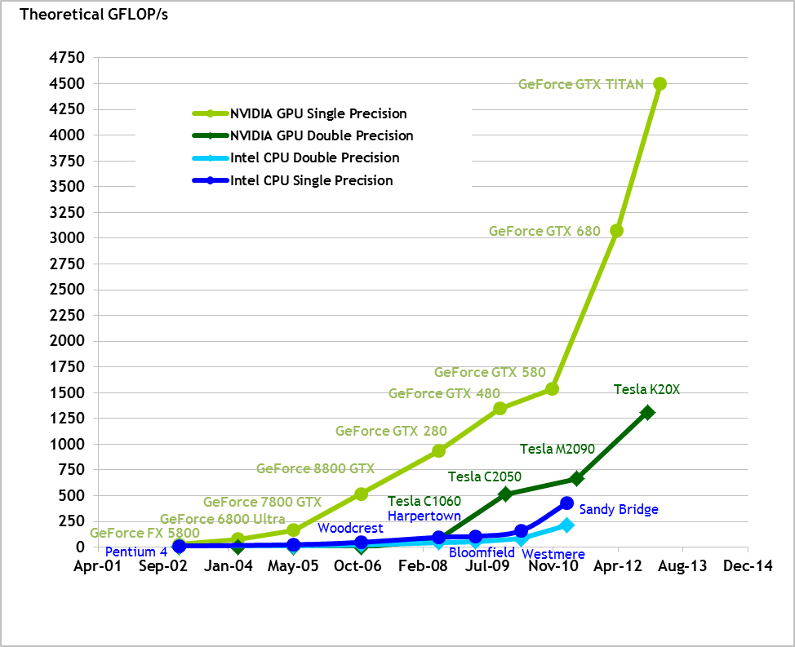
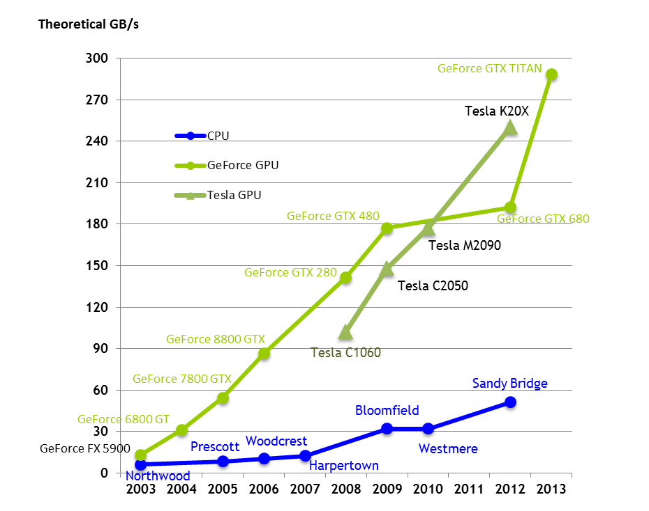
GPGPU
GPUs are massively multithreaded multi-cores chips
  Image and video rendering
  General-purpose computations
Nvidia Tesla c2070:
448 cores;
515 GFLOPs of double-precision peak performance
Ref: Nvidia CUDA_C_Programming_Guide 2013
Notes:
GPUs are originally designed to optimize the floating-point calculations for image and video rendering. GPGPU technique is to utilize a GPU to perform general computations in applications traditionally handled by the CPU.
From this figure we can see…Although GPU we used in NEXT is not the fastest GPU on the market anymore, compared to CPU, much more processing cores and much higher processing performance.
On the other hand, …GPU has big advantage compared to CPU in terms of memory bandwidth.

Slide 12
GPGPU
ALU: Arithmetic Logic Unit
GPU is specialized for computation-intensive, highly parallel computation
(exactly what graphics rendering is about)
More transistors for data processing rather than data caching and flow control
Limited number of concurrent threads
  Server with four hex-core processors
  → 24 concurrent active threads
  (or 48, if HyperThreading supported)
Much more concurrent threads
  Hundreds-cores of processor
  more than thousands of concurrent active threads
Notes:
The reason behind such differences between CPU and GPU is their different fundamental design philosophies.
Big number of transistors are used as control logic units (for the complex flow control)
Large cache memories( to reduce the instruction and data access latencies of large complex applications)
GPU is specialized for compute-intensive, highly parallel computation for graphics rendering - and therefore designed in a way that more transistors are devoted to data processing rather than data caching and flow control
(More specifically, the GPU is especially well-suited to address problems that can be expressed as data-parallel computations – the same program is executed on many data elements in parallel – with high arithmetic intensity – the ratio of arithmetic operations to memory operations. Because the same program is executed for each data element, there is a lower requirement for sophisticated flow control, and because it is executed on many data elements and has high arithmetic intensity, the memory access latency can be hidden with calculations instead of big data caches.)

Slide 13
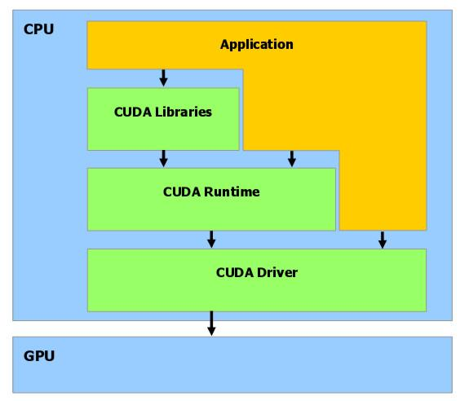
CUDA Architecture
In Nov. 2006, first GPU built with Nvidia’s CUDA architecture
CUDA: Compute Unified Device Architecture
  Each ALU can be used for general-purpose computations
  All execution units can arbitrarily read and write memory
  Allows to use high-level programming languages
  (C/C++; OpenCL; Fortran; Java&Python)
Notes:
In order to simplify the development of general-purpose computation on GPUs…
With such architecture…
The best thing is…
By using different levels of API provided by CUDA architecture, it becomes much easier for developers to execute general computations on GPU.
(required users to continue to disguise their computations as graphics problems, but they would have needed to continue writing their computations in a graphics-oriented shading language such as OpenGL’s GLSL or Microsoft’s HLSL)

Slide 14
CUDA Architecture
Serial program with parallel kernels
  Serial code executes in a host (CPU) thread
  Parallel kernel code executes in many device (GPU) threads
  Host (CPU) and device (GPU) maintain separate memory spaces
Notes:
However, with all the benefits of GPU introduced before, it doesn’t mean that GPU can replace CPU to build a standalone SDR system. We still need CPU to execute codes running in sequential order and use CPU to initialize GPU to perform codes that can be parallelized.
Moreover, CPU and GPU maintain…, which means GPU cannot directly access data stored in CPU’s memory and vice versa.

Slide 15


LDPC Decoder on GPU
U1:
n = 4800
k = 3200
V
V
V
V
V
1
2
3
4
…
...
n
$V_{i}→C_{j}$
U2:
n = 4800
k = 2400
…
...
$${C_{j}→V}_{i}$$
C
C
C
C
1
2
3
n
-
k
Assign one CUDA thread to work on each edge of each check node
Notes:
We can take our LDPC decoder as an example to show how to parallelize computations on GPU.
LDPC code can be represented by such a Tanner graph. With the standard iterative decoding algorithm known as belief propagation (BP), have to calculate messages passing from each check node to variable node along the edges of this graph and vice versa. For the CPU with single thread, start from first check node, calculate message…then move to next check node. After finished with all check nodes, it start to calculate messages from variable to check node. Such iterative decoding process repeat several times, which is very computation-intensive for CPU. Actually, decoding operations can be parallelized by GPU.
We can assign…
With the parallelization on GPU, our LDPC decoder…

Slide 16
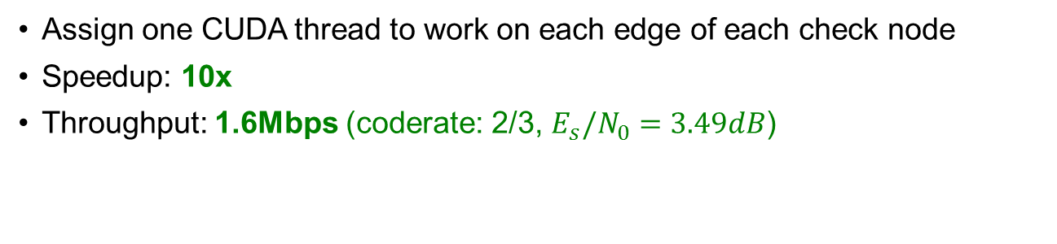
LDPC Decoder on GPU
U1:
n = 4800
k = 3200
V
V
V
V
V
1
2
3
4
…
...
n
$V_{i}→C_{j}$
U2:
n = 4800
k = 2400
…
...
$${C_{j}→V}_{i}$$
C
C
C
C
1
2
3
n
-
k
Assign one CUDA thread to work on each edge of each check node
Speedup: 10x
Throughput: 1.6Mbps (coderate: 2/3, $E_{s}/N_{0}=3.49dB$)
Notes:
We can take our LDPC decoder as an example to show how to parallelize computations on GPU.
LDPC code can be represented by such a Tanner graph. With the standard iterative decoding algorithm known as belief propagation (BP), have to calculate messages passing from each check node to variable node along the edges of this graph and vice versa. For the CPU with single thread, start from first check node, calculate message…then move to next check node. After finished with all check nodes, it start to calculate messages from variable to check node. Such iterative decoding process repeat several times, which is very computation-intensive for CPU. However, decoding operations can be parallelized by GPU.
We can assign…
With the parallelization on GPU, our LDPC decoder…

Slide 17
Overview
Introduction and Motivation
MUD System Design
GPU CUDA Architecture
GPU-accelerated Implementation of MUD
Simulation Result
Summary
Notes:
Since the basic concepts of GPGPU have been introduced, now show how we used GPU to accelerate the SDR implementation of our MUD.

Slide 18
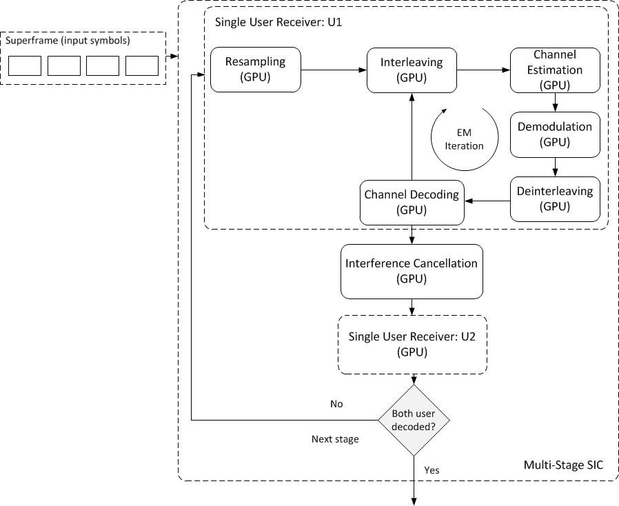
MUD receiver on GPU
GPU←CPU
Processing bottlenecks:
  LDPC channel decoding
  EM channel estimation
  Resampling and interference cancellation
  Data transfer between host and device memory
  (144GB/s of Nvidia Tesla vs. 8GB/s of PCIe*16)
All parts of each single user receiver and interference cancellation on GPU
  Minimize the latency of intermediate data transfer between host and device memory
GPU→CPU
GPU←CPU
GPU→CPU
Notes:
Based on the system design introduced before, except for a reconfigurable hardware for sampling and AD conversion, implemented all components of our MUD receiver from scratch in software, which can be shown in this figure.
As mentioned before, main bottlenecks are… First of all, we implemented these most computation-intensive parts on GPU.
…which means the data transfer between CPU and GPU memories have to repeated for 4 times. Because…PCI much lower bandwidth, such data transfer has bad impact on performance, which should be minimized.
We decided to implement all… Although some components won’t be speed up from the GPU implementation, the benefit of running all components on GPU is to minimize…

Slide 19
Overview
Introduction and Motivation
MUD System Design
GPU CUDA Architecture
GPU-accelerated Implementation of MUD
Simulation Result
Summary
Notes:
Based on such GPU-accelerated implementation of MUD receiver,…

Slide 20
Simulation Setup
GPU Nvidia Tesla c2070 (1.15GHz)
  Comparison benchmark: Intel Xeon CPU E5620 (2.4GHz)
BPSK modulation
Two user terminals (power imbalance: U1 3dB higher than U2)
Channel coding: LDPC
  Irregular Repeat Accumulate
  Blocklength: 4800 bits
  U1 coderate: 2/3 , U2 coderate: 1/2
Baud-rate: 62500 symbols/second → real-time threshold: ca. 85ms (66 kbps)
Notes:
…With such transmission symbol rate
the total processing time to decode one frame for both users
(the baud-rate used in our system for both user terminals is 62500 symbols per second.)

Slide 21
Simulation Result
Real-time threshold
Notes:
Average decoding throughput for both users to decode one packet grows with the increase of SNR. With GPU acceleration, even for SNR as low as 2.45dB (PER: ~40%)

Slide 22
Overview
Introduction and Motivation
MUD System Design
GPU CUDA Architecture
GPU-accelerated Implementation of MUD
Simulation Result
Summary

Slide 23
Summary
SDR implementation of MUD receiver
  High flexibility and low cost
  Extension to support more users
GPU acceleration
  1.8x ~ 3.8x faster than the real-time threshold
  Still space to improve
  New GPU → better performance
GPU CUDA is very promising for powerful parallel computing
  Low learning curve
  Heterogeneous: mixed serial-parallel programming
  Scalable
CUDA-powered Matlab (MATLAB® with Parallel Computing Toolbox; Jacket™ from AccelerEyes)
Days/weeks of simulation → hours
Notes:
With GPU acceleration, achieve much better decoding throughput.
still some space to improve.
From the work we’ve done…
Can keep most parts of ur existing implementation running on CPU and only move some computation-intensive parts to GPU.
You can also use CUDA…Matlab to speed up ur simulations running on Matlab.
with GPU, might get ur reults in hours instead of days/weeks of waiting.

Slide 24
GNURadio
“GNU Radio is a free & open-source software development toolkit that provides signal processing blocks to implement software radios”
Software Architecture
  Main processing of the blocks are in C++ functions processed by CPU on PC
Python Module
SWIG
Python Script /
GNU Radio Companion
C++ Shared Library
Notes:
As an extension of our work… Told us they had some issues with SDR implementation of their PNC system into gnuradio. Because of the processing performance of some gnuradio blocks they developed, they cannot make their system process in real time. Why not combine GPU with gnuradio, in other words to use GPU to speed up the processing of gnuradio blocks.
All the performance critical functions are implemented in C++ while their organization, control and the connections between the blocks are implemented in Python [2]. The Simplified Wrapper and Interface Generator (SWIG) tool is used to create the interface between C++ and Python.

Slide 25
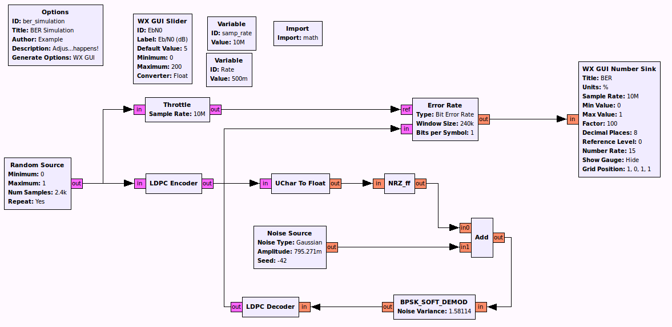

GNURadio + CUDA
$E_{b}/N_{0}=5dB$, $BER=0\%$
CPU LDPC Decoder
  Throughtput: $240Kbit/s$
GPU LDPC Decoder
  Throughput: $1.32Mbit/s$
  Irregular Repeat Accumulate LDPC(IRA)
n = 4800
k = 2400
Notes:
Persons who are familiar with gnuradio will recognize this is typical diagram from gnuradio companion, which shows simple case of a point to point communication with LDPC channel coding. Most blocks just drag and drop. Develop ldpc encoder and decoder by ourselves. Since ldpc decoder is main bottleneck on receiver side, we tried to use GPU to accelerate this block. Managed to implement this block both on cpu and GPU. There is still some space to improve, this is just to prove the concept

Slide 26
Thank you !
Q&A ?
CUDA
monster
CPU monster
CPU
CUDA core

Slide 28
GPGPU
Advantages of GPU:
  High computational processing power
  High memory bandwidth
  High flexibility
Drawbacks of GPU:
  Non stand-alone device
  Bad at serial processing
  Separate memory space
  Additional hands-on effort
Notes:
With such differences in fundamental hardware design, CPU-based SDR system has very limited number of concurrent threads, for instance…, while GPU-based system can support more than…
From here we can see compared to CPU…
In the following part another advantage of GPU-based SDR, which is its high flexibility.

Slide 29
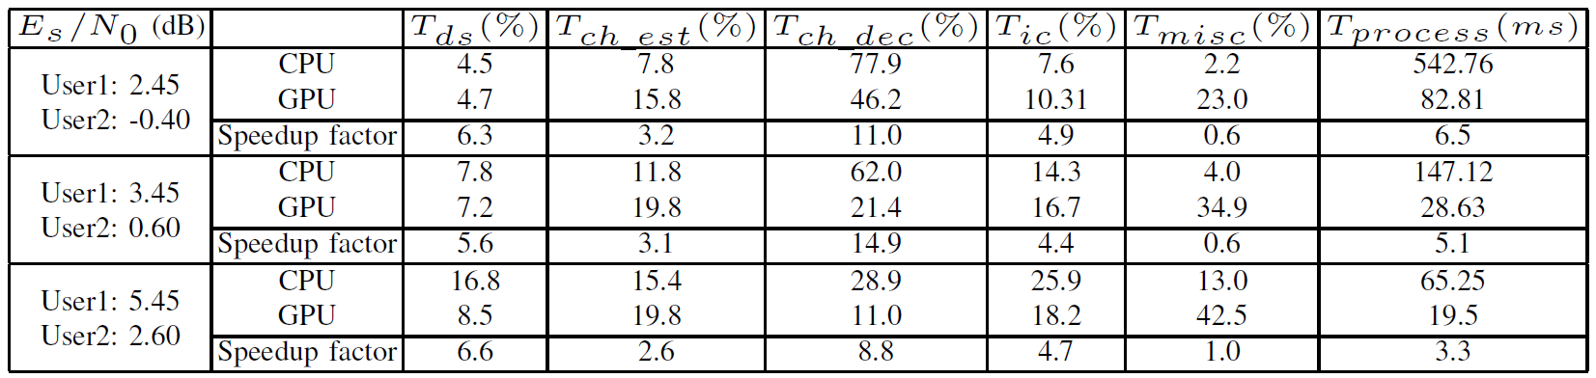
Comparison of total processing time of MUD between CPU and GPU

