Slide 1
S.-Y. Robert Li (Bob Li)
CUHK
Linear NC⎯An Overview on Theory & Applications
Network coding at the presence of cycles
Notes:
Overview overlaps with other talk. Will be brief and spend more time on newer things.

Slide 2
The butterfly network
x
y
x+y
x+y
x+y
Notes:
这就是 wireless butterfly network

Slide 3
Interpreting butterfly network as 2-way relay channel
T
T
x
y
R
x+y
T
R
x+y
Multicast
x+y
R
x
y
Physically,
Notes:
这就是 wireless butterfly network

Slide 4
Interpreting butterfly network as 2-way relay channel
T
T
x
y
R
x+y
T
R
x+y
Multicast
x+y
R
Wireless transmission
x
y
Notes:
Wireless transmission is multicasting in nature, perfect for applying NC.

Slide 5
Half-duplex 2-way relay
Store-and-forward, 4 steps to exchange a message through the middle relay
x
y

Slide 6
Half-duplex 2-way relay
Store-and-forward, 4 steps to exchange a message through the middle relay
x
y

Slide 7
Half-duplex 2-way relay
Store-and-forward, 4 steps to exchange a message through the middle relay
x
y
NC, 3 steps
x
y

Slide 8
Half-duplex 2-way relay
Store-and-forward, 4 steps to exchange a message through the middle relay
x
y
NC, 3 steps
x⊕y
x⊕y
M.I.T. prototype
standard of wireless LAN
(802.11 Wi-Fi)
3GPP2 selects NC as its potential technology in 4G wireless systems.

Slide 9
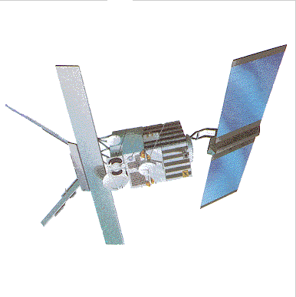
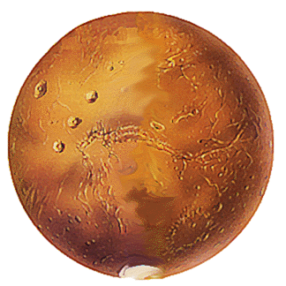
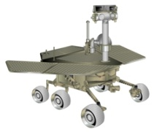
Communications on Mars
A
B
A
B
B
A
A+B
Notes:
This example is taken from a proposal for a NASA project.
The same application of NC can be used for satellite and wireless communications.
In fact, this has been prototyped by MIT on the wireless local area network standard known as Wi-Fi or 802.11.

Slide 10
Physical-layer NC (PNC)
x
y
Store-and-forward, 4 steps
x
y
NC, 3 steps
x⊕y
x
y
2 steps
(1 reception & 1 transmission, naturally)

Slide 11
Physical-layer NC (PNC)
x
y
Store-and-forward, 4 steps
x
y
NC, 3 steps
x⊕y
Physical-layer NC, 2 steps
x+y
x+y
Notes:
“+” can be algebraic or physical

Slide 12
Algebraic underpinning of NC
The source generates symbols
a, b ∈ the symbol field.
The message is a row vector (a b).
In this instance, the symbol field = GF(2).
a
b
a
b
a
a⊕b
a⊕b a⊕b
b

Slide 13
Algebraic underpinning of NC
The source generates symbols
a, b ∈ the symbol field.
The message is a row vector (a b).
a = (a b) ⋅
1
0
b
a
b
a
a⊕b
a⊕b a⊕b
b
= (a b) ⋅
1
1

Slide 14
Algebraic underpinning of NC
The source generates symbols
a, b ∈ the symbol field.
The message is a row vector (a b).
The transmitted symbol is
(a b)⋅
1
0
0
1
x
y
1
0
0
1
1
0
1
1
0
1
1
1
1
1

Slide 15
Message pipelining over a network
Now consider a pipeline (a₁ b₁), (a₂ b₂), (a₃ b₃), (a₄ b₄), … of messages.
NC theory is linear algebra on vectors over symbol field. Fundamental theory of NC deals with each individual message separately.
But, when the network contains cycles, cyclic feedback convolves different messages together.
Q. Can NC theory overcome cycles?
a₄
b₄
a₃
b₃
a₃
a₂⊕b₂
a₁⊕b₁ a₁⊕b₁
b₃

Slide 16
Message pipelining over a cyclic network
A data unit = a whole pipeline (c₀, c₁, …, c_{t}, …) of symbols
↔ A rational power series Σ_{t≥0} c_{t} D^{t} // D = unit-time delay
(rather than a polynomial)
Σ_{t≥0} a_{t}D^{t}
Σ_{t≥0} b_{t}D^{t}

Slide 17
Convolutional network coding (CNC)
A data unit = A rational power series rather an a polynomial
The whole data = A row vector of rational power series
a = Σ_{t≥0} a_{t}D^{t}
b = Σ_{t≥0} b_{t}D^{t}
a+bD
1–D
1
1
1
1
b
a+bD
1–D
a+bD
a+b
1
1
1–D
1–D
a+b
1–D
a
1
D
1
1
a+b
1–D

Slide 18
Convolutional network coding (CNC)
A data unit = A rational power series rather an a polynomial
The whole data = A row vector of rational power series
= (a b) ⋅
1
0
a
b = Σ_{t≥0} b_{t}D^{t}
1
1
1
1
1
1
1
D
1
1
a+b
1–D
= (a b) ⋅

Slide 19
Convolutional network coding (CNC)
CNC theory is linear algebra on vectors over the ring of rational power series.
Q. But, does linear algebra really apply to a ring?
1
1
1
1
1
1
1
D
1
1

Slide 20
Field ⇒ Ring
Can add, subtract, multiply, divide
Can add, subtract, multiply
No linear algebra over a ring in general

Slide 21
Field ⇒ PID ⇒ Ring
(Principal ideal domain)
The ensemble of rational power series qualifies.
Linear algebra does apply to vectors over a PID except for the beautiful complication by invariant factors.

Slide 22
Field ⇒ PID ⇒ Ring
(Principal ideal domain)
The ensemble of rational power series qualifies.
Linear algebra does apply to vectors over a PID except for the beautiful complication by invariant factors.
// We now provide a simple example.
CNC theory becomes a special case of LNC theory over PID.

Slide 23
A taste of invariant factors
The simplest PID is the integer ring Z.
Linear algebra does apply to vectors over a PID except for the beautiful complication by invariant factors.
This beautiful complication is called the “invariant factor decomposition theorem over a PID.”

Slide 24
Z² = lattice points on grid = a free Z-module at rank 2
(“Vector space” over Z)
(0, 1)
(1, 0)

Slide 25
Theorem: A submodule over Z is also a free Z-module, which also attains the rank 2 in this instance.
(1, 2)
(0, 1)
(1, 0)
(3, 0)
Notes:
Pro vice chancellor of PLA Univ of HK

Slide 26
Theorem: A submodule over Z is also a free Z-module. Moreover, the bases of the two can be aligned.
In this alignment, the sequential factors of the submodule in Z² are (3, 2).
(4, 2)
(2, 1)
(1, 0)
(3, 0)

Slide 27
Moreover, can align so that “factors” divide one another.
The sequential factors of the submodule in Z² become (−1, −6) in the new alignment.
⇒ As −1 | −6, the invariant factors are sequentially (±1, ±6). ⇒ Canonical
(1, 2)
(0, 1)
(−1, −2)
(0, −6)

Slide 28
A smaller submodule at the rank 2
The invariant factors of this smaller submodule in Z² are (±2, ±6).
(4, 2)
(2, 1)
(−6, 0)
(1, 0)

Slide 29
Field ⇒ PID ⇒ Ring
(Principal ideal domain)
The ensemble of rational power series qualifies.
Linear algebra does apply to vectors over a PID except for the beautiful complication by invariant factors.
CNC theory becomes a special case of LNC theory over PID,
which however does not provide a sense of causal transmission.
// ∴ Not implementable.

Slide 30
Field → DVR ⇒ PID ⇒ Ring
(Discrete valuation ring)
A degenerated DVR with the trivial “valuation”
The ensemble of rational power series qualifies.
Linear algebra does apply to vectors over a PID except for the beautiful complication by invariant factors.
Notes:
It takes a long time to describe the “valuation.”

Slide 31
Field → DVR ⇒ PID ⇒ Ring
(Discrete valuation ring)
The ensemble of rational power series qualifies.
Linear algebra does apply to vectors over a PID except for the beautiful complication by invariant factors.
The ensemble of rational power series again qualifies.
LNC theory over a DVR provides a sense of causal transmission.

Slide 32
Conclusion
Linear NC theory over a DVR generalizes both LNC and CNC theories for acyclic and cyclic networks. // DVR = ensemble of data units
The discrete valuation in DVR provides a sense of causal transmission.
// On an acyclic network, this sense is by the upstream-to-downstream order.

Slide 33
Commutative algebra vs. NC
Linear NC theory over a DVR generalizes both LNC and CNC theories for acyclic and cyclic networks. // DVR = ensemble of data units
The discrete valuation in DVR provides a sense of causal transmission.
// On an acyclic network, this sense is by the upstream-to-downstream order.
All coding vectors at the source linearly span a free module over the DVR; all incoming coding vectors to a receiver span a submodule.
  Decodability at the receiver = full rank of the submodule
  Decoding delay = the highest valuation among invariant factors of the submodule in the source module.
Thank you.

