Slide 1
COGNITIVE COOPERATIVE RANDOM ACCESS
AND
AN UNCOMMON USE OF NETWORK CODING
Shenzen Sino-German Workshop
March 4-7, 2014
Anthony Ephremides
University of Maryland

Slide 2
TALK STRUCTURE
(two completely different topics)
Description of Cognitive, possibly Co-operative, Random Access
Trading bits/s versus bits/joule
Description of Secure Content Distribution
Use of Deterministic Network Coding

Slide 3
Cognitive Networks
“Primary” and “Secondary” users in same channel (spectrum sharing)
Priority, or “primacy” of the primary user
Channel sensing by secondary user
Possibility of interference and cooperation

Slide 4
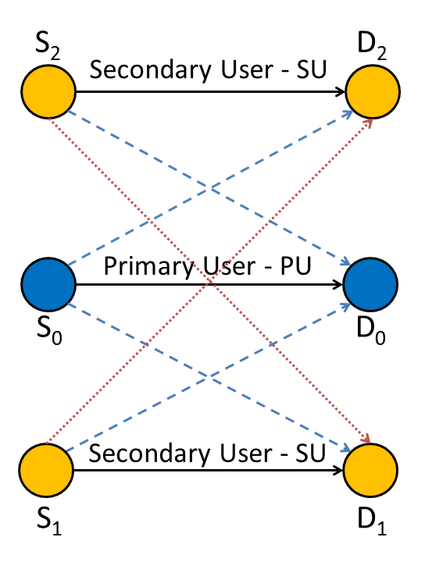
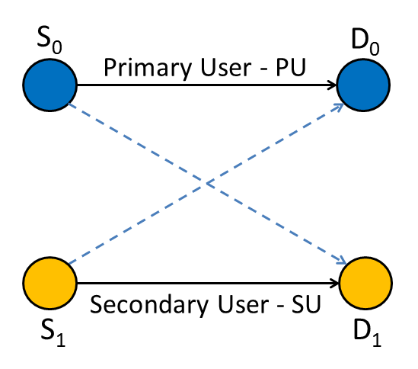
Non-Cooperative Network Model
Fig. 1: Simple Network Model - Single SU
Fig. 2: Multiple SU

Slide 5
Assumptions
Time is slotted
One packet per time slot
Instant ACKs
Block Rayleigh fading (packet erasure channels)
  q: success probability
Gaussian noise added at receiver
Single-user detector (interference treated as noise)
Symmetry in the case of multiple SUs

Slide 6
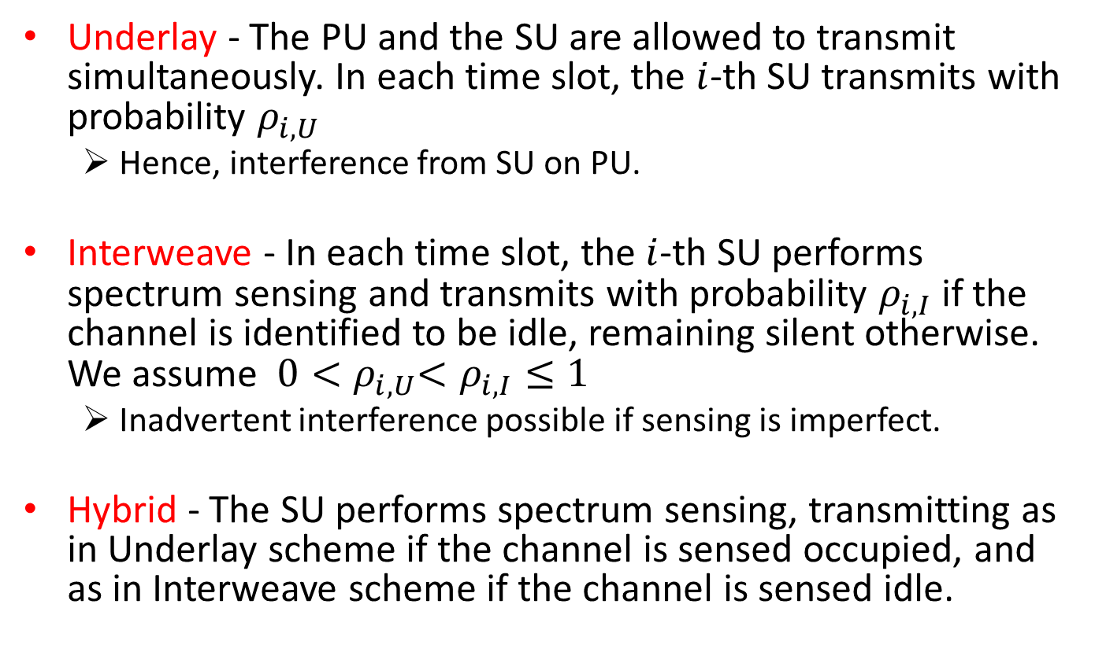
Spectrum Sharing Scheme Terminology (Not totally standard)
Underlay - The PU and the SU are allowed to transmit simultaneously. In each time slot, the $i$-th SU transmits with probability $ρ_{i,U}$
  Hence, interference from SU on PU.
Interweave - In each time slot, the $i$-th SU performs spectrum sensing and transmits with probability $ρ_{i,I}$if the channel is identified to be idle, remaining silent otherwise. We assume ${{ 0<ρ}_{i,U}<ρ}_{i,I}≤1$
  Inadvertent interference possible if sensing is imperfect.
Hybrid - The SU performs spectrum sensing, transmitting as in Underlay scheme if the channel is sensed occupied, and as in Interweave scheme if the channel is sensed idle.

Slide 7
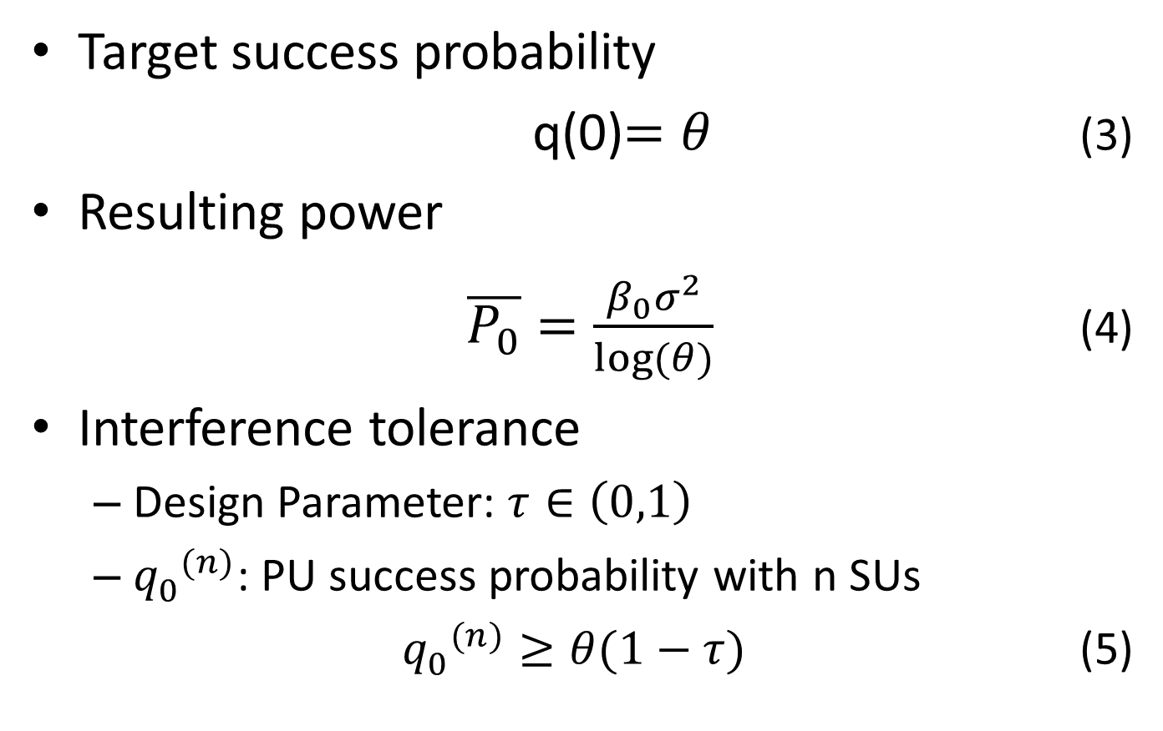
Transmission Power - PU
Target success probability
q(0)$=θ$ (3)
Resulting power
$\overline{P_{0}}=\frac{β_{0}σ^{2}}{log⁡(θ)}$ (4)
Interference tolerance
  Design Parameter: $τ∈\left(0,1\right)$
  ${q_{0}^{}}^{(n)}$: PU success probability with n SUs
  ${q_{0}^{}}^{(n)}≥θ(1−τ)$ (5)

Slide 8
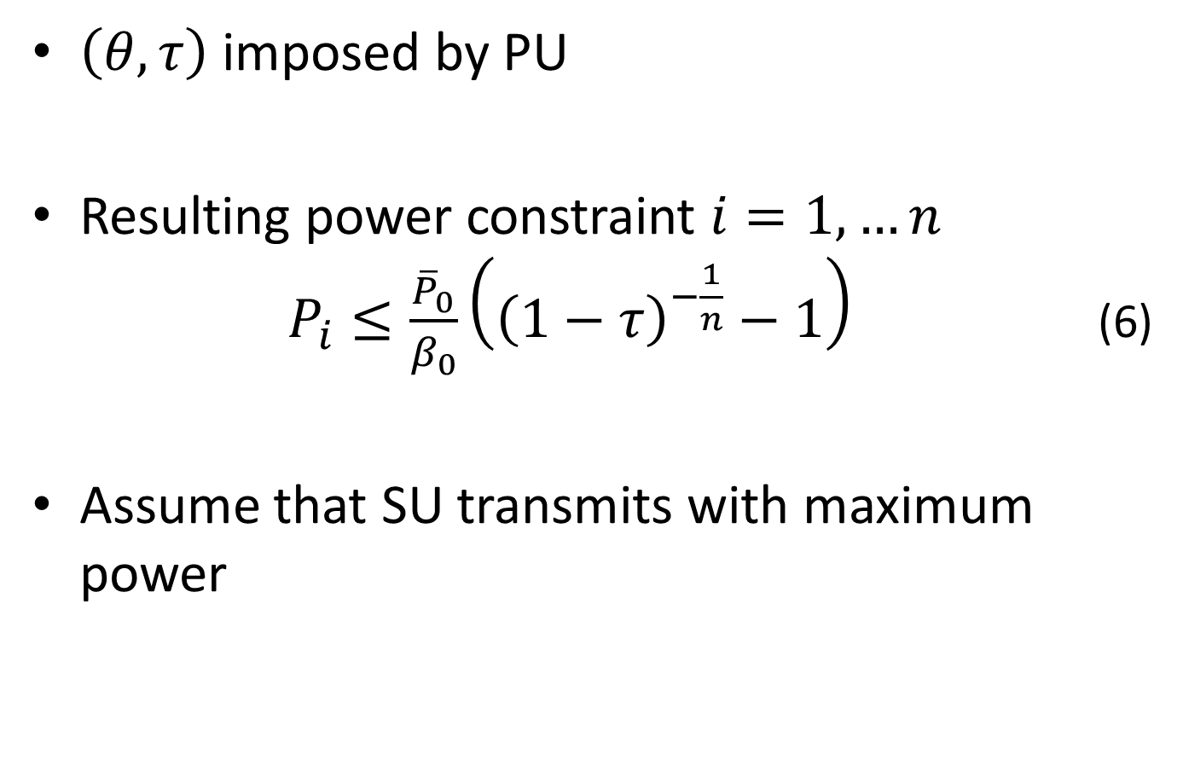
Transmission Power - SU
$\left(θ,τ\right)$ imposed by PU
Resulting power constraint $i=1,…n$ $P_{i}≤\frac{{\overline{P}}_{0}}{β_{0}}\left({\left(1−τ\right)}^{−\frac{1}{n}}−1\right)$ (6)
Assume that SU transmits with maximum power

Slide 9
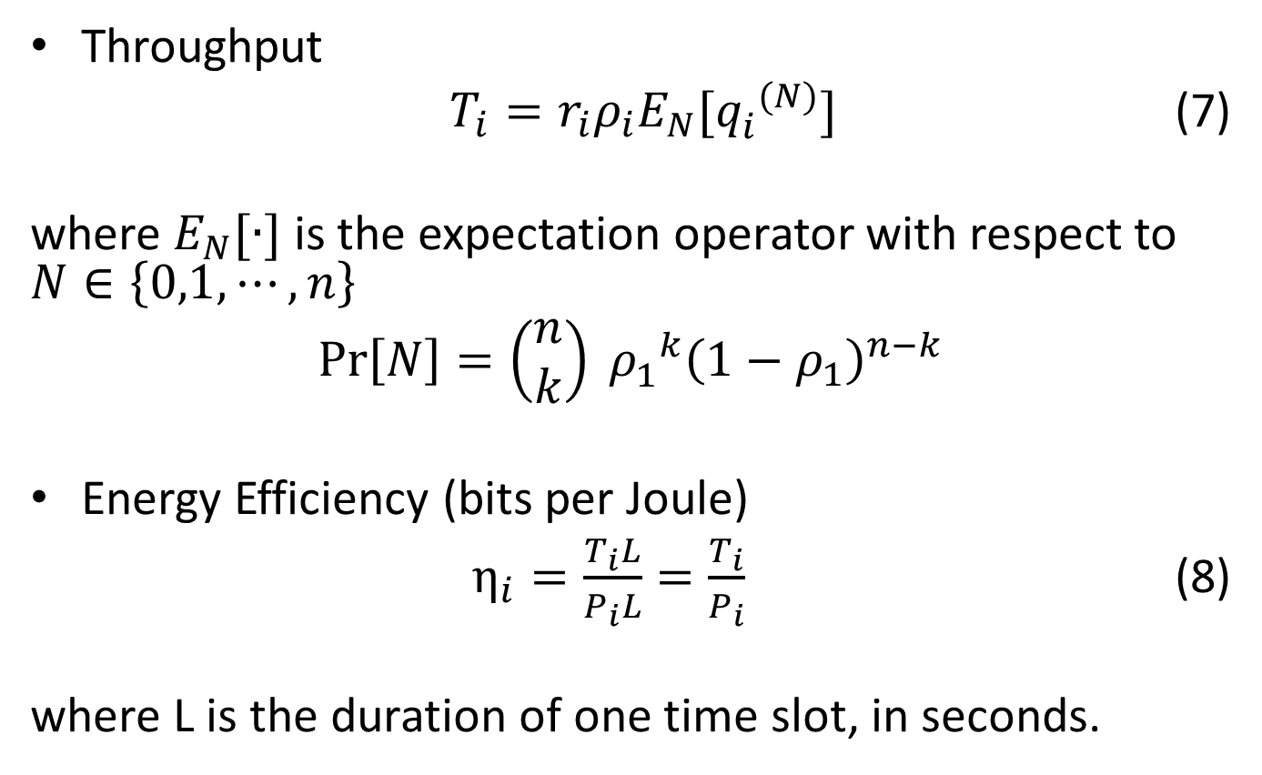
Throughput and Energy Efficiency
Throughput
$T_{i}=r_{i}ρ_{i}E_{N}[{q_{i}^{}}^{(N)}]$ (7)
where $E_{N}[∙]$ is the expectation operator with respect to $N∈\left\{0,1,⋯,n\right\}$
$$\operatorname{Pr}\left[N\right]=\left(\begin{matrix}n \\ k\end{matrix}\right) {ρ_{1}^{}}^{k}{\left(1−ρ_{1}\right)}^{n−k}$$
Energy Efficiency (bits per Joule)
$η_{i}=\frac{T_{i}L}{P_{i}L}=\frac{T_{i}}{P_{i}}$ (8)
where L is the duration of one time slot, in seconds.

Slide 10
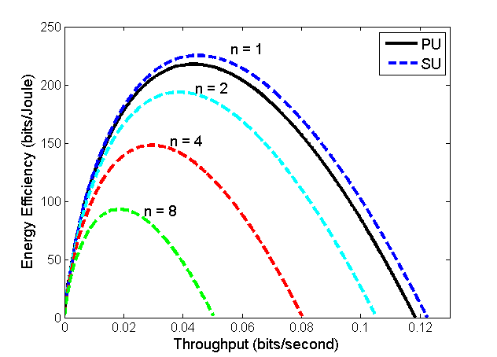
Energy-Throughput Trade-Off
Underlay
θ varies in (0,1), yields powers
Increasing power increases throughput
For simplicity, channel gains are “suppressed” (=1)
Increasing number of SUs reduces power for SUs
PU remains protected from interference for any number of SUs
Fig. 4: Energy-Throughput Trade-Off
with Underlay Spectrum Sharing

Slide 11
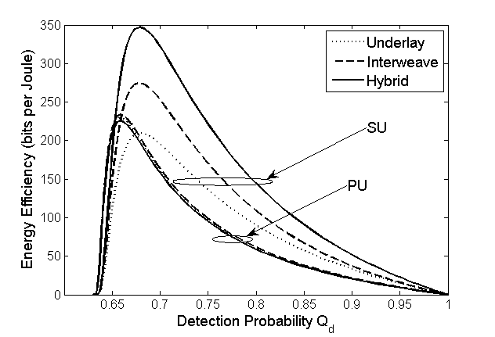
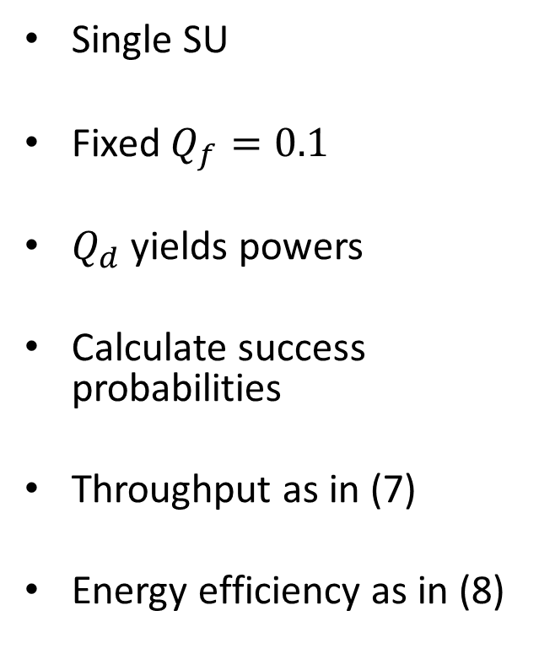
Energy Efficiency versus Detection Probability
Single SU
Fixed $Q_{f}=0.1$
$Q_{d}$ yields powers
Calculate success probabilities
Throughput as in (7)
Energy efficiency as in (8)
Fig. 5: Energy Efficiency versus
Detection Probability

Slide 12
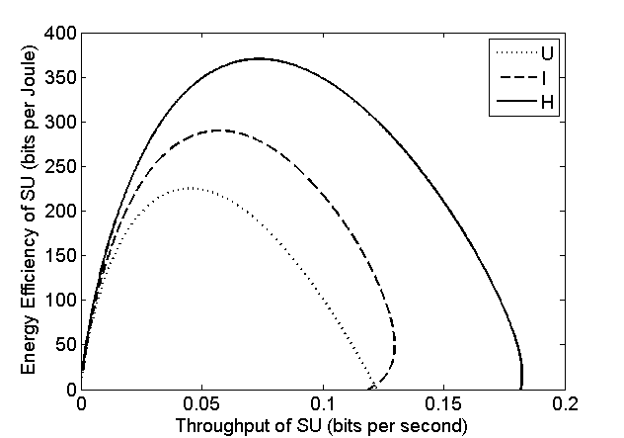
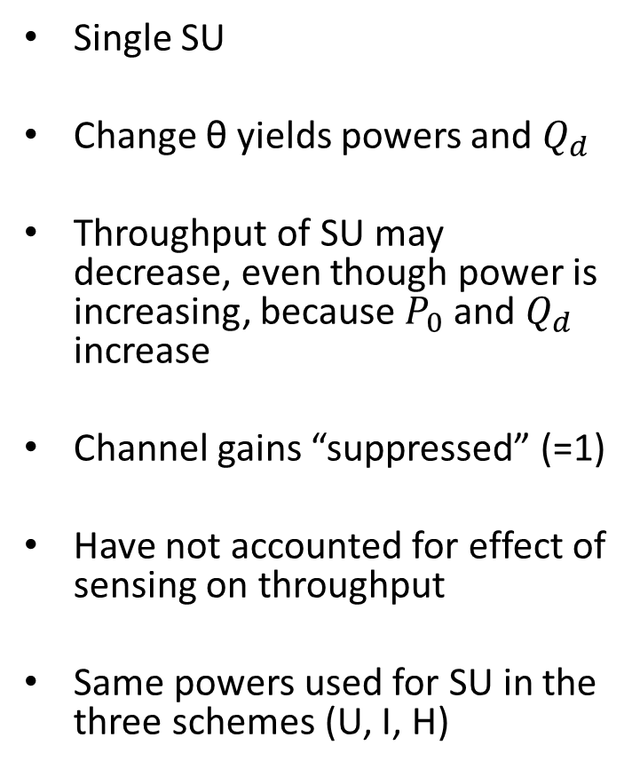
Energy-Throughput Trade-Off for SU
Single SU
Change θ yields powers and $Q_{d}$
Throughput of SU may decrease, even though power is increasing, because $P_{0}$ and $Q_{d}$ increase
Channel gains “suppressed” (=1)
Have not accounted for effect of sensing on throughput
Same powers used for SU in the three schemes (U, I, H)
Fig. 10: Energy-Throughput Trade-Off
for SU Changing θ

Slide 13
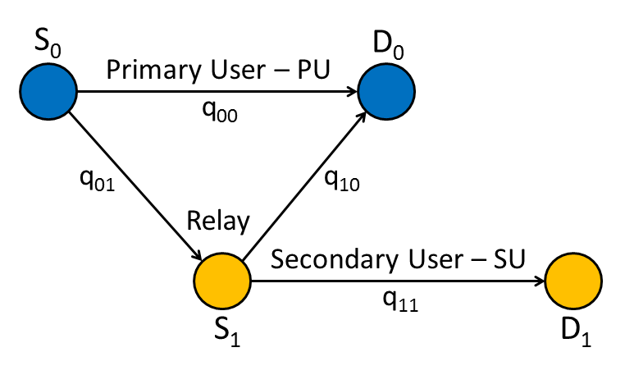
Introduce Cooperation
(As means of “repayment” from SU to PU for the caused interference)
Fig. 12: Simple Network Model for Cooperation
Plenty of prior work: B.Rong, A. Ephremides & S. Kompella, C. Kam, G. Nguyen, A. Ephremides.

Slide 14
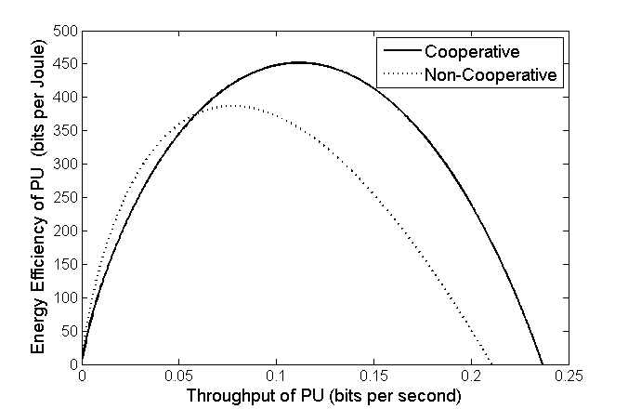
Cooperative Underlay versus
Non-Cooperative Underlay
Saturated nodes
θ yields powers
Calculate success probabilities
Calculate throughput and energy efficiency
Fig. 14: Energy-Throughput Trade-Off: Cooperative versus Non-Cooperative Underlay

Slide 15
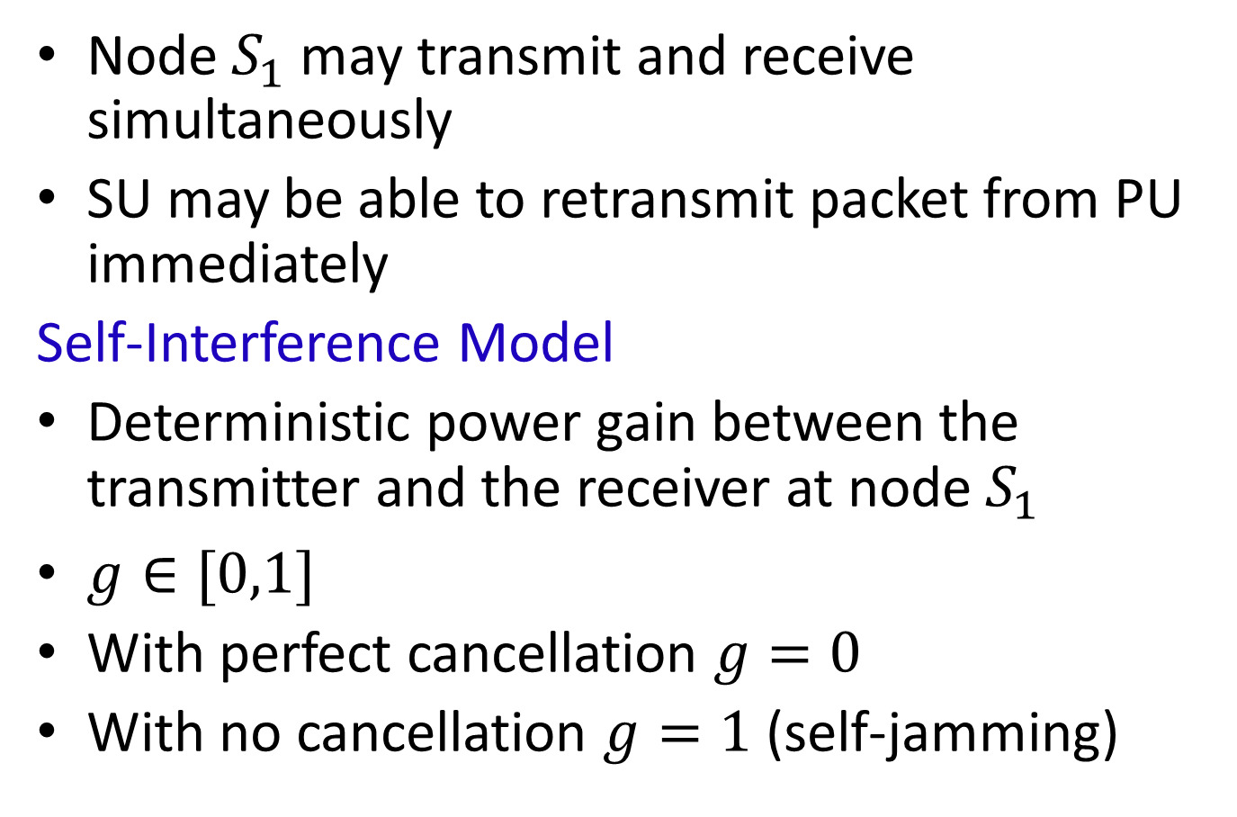
Full-Duplex Relay Node
Node $S_{1}$may transmit and receive simultaneously
SU may be able to retransmit packet from PU immediately
Self-Interference Model
Deterministic power gain between the transmitter and the receiver at node $S_{1}$
$g∈[0,1]$
With perfect cancellation $g=0$
With no cancellation $g=1$ (self-jamming)

Slide 16
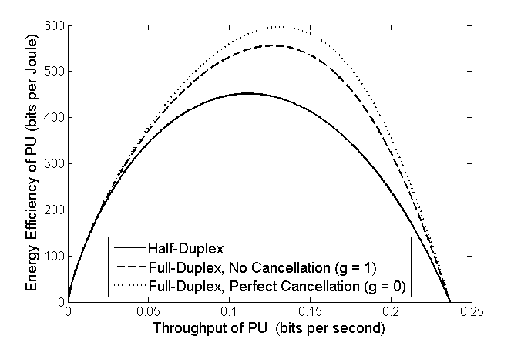
Energy-Throughput Trade-Off With Full-Duplex Relaying
Fig. 15: Energy-Throughput Trade-Off for PU with Cooperation from SU.
Effect of Self-Interference Cancellation.

Slide 17
In Summary
Throughput performance and energy efficiency lead to a complex trade-off
Cognitive scheme has an effect
Sensing quality has an effect
Cooperation has an effect
Full-duplex relaying has an effect
Key Design Question
Set requirements and select parameters for optimal operations.

Slide 18
The problem
K users, each user i holding X_{i} packets of a file of size M
How many transmissions are needed to ensure all users obtain the entire file?
Shared Channel (but fully controlled for interference)
1
2
.
K
.
.
i

Slide 19
Complication
Dimbo
*
*
Ulrica
1
2
.
K
.
*
.
Amadeus
i
Eavesdroppers!
Hence: 2 channels (private, public)
Private: more “expensive”
How many transmissions are needed over the private channel to deliver all the packets to all users while the eavesdroppers are only allowed to receive up to a fixed number of packets?

Slide 20
Reminiscent of Past Work
A. Yao (’74):
      How many bits do P₁ and P₂ need to exchange to be able to compute f(X,Y)?
A. Orlitsky, A. ElGamal (’84):
      How many bits do P₁ and P₂ need to exchange over the private channel to ensure the computation of f(X,Y) while eavesdropper’s probability of computing f stays below a certain level?
E. Modiano, A. Ephremides (’00): as above, except the channels are noisy
(turns out, noise helps because it confuses the eavesdropper more than the two processors)
P. Sadeghi (’11): bounds on the number of transmissions in the basic network problem
X
Y
f(X,Y)
P₁
P₂
X
Y
2 channels
(private & public)
P₁
P₂
Lena (eavesdropper)

Slide 21
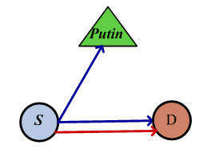
Key Ideas
Quantify the “cost” of security (Energy, Delay)
Use of Deterministic Network Coding
(Only one packet needs to be transmitted privately)
3. Start with single link case

Slide 22
System Model
Independent slow Rayleigh fading channels
Packet erasure model
Instant error free acknowledgements
Secrecy Requirement: the probability that the eavesdropper receives successfully n or more packets is less than a target value λ
Reliable Transmission Schemes:
  Simple ARQ
  Deterministic Network Coding (DNC)
public
private

Slide 23
Objective
Find the optimal number of packets transmitted through the private channel in order to minimize the security cost subject to the secrecy requirement
      m: # of packets over public channel
      M-m: # of packets over private channel
Two types of Security Cost:
  Extra energy spent to transmit through the private channel
  Extra delay required to transmit through the private channel

Slide 24


ARQ Case
Security Costs:
  Delay Cost:
      T_{private}: # of time slots needed to transmit a packet over the private channel
      T_{public}: # of time slots needed to transmit a packet over the public channel
  Energy Cost:
      ξ_{private}: Energy spent to eventually transmit a packet over the private channel successfully
      ξ_{public}: Energy Spent to eventually transmit a packet over the public channel successfully

Slide 25
ARQ Case: Solution
Lemma:
  The probability is a decreasing function of m
  The security costs C_{Delay} and C_{Energy} are decreasing functions of m
  The optimal solution to both problems is m* = m_{λ} where m_{λ} is the greatest integer (0 ≤ m_{λ} ≤ M) that satisfies:
  The probability is non linear in m
  Optimal solution method: search iteratively through the range of values of m (Complexity still linear in m)

Slide 26
DNC Case:
Property: The eavesdropper can not recover the value of any of the M packets except if it receives successfully all M linearly independent coded packets.
Conditions:
Consider n linear independent equations in m variables x₁,…, x_{m}, (n<m):
  For any equation with non zero coefficient of the variable x_{i}, the coefficient vector of the remaining variables must not be the all-zero vector.
  For all equations with non-zero coefficient of the variable x_{i}, the coefficients vectors of the remaining variables must be linearly independent.

Slide 27
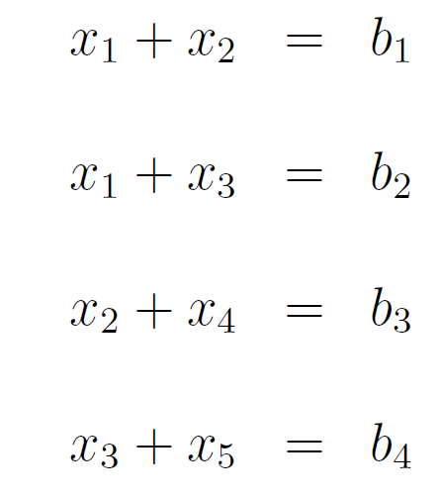

Example

Slide 28

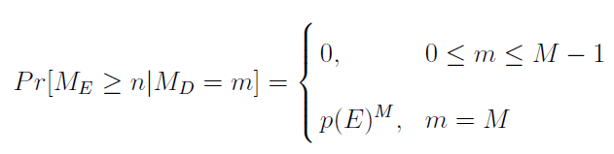
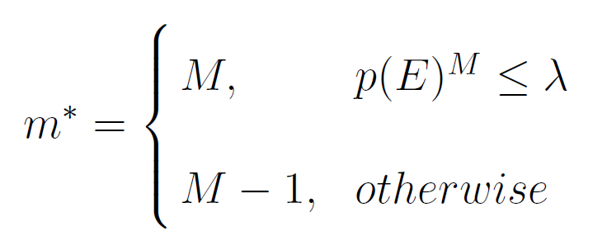
DNC Case: Cont’d
Security Costs: Same as ARQ
  Eavesdropper’s probability of receiving n or more packets:
The optimal solution:

Slide 29
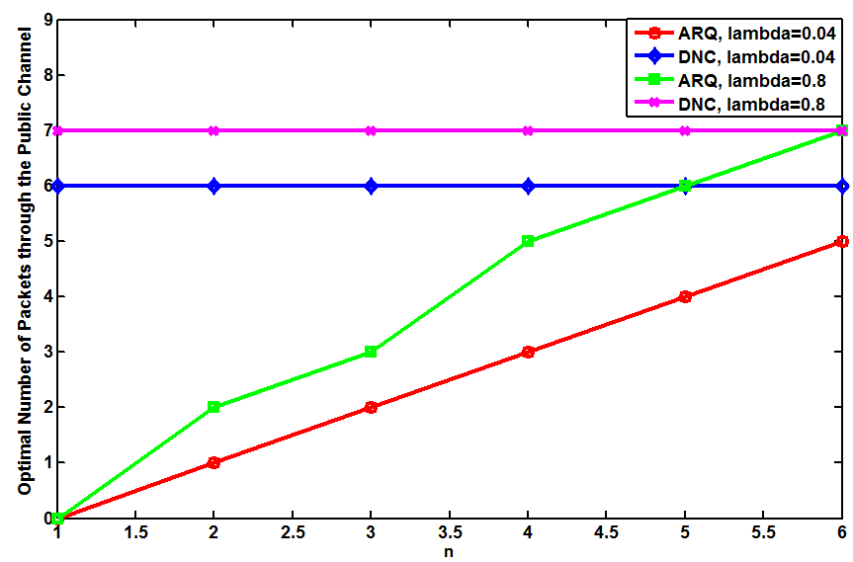
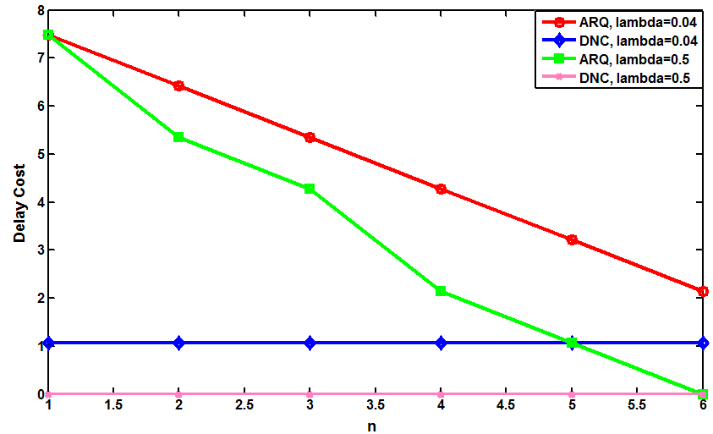
Numerical Results
M = 7

Slide 30
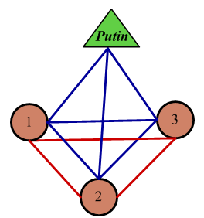
Network Case
K nodes
Each node i has a distinct subset X_{i} of the M packets (|X_{i}|=m_{i})
In each time slot, a node transmits a packet with
fixed power P
Independent Rayleigh fading channels
Packet erasure model
Error free acknowledgements
public
private

Slide 31
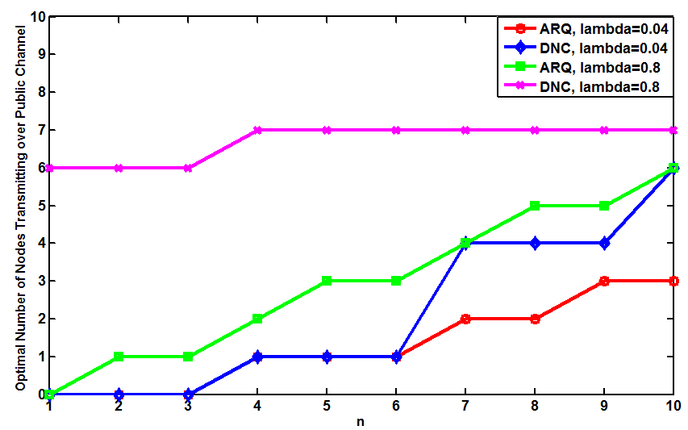
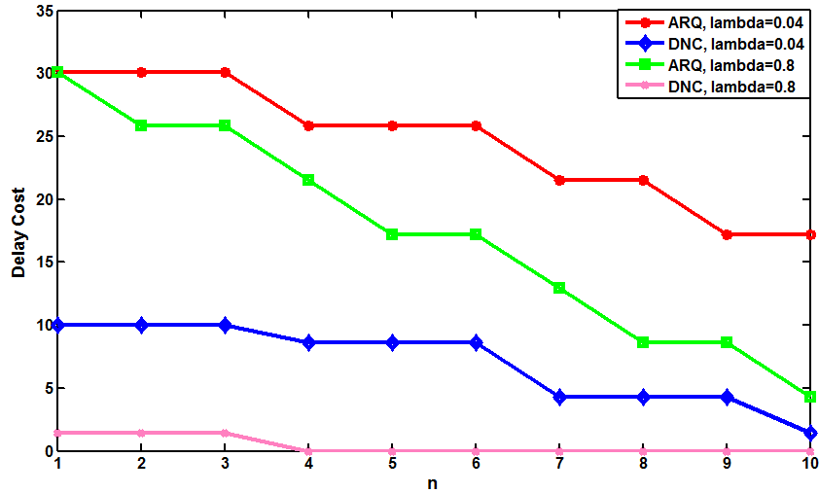
Numerical Results
K = 7
I = 3
M = 21

Slide 32
Conclusion
DNC has a superb unexploited property in this context
“Cost” of security is the “right” criterion in this context

