Slide 1
Secret Sharing
Non-Shannon Information Inequalities
and
+ NEW RESULTS
Ilan Orlov
Ben-Gurion University
Joint work with Amos Beimel
Presented in: Theory of Cryptography Conference (TCC) 2009
Published in: IEEE Transactions on Information Theory

Slide 2
Lecture Plan
Short Reminder on Secret Sharing
Entropy and Secret Sharing
Information Inequalities
Limitations of Information Inequalities
Related and New Results
Conclusions and Open Problems

Slide 3

SECONDS
ON
SECRET
SHARING

Slide 4
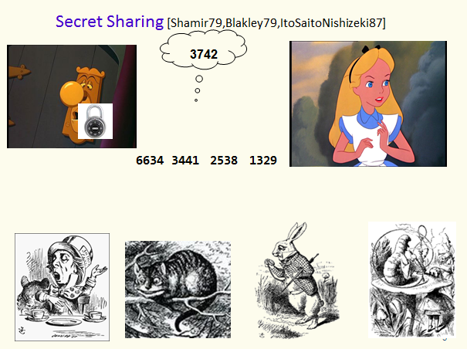
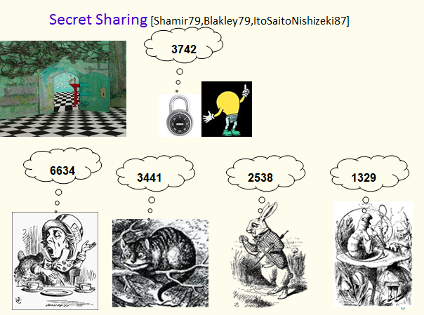
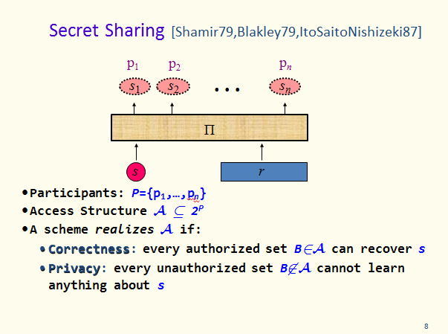
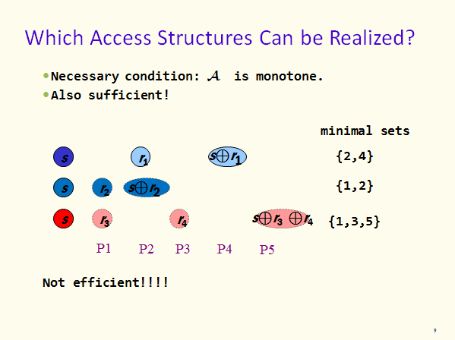

Slide 5
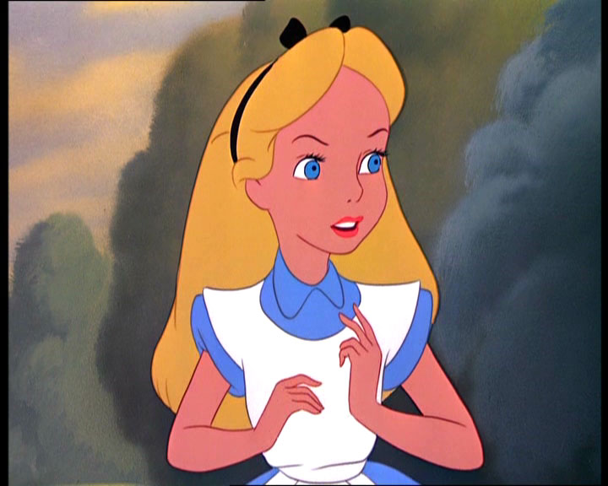
Secret Sharing [Shamir79,Blakley79,ItoSaitoNishizeki87]
P₁
P₂
P_{n}
s₁
s₂
s_{n}
Dealer
s
r
Participants: P={P₁,…,P_{n}}
Access Structure   2^{P}
A scheme realizes  if:
  Correctness: every authorized set B can recover s
  Privacy: every unauthorized set B cannot learn anything about s

Slide 6
Which Access Structures Can be Realized?
Necessary condition:  is monotone
Also sufficient!
The known schemes for general access structures have shares of size ℓ·2^{O(n)}
  n – number of participants
  ℓ – size of secrets in bits
Best lower bound [Csirmaz94]: ℓ· n / log n
Large gap!
No significant progress made from 94
Conjecture: There is an access structure that requires shares of size ℓ·2^{Ω(n)}

Slide 7


Main Question: How Big are the Shares?
Exponential
(in the number
of participants)
Polynomial
(in the number
of participants)

Slide 8
Lecture Plan
Short Reminder on Secret Sharing
Entropy and Secret Sharing
Information Inequalities
Limitations of Information Inequalities
Related and New Results
Conclusions and Open Problems

Slide 9
Secret Sharing Schemes and Entropy
S – random variable representing the secret
For every p_{i}∈P:
S_{i} – r.v. – the share of the party p_{i}
For set A  P:
S_{A} – r.v. – shares of all parties p_{i}∈A
E.g.: A={p₂,p₃,p₇}  S_{A}=S₂S₃S₇
Correctness: Every authorized set can reconstruct the secret
A is authorized  S_{A} determines S  H(S_{A}|S) = 0
Privacy: Every unauthorized set cannot learn any information on the secret
A is unauthorized  S_{A} and S are independent
 H(S_{A}|S) = H(S_{A})
H(S_{A}S) = H(S_{A})
H(S_{A}S) = H(S_{A}) + H(S)
Notes:
9

Slide 10
Secret Sharing Schemes and Entropy (cont.)
For an access structure  we have a set of equalities:
  H(S_{A}S) = H(S_{A}) for every A
  H(S_{A}S) = H(S_{A}) + H(S) for every A
Use properties of the entropy function (information inequalities) to derive lower bounds
Notes:
10

Slide 11
Lecture Plan
Short Reminder on Secret Sharing
Entropy and Secret Sharing
Information Inequalities
Limitations of Information Inequalities
Related and New Results
Conclusions and Open Problems

Slide 12
SECONDS
ON
INFORMATION
INEQULITIES
(Just for the notations…)

Slide 13

Information Inequalities
  Let {X₁,…,X_{m}} be a set of random variables
For I={i₁,…,i_{j}}[m] denote X_{I}=X_{i1}…X_{ij}
  Information inequality:
  _{I⊆[m]}α_{I}H(X_{I})  0
Monotonicity:
H(X_{I2})  H(X_{I1}) whenever I₁ ⊆ I₂
Submodularity:
H(X_{I1}) + H(X_{I2})  H(X_{I1∩I2}) + H(X_{I1∪I2})
Shannon type inequalities: All inequalities implied by monotonicity and submodularity
holds for all r.v.
H(X_{{1,2,3}})
13
Notes:
13
implied = linear combination with positive coefficients

Slide 14
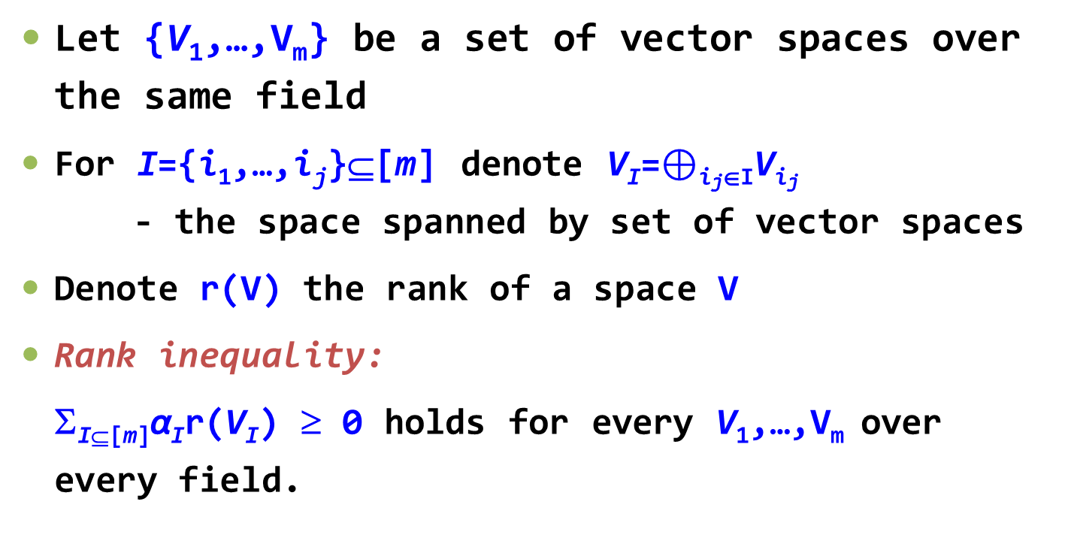
Rank Inequalities
  Let {V₁,…,V_{m}} be a set of vector spaces over the same field
  For I={i₁,…,i_{j}}[m] denote V_{I}=$⊕$_{ijI}V_{ij} - the space spanned by set of vector spaces
  Denote r(V) the rank of a space V
  Rank inequality:
  _{I⊆[m]}α_{I}r(V_{I})  0 holds for every V₁,…,V_{m} over every field.
14
Notes:
14

Slide 15

Rank Inequalities Vs. Information Inequalities
Ingleton
Inequality
Rank
Inequalities
A set of 2^{n} coefficients of any information inequality with n variables is also
a set of a valid rank inequality
Information Inequalities

Slide 16
Some Useful Facts on Inequalities
There are infinitely many independent information inequalities
=
Information inequality with 3 variables or less
Shannon type information inequality
+
=
All rank inequalities with 4 variables
Ingleton inequality
Shannon type information inequalities
Ingleton inequality
+
Shannon type information inequalities
+
24 Rank inequalities
=
All rank inequalities with 5 variables
There are examples of infinite sequences of non-Shannon information inequalities: For every n an information inequality with n variables

Slide 17
Lecture Plan
Short Reminder on Secret Sharing
Entropy and Secret Sharing
Information Inequalities
Limitations of Information Inequalities
Related and New Results
Conclusions and Open Problems

Slide 18
Motivation – Lower Bound for General Access Structures
Large gap between lower bounds and upper bounds for general access structures
All known lower bounds proofs only use information inequalities
Csirmaz's proof (1994) uses Shannon type information inequalities
Csirmaz: Using Shannon information inequalities one cannot prove a strong lower bound
New non-Shannon information inequalities were discovered
Applications of non-Shannon information inequalities – details follow
18
Notes:
18

Slide 19


Applications
  Lower bound for a specific access structure
  By Amos Beimel, Noam Livne, and Carles Padro
  Trivial lower bound: |share|  |secret|
  Cannot do better using Shannon information inequalities
  Using non-Shannon information inequalities: |share|  1.1|secret|
More results obtained using non-Shannon information inequalities
Hope for super-linear
lower bounds for general access structures!
Sounds great!
19
Notes:
19

Slide 20
Limitations of Information Inequalities – Our Results
Define when an information inequality cannot help in proving a super-linear lower bound on the share size
  Provide an algorithm that checks if a given information inequality cannot help
    The algorithm can be used for new information inequalities
  We also deal with known infinite collection of information inequalities
Our result: Information inequalities with up-to 5 variables cannot help in proving a super-linear lower bound on the share size (even when used simultaneously)
  Even known infinite sets of information inequalities
20
Notes:
20

Slide 21



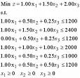
Csirmaz Framework for Proving Lower Bounds
Idea: Construct a linear program
  lower bounds on the objective function  lower bounds on the share size
Inequalities in linear program are based on
  Privacy & Correctness
  Shannon information inequalities
Formal details follow…
lower bound on
the share size
21
Notes:
21

Slide 22
Csirmaz Framework for Proving Lower Bounds
  Observation: Given A, it is possible to derive “stronger” inequalities using the privacy & correctness properties
  Monotonicity:
  If ABP, H(S_{A}S)  H(S_{B}S)
“Strong” monotonicity:
  If A∉A and BA, then
  H(S_{A}) + H(S) = H(S_{A}S)  H(S_{B}S) = H(S_{B})
  or H(S_{A})/H(S) + 1  H(S_{B})/H(S)
Submodularity:
  H(S_{AB}S)+H(S_{AB}S)  H(S_{A}S)+H(S_{B}S)
“Strong” submodularity:
  If A,BA but AB∉ A,
  then H(S_{AB}) + H(S_{AB}) + H(S)  H(S_{A}) + H(S_{B})
  or [H(S_{AB}) + H(S_{AB})]/H(S) + 1  [H(S_{A}) + H(S_{B})]/H(S)
Notes:
22

Slide 23
Csirmaz Framework for Proving Lower Bounds
  Observation: Given A, it is possible to derive “stronger” inequalities using the privacy & correctness properties
  (Jumping a head)
  Deriving “stronger” versions of inequalities is essential!
  We proved: Without this “trick”, any information inequality cannot help in proving a super-linear lower bound on the share size
Notes:
23

Slide 24
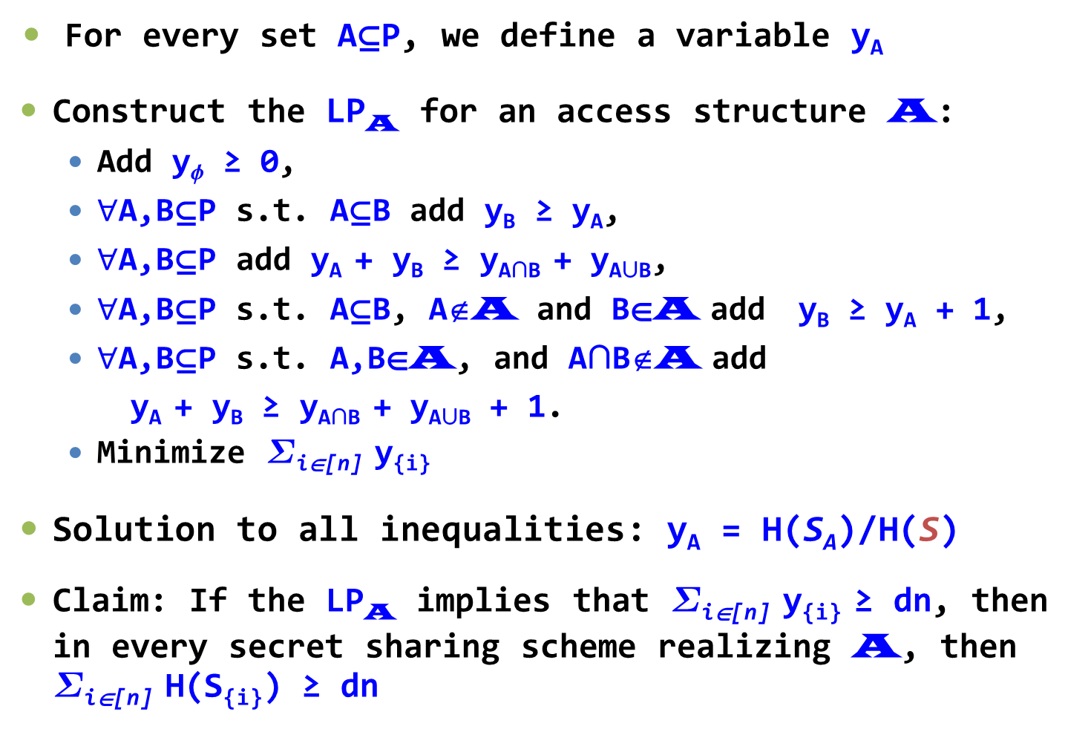
Csirmaz Framework for Proving Lower Bounds
For every set AP, we define a variable y_{A}
Construct the LP_{A} for an access structure A:
  Add y ≥ 0,
  $∀$A,BP s.t. AB add y_{B} ≥ y_{A},
  $∀$A,BP add y_{A} + y_{B} ≥ y_{AB} + y_{AB},
  $∀$A,BP s.t. AB, A∉A and BA add y_{B} ≥ y_{A} + 1,
  $∀$A,BP s.t. A,BA, and AB∉A add
  y_{A} + y_{B} ≥ y_{AB} + y_{AB} + 1.
  Minimize _{i[n]} y_{{i}}
  Solution to all inequalities: y_{A} = H(S_{A})/H(S)
Claim: If the LP_{A} implies that _{i[n]} y_{{i}} ≥ dn, then in every secret sharing scheme realizing A, then _{i[n]} H(S_{{i}}) ≥ dn
Notes:
24

Slide 25
Csirmaz’s Lower Bounds
Csirmaz has constructed an explicit access structure A
  Linear program LP_{A} implies
    _{i[n]} y_{i} ≥ n²/log n
For some i
    y_{i} ≥ n/log n
  By setting y_{A} = H(S_{A})/H(S)
  H(S_{i})/H(S) ≥ n/log n
(S_{i} – r.v. share of p_{i})
n/log n
25
Notes:
25

Slide 26


Limitation of Shannon Inequalities
Theorem (Csirmaz):
Given any access structure A on with n parties, the linear program built using
  Properties of secret sharing
  Shannon inequalities
has a small solution
any 
Can only prove small lower bounds on the share size
26
Notes:
26
Matus, other guys

Slide 27
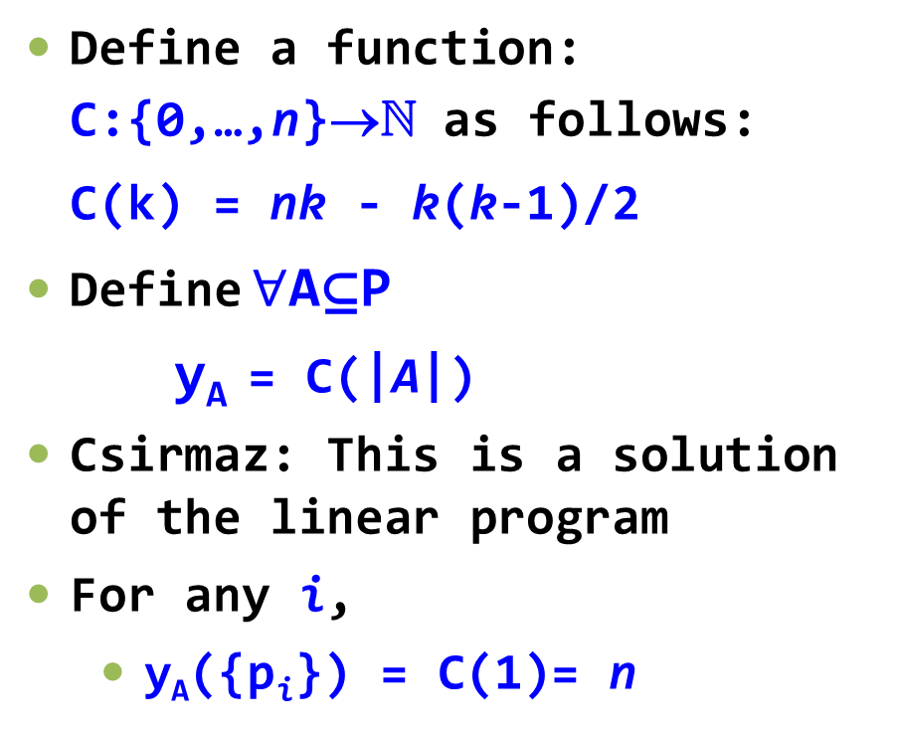
Limitation of Shannon Inequalities: Proof
Define a function:
C:{0,…,n}→ as follows:
C(k) = nk - k(k-1)/2
Define $∀$AP
y_{A} = C(|A|)
Csirmaz: This is a solution of the linear program
For any i,
  y_{A}({p_{i}}) = C(1)= n
any 
n
small solution
27
Notes:
27
Matus, other guys

Slide 28
Some Useful Facts on Inequalities
There are infinitely many independent information inequalities
=
Information inequality with 3 variables or less
Shannon type information inequality
Csirmaz:
cannot help
Csirmaz: cannot help
+
=
All rank inequalities with 4 variables
Ingleton inequality
Shannon type information inequalities
Csirmaz: cannot help
Ingleton inequality
+
Shannon type information inequalities
+
24 Rank inequalities
=
All rank inequalities with 5 variables
Csirmaz: cannot help
There are examples of infinite sequences of non-Shannon information inequalities: For every n an information inequality with n variables

Slide 29



Our Original Plan / Hope
any 
NON-
Supper-linear
lower bounds
NO
small solution
S
29
Notes:
29
Matus, other guys

Slide 30


When Can Information Inequalities Help?
Lemma: Any information inequality applied on set of r.v. {S_{AI}}, where I⊆[m], remains valid after plugging in the Csirmaz function
S_{AI}

_{I⊆[m]}α_{I}C_{n}(|A_{I}|)0
_{I⊆[m]}α_{I}H( X_{I} )0
Even for unknown inequalities the
linear program has a small solution
We have to use the “stronger” inequalities!
A demonstration follows…
30
Notes:
30

Slide 31
Demonstration of Our Ideas
Recall: “Strong” submodularity:
  If A₁,A₂,A₁∪A₂  A but A₁∩A₂ ∉ A, then
  y_{A1} + y_{A2} - y_{A1A2} - y_{A1A2}  1
  Csirmaz: It cannot help in proving super-linear lower bounds
  Demonstrate some of our ideas
Csirmaz function is a solution!
Lets plug-in the Csirmaz function and check!
31
Notes:
31

Slide 32
Csirmaz Function is a Solution
C(k) = nk - k(k-1)/2
C(|A₁|) + C(|A₂|) - C(|A₁∪A₂|) - C(|A₁∩A₂|)
 |A₁\(A₁∩A₂)|·|A₂\(A₁∩A₂)|
The selection of A₁,A₂∈, A₁∩A₂∉ implies
  A₁\(A₁∩A₂)≠ ⇒ |A₁\(A₁∩A₂)|  1
  A₂\(A₁∩A₂)≠ ⇒ |A₂\(A₁∩A₂)|  1
Which means that
C(|A₁|)+C(|A₂|)-C(|A₁∪A₂|)-C(|A₁∩A₂|)  1
For this stronger inequality the linear program has a small solution!
We used similar ideas on the other inequalities
Notes:
32

Slide 33
A Brute-Force Algorithm that Checks if an Information Inequality Cannot Help
The algorithm is based on several observations and lemmas
  Does not depend on the number of participants in the access structure – non trivial to achieve!
The algorithm is not efficient
  For our purpose the algorithm is good enough
  Takes several minutes for each execution
We have executed the algorithm on:
  Ingleton inequality
  24 “special” rank inequalities
  They cannot help in proving super-linear lower bounds!
33
Notes:
33

Slide 34
Some Useful Facts on Inequalities
There are infinitely many independent information inequalities
=
Information inequality with 3 variables or less
Shannon type information inequality
Csirmaz:
cannot help
Csirmaz: cannot help
+
=
All rank inequalities with 4 variables
Shannon type information inequalities
Simultaneous theorem: cannot help
Ingleton inequality
Csirmaz: cannot help
Computer program:
Cannot help
+
Shannon type information inequalities
+
24 Rank inequalities
=
All rank inequalities with 5 variables
Ingleton inequality
Simultaneous theorem: cannot help
Computer program:
Cannot help
Csirmaz: cannot help
Computer program:
Cannot help
There are examples of infinite sequences of non-Shannon information inequalities: For every n an information inequality with n variables

Slide 35
Infinite Collections of Information Inequalities
There are few examples for infinite sequences of non-Shannon information inequalities
  The first example: Zhang and Yeung
  For every n∈N an information inequality with n variables
We used a similar technique to deal with the those infinite sequences – executed the algorithm “symbolically”
35
Notes:
35

Slide 36
Some Useful Facts on Inequalities
There are infinitely many independent information inequalities
=
Information inequality with 3 variables or less
Shannon type information inequality
Csirmaz:
cannot help
Csirmaz: cannot help
+
=
All rank inequalities with 4 variables
Shannon type information inequalities
Simultaneous theorem: cannot help
Ingleton inequality
Csirmaz: cannot help
Computer program:
Cannot help
+
Shannon type information inequalities
+
24 Rank inequalities
=
All rank inequalities with 5 variables
Ingleton inequality
Simultaneous theorem: cannot help
Computer program:
Cannot help
Csirmaz: cannot help
Computer program:
Cannot help
cannot help
(similar technique)
There are examples of infinite sequences of non-Shannon information inequalities: For every n an information inequality with n variables

Slide 37
Lecture Plan
Short Reminder on Secret Sharing
Entropy and Secret Sharing
Information Inequalities
Limitations of Information Inequalities
Related Results
Conclusions and Open Problems

Slide 38
Some Other Related Results
Several papers on proving lower bounds on the size of the share
  For specific families of access structures
  Using the linear programing approach
  Adding non-Shannon inequalities
A very recent result about the power of non-Shannon information inequalities for proving lower bounds on the size of the share
38
Notes:
38

Slide 39
Some Other Related Results
1. “Matroids Can Be Far From Ideal Secret Sharing”
  By Amos Beimel, Noam Livne, and Carles Padro
  First result in secret sharing obtained by using non-Shannon inequalities
  Trivial lower bound using Shannon information inequalities: |share|  |secret|
  Using non-Shannon information inequalities: |share|  1.1|secret|
2. “Improved Upper Bounds for the Information Rates of the Secret Sharing Schemes Induced by the Vamos Matroid”
  By Jessica Ruth Metcalf-Burton
39
Notes:
39

Slide 40
Some Other Related Results
3. “Finding Lower Bounds on the Complexity of Secret Sharing Schemes by Linear Programming”
  By Carles Padro and Leonor Vazquez and An Yang
  Lower bounds for specific families of access structures
4. “An impossibility result on graph secret sharing”
  By László Csirmaz
  Lower bounds for families of graph access structure
  Some background on graph access structure:
    Nodes of the graph = participants
    A∈ iff there exists at least one edge between the nodes of A
    Lots of papers in this model (small graphs, special graphes and more…)
40
Notes:
40

Slide 41
Even Less Hope! – A Very Recent Result
“Secret Sharing, Rank Inequalities and Information Inequalities”
  By Sebastia Martin, Carles Padro, and An Yang
  Main Theorem (using our notation):
  All information inequalities with r=O(1) variables cannot provide lower bounds that are polynomial on the number of participants
  Our results (r=4,5) are better (as our polynomial is smaller)
  Adds formalism and deeper understanding
Formal details follow…
41
Notes:
41

Slide 42
Even Less Hope! – More Details
  Suggested a solution (polymatroid)
    M(P,r) – Collection of all multisets of size r of the set P
    Lemma: |M(P,r)| is a solution for every linear program constructed using all the information inequalities with up-to r varibles
    Compatible with all access structures
    |M(P,r)| = O(n^{r})
    |M(P,3)| = Csirmaz’ function
  Reduces the hope to prove better lower bounds using information inequalities
    Can new infinite sequences help?
    Can information inequalities of a different structure help? Non-Linear? Conditional information inequalities?
42
Notes:
42

Slide 43
Lecture Plan
Short Reminder on Secret Sharing
Entropy and Secret Sharing
Information Inequalities
Limitations of Information Inequalities
Related and New Results
Conclusions and Open Problems

Slide 44
Conclusions
Motivation: Which techniques can prove strong lower bounds on the size of shares?
Our result: Information inequalities with up-to 5 variables cannot prove super-linear lower bound on the share size
  Even few known infinite sets of information inequalities
44
Notes:
44

Slide 45
Open Questions
Find information inequalities that can help proving a super-linear lower bound on the share size
    New infinite sequences?
    Different structure? Non-Linear structure?
    Conditional information inequalities?
Find sufficient conditions for information inequalities that can prove a super-linear lower bound on the share size
Improve the lower bound!
  Even just to close the gap n/log n → n
    Might be possible using Shannon type information inequalities
45
Notes:
45

Slide 46

46
Notes:
46

