Slide 1
网络编码创新科技研讨会 Workshop on Network Coding Innovative Technology 30 August, 2013

Slide 2
致词
Open Address
网络编码创新科技研讨会
Workshop on Network Coding Innovative Technology
网络编码创新科技研讨会 Workshop on Network Coding Innovative Technology 30 August, 2013

Slide 3
创 新 与 发 展
Innovation & Development
网 络 编 码 研 究 所（深 圳）
Institute of Network Coding (Shenzhen)
网络编码创新科技研讨会 Workshop on Network Coding Innovative Technology 30 August, 2013

Slide 4
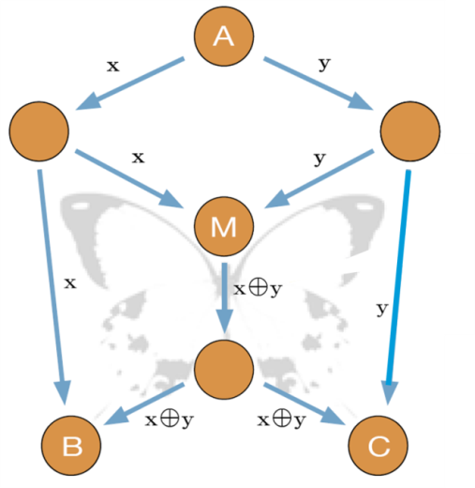
网络编码 (NC) — 信息科技的突破
拓展信息科学、创立全新学科
彻底摆脱“存贮转发”传统网络信息传递思维
解决网络发展瓶颈的创新理论和关键技术
蝴蝶网（Butterflyer network）已成为网络编码的符号。
更有效
更可靠
更健壮
更安全
网络编码创新科技研讨会 Workshop on Network Coding Innovative Technology 30 August, 2013
Notes:
Network Coding is a new paradigm because it fundamentally changes the concept of network communication. With Network Coding, we can build a new information superhighway system.
4

Slide 5
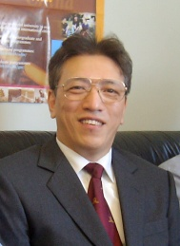
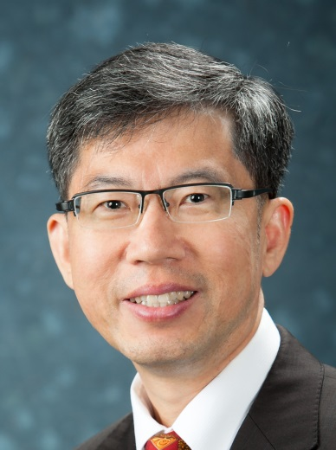
网络编码创始人 Founders
李硕彦 教授
Prof. Bob Li
杨伟豪 教授
Prof. Raymond Yeung
网络编码创新科技研讨会 Workshop on Network Coding Innovative Technology 30 August, 2013

Slide 6
IEEE Information Theory Society Paper Award
李硕彦教授和杨伟豪教授等所经典论文“Linear Network Coding”在理论和实践上具有重要意义。它获得了IEEE信息论协会2005年度论文奖，这是近三十多年来亚洲学者首次获此信息科学最高荣誉。
网络编码创新科技研讨会 Workshop on Network Coding Innovative Technology 30 August, 2013
Notes:
Network Coding is a new paradigm because it fundamentally changes the concept of network communication. With Network Coding, we can build a new information superhighway system.
6

Slide 7
网络编码意味什么？
“Network Coding is sparking the next revolution.”
“Breaking Network Logjams”
“我相信网络编码会是带领我们进入下一个革命阶段的蒸汽引擎。” —— 杨伟豪教授
“网络编码架起了抽象代数与通讯工程之间的新桥梁。”—— 李硕彦教授
网络编码创新科技研讨会 Workshop on Network Coding Innovative Technology 30 August, 2013
Notes:
Network Coding is a new paradigm because it fundamentally changes the concept of network communication. With Network Coding, we can build a new information superhighway system.
7

Slide 8
里程碑 Milestones
2007年，Scientific American刊载专文，“Breaking Network Logjams”一文,喻网络编码为“新信息科学技术革命”。
Year 2012 主办SRIF 2012 软件无线电实现研讨会Year 2013主办SRIF 2013国际软件无线电应用技术专题研讨会作为ACM SIGMOBILE的旗舰会议SIGCOMM的Workshop
8
网络编码创新科技研讨会 Workshop on Network Coding Innovative Technology 30 August, 2013
Notes:
8
Network coding has appeared in Wikipedia since 2006. There have been special reports on Network Coding in Scientific American and New Scientist.

Slide 9
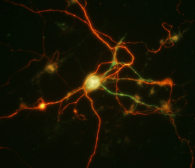
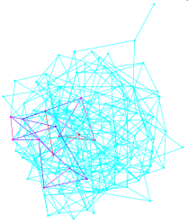
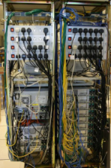
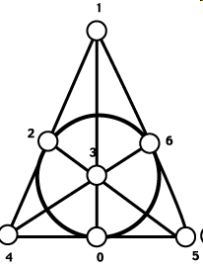
交叉学科深刻影响
信息理论
信道编码
细胞信息传递
量子信息理论
无线网络
互联网
图论
优化理论
大数据
搏奕论
计算机科学
拟阵学
信息安全
网络编码创新科技研讨会 Workshop on Network Coding Innovative Technology 30 August, 2013
Notes:
It is therefore not surprising that Network Coding has made tremendous impact on many fields in information science.
These fields are shown on the right hand side.
The impact of Network Coding goes as far as mathematics, physics and biology.
In this AOE proposal, we will focus on fields that are related to information science.

Slide 10
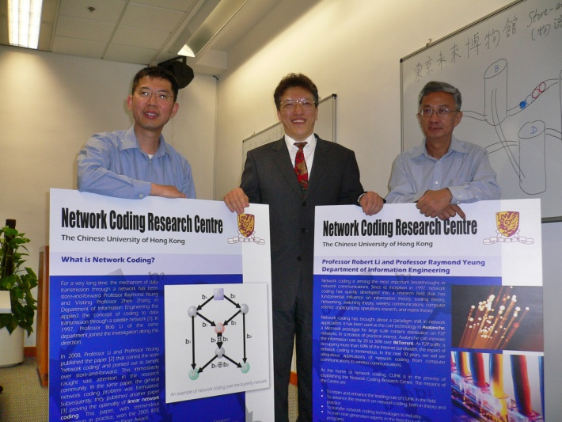
卓越学科领域AoE (Area of Excellence)
2010年香港大学教育资助委员会批准AoE计划，总共投入1.03亿港元资助我们建立了世界上最大的网络编码研究所。这是工程领域最大的研究项目，也是香港迄今最大的工程研究项目。
网络编码创新科技研讨会 Workshop on Network Coding Innovative Technology 30 August, 2013

Slide 11
网络编码研究所（深圳）
网络编码研究所（深圳）于2011年成立，是香港中文大学网络编码研究所的第一个分部。
网络编码创新科技研讨会 Workshop on Network Coding Innovative Technology 30 August, 2013

Slide 12
愿景 Vision
建设一流的网络编码研究中心
掌握核心自主关键技术
攻克前沿科学重大难题
推动珠三角信息产业升级
提升信息技术实力
网络编码创新科技研讨会 Workshop on Network Coding Innovative Technology 30 August, 2013

Slide 13
目标 Goals
参与国内国际重大科研项目
建设前沿科技与创新技术基地
搭建国际学术交流平台
实现创新技术成果转化
实现信息技术知识经济化
网络编码创新科技研讨会 Workshop on Network Coding Innovative Technology 30 August, 2013

Slide 14
目标 Goals
网络编码研究所（深圳）
14
Notes:
14
The sustainability of this AOE beyond its supporting period depends on different scenarios.
The first scenario is on the right. At the end of this AOE, if it happens that all ideas in Network Coding have been developed and productized, then mission is accomplished and the AOE should not be continued. This is not very likely though.
Under the scenario on the left, if the AOE is going strong, then it should be fairly self-sustainable through funding from the private sector and the government, such as the ITF.
The last scenario is such that there are new major breakthroughs along the way.
In this case, the AOE should evolve into an entity of a larger scope through different sources of funding, including private donations.
This would be similar to the Institute of Mathematical Sciences at CUHK, headed by Fields Medalist Prof. Shing-Tung Yau.
14

Slide 15
目标 Goals
承担国内外重大科研项目
培养高素质人才
网络编码研究所（深圳）
15
Notes:
15
The sustainability of this AOE beyond its supporting period depends on different scenarios.
The first scenario is on the right. At the end of this AOE, if it happens that all ideas in Network Coding have been developed and productized, then mission is accomplished and the AOE should not be continued. This is not very likely though.
Under the scenario on the left, if the AOE is going strong, then it should be fairly self-sustainable through funding from the private sector and the government, such as the ITF.
The last scenario is such that there are new major breakthroughs along the way.
In this case, the AOE should evolve into an entity of a larger scope through different sources of funding, including private donations.
This would be similar to the Institute of Mathematical Sciences at CUHK, headed by Fields Medalist Prof. Shing-Tung Yau.
15

Slide 16
目标 Goals
攻克前沿科技问题
取得标志性成果
承担国内外重大科研项目
培养高素质人才
网络编码研究所（深圳）
16
Notes:
16
The sustainability of this AOE beyond its supporting period depends on different scenarios.
The first scenario is on the right. At the end of this AOE, if it happens that all ideas in Network Coding have been developed and productized, then mission is accomplished and the AOE should not be continued. This is not very likely though.
Under the scenario on the left, if the AOE is going strong, then it should be fairly self-sustainable through funding from the private sector and the government, such as the ITF.
The last scenario is such that there are new major breakthroughs along the way.
In this case, the AOE should evolve into an entity of a larger scope through different sources of funding, including private donations.
This would be similar to the Institute of Mathematical Sciences at CUHK, headed by Fields Medalist Prof. Shing-Tung Yau.
16

Slide 17
目标 Goals
攻克前沿科技问题
取得标志性成果
承担国内外重大科研项目
培养高素质人才
国际交流合作平台
网络编码研究所（深圳）
17
Notes:
17
The sustainability of this AOE beyond its supporting period depends on different scenarios.
The first scenario is on the right. At the end of this AOE, if it happens that all ideas in Network Coding have been developed and productized, then mission is accomplished and the AOE should not be continued. This is not very likely though.
Under the scenario on the left, if the AOE is going strong, then it should be fairly self-sustainable through funding from the private sector and the government, such as the ITF.
The last scenario is such that there are new major breakthroughs along the way.
In this case, the AOE should evolve into an entity of a larger scope through different sources of funding, including private donations.
This would be similar to the Institute of Mathematical Sciences at CUHK, headed by Fields Medalist Prof. Shing-Tung Yau.
17

Slide 18
目标 Goals
建成有影响的NC
关键技术研发基地
攻克前沿科技问题
取得标志性成果
承担国内外重大科研项目
培养高素质人才
国际交流合作平台
网络编码研究所（深圳）
18
Notes:
18
The sustainability of this AOE beyond its supporting period depends on different scenarios.
The first scenario is on the right. At the end of this AOE, if it happens that all ideas in Network Coding have been developed and productized, then mission is accomplished and the AOE should not be continued. This is not very likely though.
Under the scenario on the left, if the AOE is going strong, then it should be fairly self-sustainable through funding from the private sector and the government, such as the ITF.
The last scenario is such that there are new major breakthroughs along the way.
In this case, the AOE should evolve into an entity of a larger scope through different sources of funding, including private donations.
This would be similar to the Institute of Mathematical Sciences at CUHK, headed by Fields Medalist Prof. Shing-Tung Yau.
18

Slide 19
目标 Goals
建成有影响的NC
关键技术研发基地
知识经济化
攻克前沿科技问题
取得标志性成果
承担国内外重大科研项目
培养高素质人才
国际交流合作平台
网络编码研究所（深圳）
19
Notes:
19
The sustainability of this AOE beyond its supporting period depends on different scenarios.
The first scenario is on the right. At the end of this AOE, if it happens that all ideas in Network Coding have been developed and productized, then mission is accomplished and the AOE should not be continued. This is not very likely though.
Under the scenario on the left, if the AOE is going strong, then it should be fairly self-sustainable through funding from the private sector and the government, such as the ITF.
The last scenario is such that there are new major breakthroughs along the way.
In this case, the AOE should evolve into an entity of a larger scope through different sources of funding, including private donations.
This would be similar to the Institute of Mathematical Sciences at CUHK, headed by Fields Medalist Prof. Shing-Tung Yau.
19

Slide 20
创新科技 Innovative Technology
基础理论与工程技术结合
知识创新与成果转化并重
Bridging Theory and Technology
Creating Excellence in Innovation and Engineering
网络编码创新科技研讨会 Workshop on Network Coding Innovative Technology 30 August, 2013

Slide 21
创新路线图 Roadmap
原创理论
创新发明
关键技术
知识经济
网络编码研究所(深圳)
网络编码研究所（INC ）
网络编码创新科技研讨会 Workshop on Network Coding Innovative Technology 30 August, 2013

Slide 22
关键技术 Key Technologies
基于网络编码的分布式数据存储（NCDS）
侧重于突破传统存储系统局限，实现实时数据修复操作并节省存储空间。
物理层网络编码（PNC）
利用无线信道在物理层的广播特性，将网络编码技术应用于直接叠加的电磁波上。
先进交换技术
借助网络编码和代数交换技术与生俱有的自主路由、无限扩展性、完全分布控制、多播支持等特质，以及在ASIC上的成功验证和实现，展现了新一代交换技术的最新实破。
网络编码创新科技研讨会 Workshop on Network Coding Innovative Technology 30 August, 2013

Slide 23
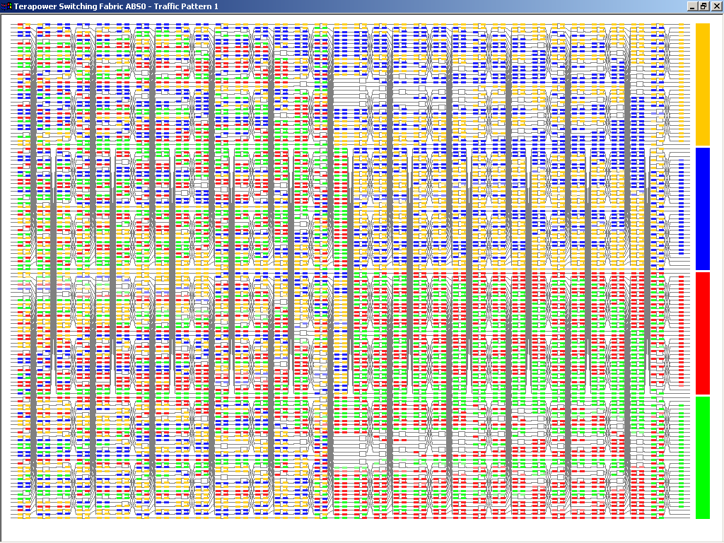
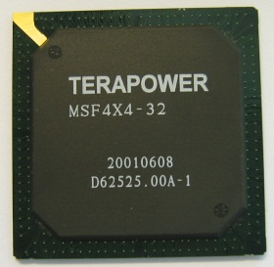
代数交换及引擎 Algebraic Switching & Fabric
Algebraic Fabric Chip Construction
网络编码创新科技研讨会 Workshop on Network Coding Innovative Technology 30 August, 2013

Slide 24
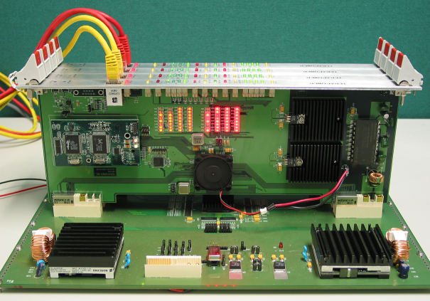
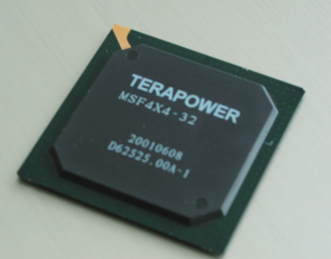
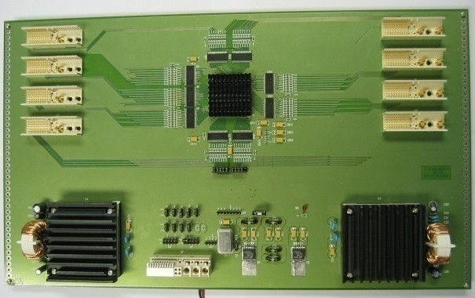
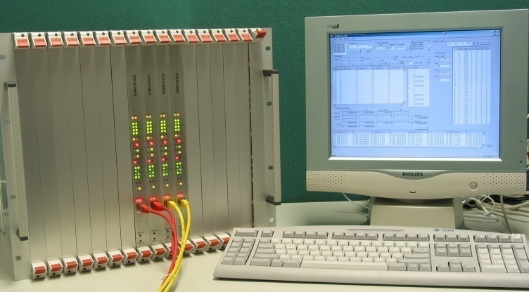
代数交换及引擎 Algebraic Switching & Fabric
1st Algebraic Fabric Chip & Prototype System
Prototype switching fabric chip Prototype system without chassis
Prototype switching fabric board Prototype system
网络编码创新科技研讨会 Workshop on Network Coding Innovative Technology 30 August, 2013

Slide 25
深圳网络编码关键技术及应用重点实验室
深圳网络编码关键技术及应用重点实验室由深圳市创新环境建设计划资金资助，于2012年正式成立，是网络编码研究所（深圳）建立的网络编码技术研发、成果转化、产业应用实验基地。
网络编码创新科技研讨会 Workshop on Network Coding Innovative Technology 30 August, 2013

Slide 26
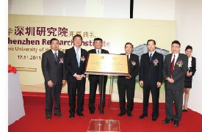
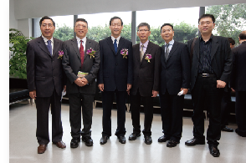
CU-Xidian SKL-ISN深圳研究中心
CU-Xidian SKL-ISN深圳研究中心是顶尖学术理论研究和一流关键技术开发的资源整合与优势互补，是突破网络技术挑战和引领新一代网络核心技术发展的强强联合。
网络编码创新科技研讨会 Workshop on Network Coding Innovative Technology 30 August, 2013

Slide 27
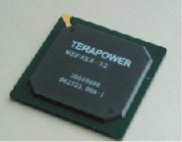
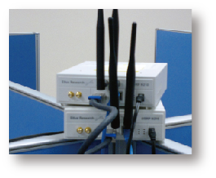
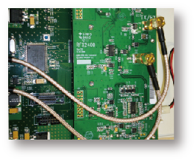
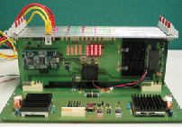
研究成果
处于国际领先地位，具有明显的持续创新能力和创新成果转化能力，其成果不仅可用作大型、高端、有线与无线网络关键技术，亦可支撑云计算及云存贮等核心技术。
网络编码创新科技研讨会 Workshop on Network Coding Innovative Technology 30 August, 2013

Slide 28
研究项目
2项国家973项目
“高移动性宽带无线通信网络重点理论基础研究” 2011-15
“可重构信息通信基础网络体系研究”, 2011-15
2项国家111 计划
李教授和杨教授分別担任学术大师和核心成员
3项 NSFC项目
2项深圳科研项目
孔雀计划之创新项目（pending）
网络编码创新科技研讨会 Workshop on Network Coding Innovative Technology 30 August, 2013

Slide 29
合作项目（即将开展）
云存贮技术产业合作
大数据交换关键技术
中德DLR-INC科技合作项目
高速安全自主无线网络综合通信网
2018年火星计划之在轨中继卫星通信关键技术
空间站绿色网络关键技术

Slide 30
Thanks 谢谢
网络编码创新科技研讨会 Workshop on Network Coding Innovative Technology 30 August, 2013

